Slide 1


Building Bridges
Integrative publishing solutions with Plone.
From storages to converters.
.
.
Andreas Jung @MacYET info@zopyx.com
Plone Conference 2015 Bucharest

Slide 2


/about
20 years in publishing business since 1995
Integrator Building generic and
unified solutions
Always interested in alternative high-quality components besides the mainstram

Slide 3


Agenda
•
Storages and services
Integration and federation of external storages and web services into Plone
•
Documents and formats
converters (A➝B)

Slide 4
Plone as Publishing Platform
•
Pros
Secure
Workflows
Extensible
Cons
self-contained universe (ZODB)
lack of decent integration with external data sources, cloud storages and cloud services besides relational databases
focused on HTML as content format (in addition to binary data and assets)
•

Slide 5
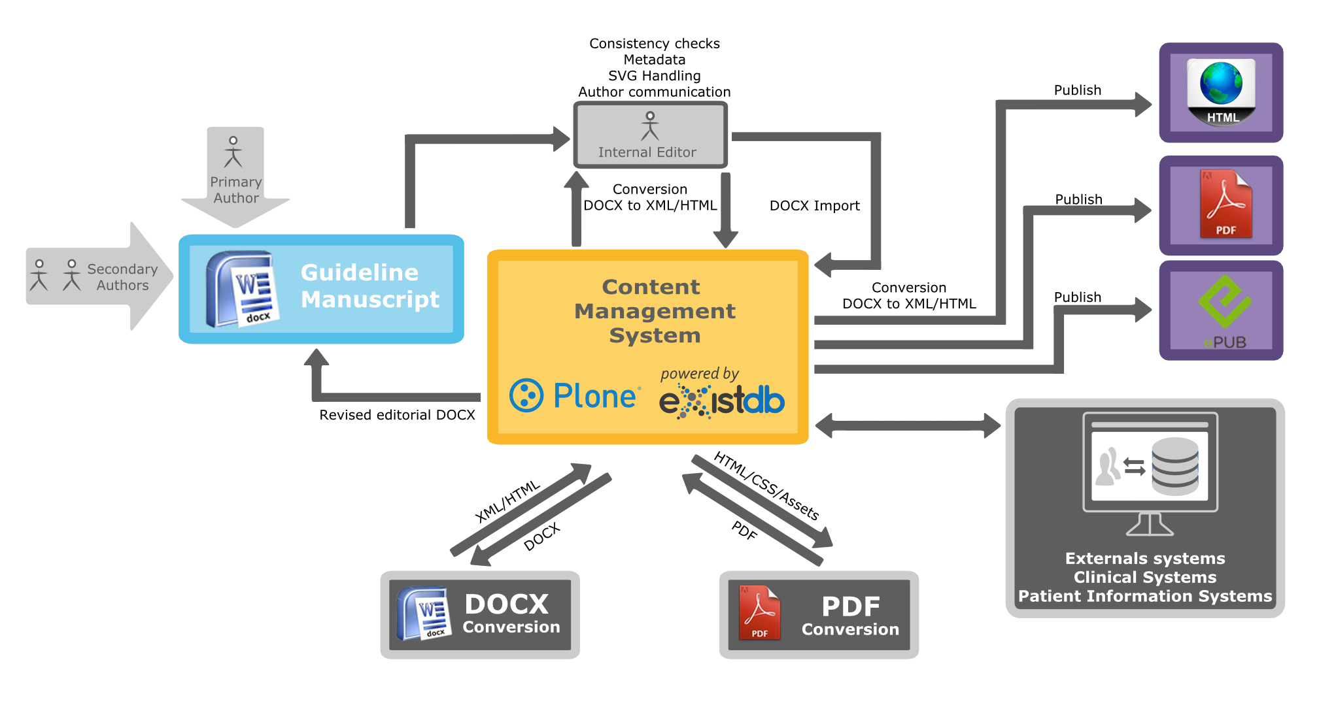
A typical publishing workflow

Slide 6


Our Publishing Universe

Slide 7






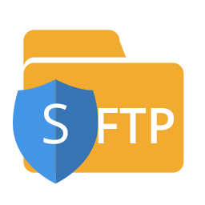

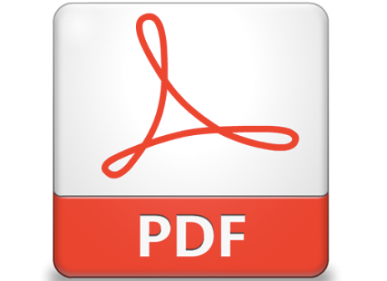

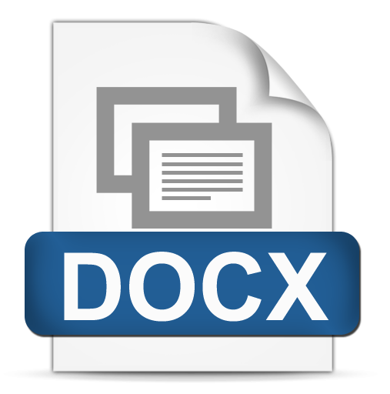




Our Publishing Universe

Slide 8


Slide 9

(Cloud) storages and web services

Slide 10
External/cloud storages in Plone
•
Current state:
Reflecto
RDBMS (SQLAlchemy)
Dexterity content only stored in ZODB (no dedicated storage layer)
Archetypes external storages poor integration story
•
•
different integration approaches, different APIs
•
most add-ons unmaintained

Slide 11


•
Plone 4.3/(5.0 compatible) add-on for the integration of other storage systems (other than ZODB) into Plone
•
Part of our XML publishing toolbox
•
Can be used without the "XML" stuff
•
Unified access and API to external storages and services
•
Available modes
Mounting
Dexterity support
100 tests, Plone 4.3/5.0 against 6 different storage backends
•

Slide 12

XML Director - Mounting
•
Plone "Connector" content-type
•
parameters: connection URL, username, password
•
acts as a mountpoint
•
URL traversal support
•
ZIP import/export, multi-file upload
•
basic UI for creating/renaming/deleting collections/ folders and resources
•
simple view registry
•
ACEditor integration for common formats
•
minimal, small and extensible
•
no indexing support
•
no proxy object magic as in Reflecto
•
intended for applications that need to access external data sources and storages

Slide 13



…
mammakarzinom-des-mannes
draft | source incoming.docx xml index.xml html index.html 1.jpg media 2.jpg … pdf index.pdf | Connector
current | source incoming.docx xml index.xml html index.html 1.jpg media 2.jpg … pdf index.pdf | Connector
archive | source xml html Version 25.03.2012 media |  | incoming.docx index.xml index.html 1.jpg 2.jpg … index.pdf
 | pdf Version 01.04.2013 Version 07.08.2014
de
my-onkopedia
mammakarzinom-der-frau
root
…
Connector
onkopedia-p
knowledge-database
http://host/de/my-onkopedia/mammakarzinom-der-frau/archive/version-25.03.2014/@@view/xml/index.xml
en
onkopedia
my-onkopedia

Slide 14
XML Director - Dexterity
•
three new Dexterity fields
XMLText (stores, validates XML) with ACEditor widget
XMLImage, XMLFile
XPath
content stored on the configured storage
xml_text = XMLText() xml_image = XMLImage()
obj.set_xml('xml_text', xml) obj.set_xml('xml_img', img_bin)
xml = obj.get_xml('xml_text') img_bin = obj.get_xml('xml_img')
•
•
flat storage hierarchy based on UID
•
dedicated set() and get() methods (due to lack of a DX storage API) as data managers
•
DX behaviors not applicable here
•
(we need a Dexterity storage API or some wrapper in plone.api)

Slide 15
pyfilesystem
abstraction layer on top of storages, access through a uniform API
Python 2/3 compatible
various filesystem/webservices drivers
Goal: your code must not know about the underlaying storage system. The backend is just aconfiguration option.
extensible (writing a new driver is straight forward
sandboxed filesystem operations
OOTB support for: WebDAV, S(FTP), RPCFS, OSFS, S3, ZIP, Memory,
MultiFS, WrapFS
handle = fs.opener(some_url)
with handle.open('foo', 'w') as fp: fp.write(data)
handle.listdir(dirname) handle.makedir('foo/bar/test') handle.removedir('foo/bar/test) handle.exists(some_filename) handle.isfile(some_name) handle.move(src, dst) handle.copy(src, dst)
….

Slide 16








































Architecture
Driver Driver Driver
Plone
xmldirector.plonecore
pyfilesystem
WebDAV
Otixo
SME
DropDav
native protocols
Your setup
SaaS setup
Dropbox GDrive
native protocols
WebDAV
(S)FTP
AWS S3
Yandex
OwnCloud Alfresco eXistDB BaseX
Local FS
Dropbox
Sharepoint
Evernote
OneDrive
Facebook
Flickr
many others

Slide 17
pyfilesystem driver options
Storage/ Web Service | self-hosted (Privacy) | via external SaaS Bridge (limited privacy?)
WebDAV (Owncloud, BaseX, eXist-DB, Alfresco, etc.) | YES | YES
Amazon S3 | YES | YES
Local filesystem | YES | NO
Dropbox | (YES, auth token issues) | YES
FTP/SFTP | (YES, V1.4) | YES
4Shared ADrive Alfresco Amazon Cloud Amazon S3 Box CloudMe Copy Cubby Digital Bucket DriveOnWeb Dropbox Dump Truck Evernote FTP Fabasoft Facebook FilesAnywhere Flickr GMX.DE Google Drive HiDrive Huddle LiveDrive Mediencenter MyDrive OneDrive Online FileFolder OwnCloud Picasa SugarSync TrendMicro SafeSync Web.de WebDAV Yandex | NO | YES

Slide 18
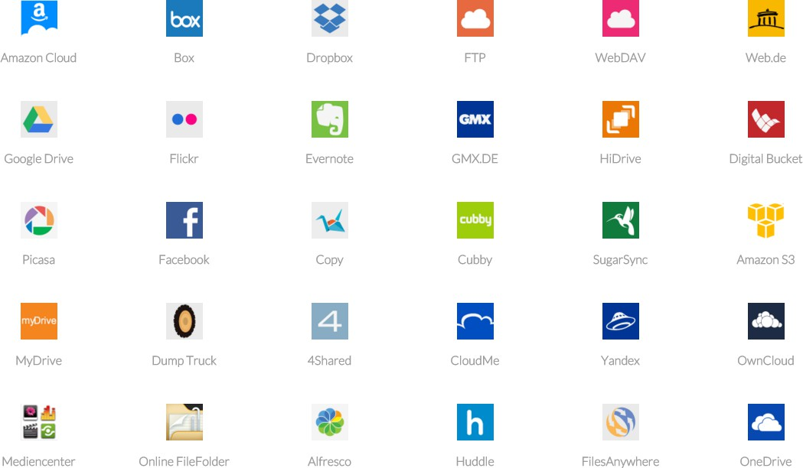
Supported services through 3rd party services (example)

Slide 19
https://pypi.python.org/pypi/xmldirector.plonecore/1.3.0b1

Slide 20


Slide 21

Document formats and conversion options

Slide 22









Structured data
Structured content
Professional Publishing
Document relations
Metadata

Slide 23

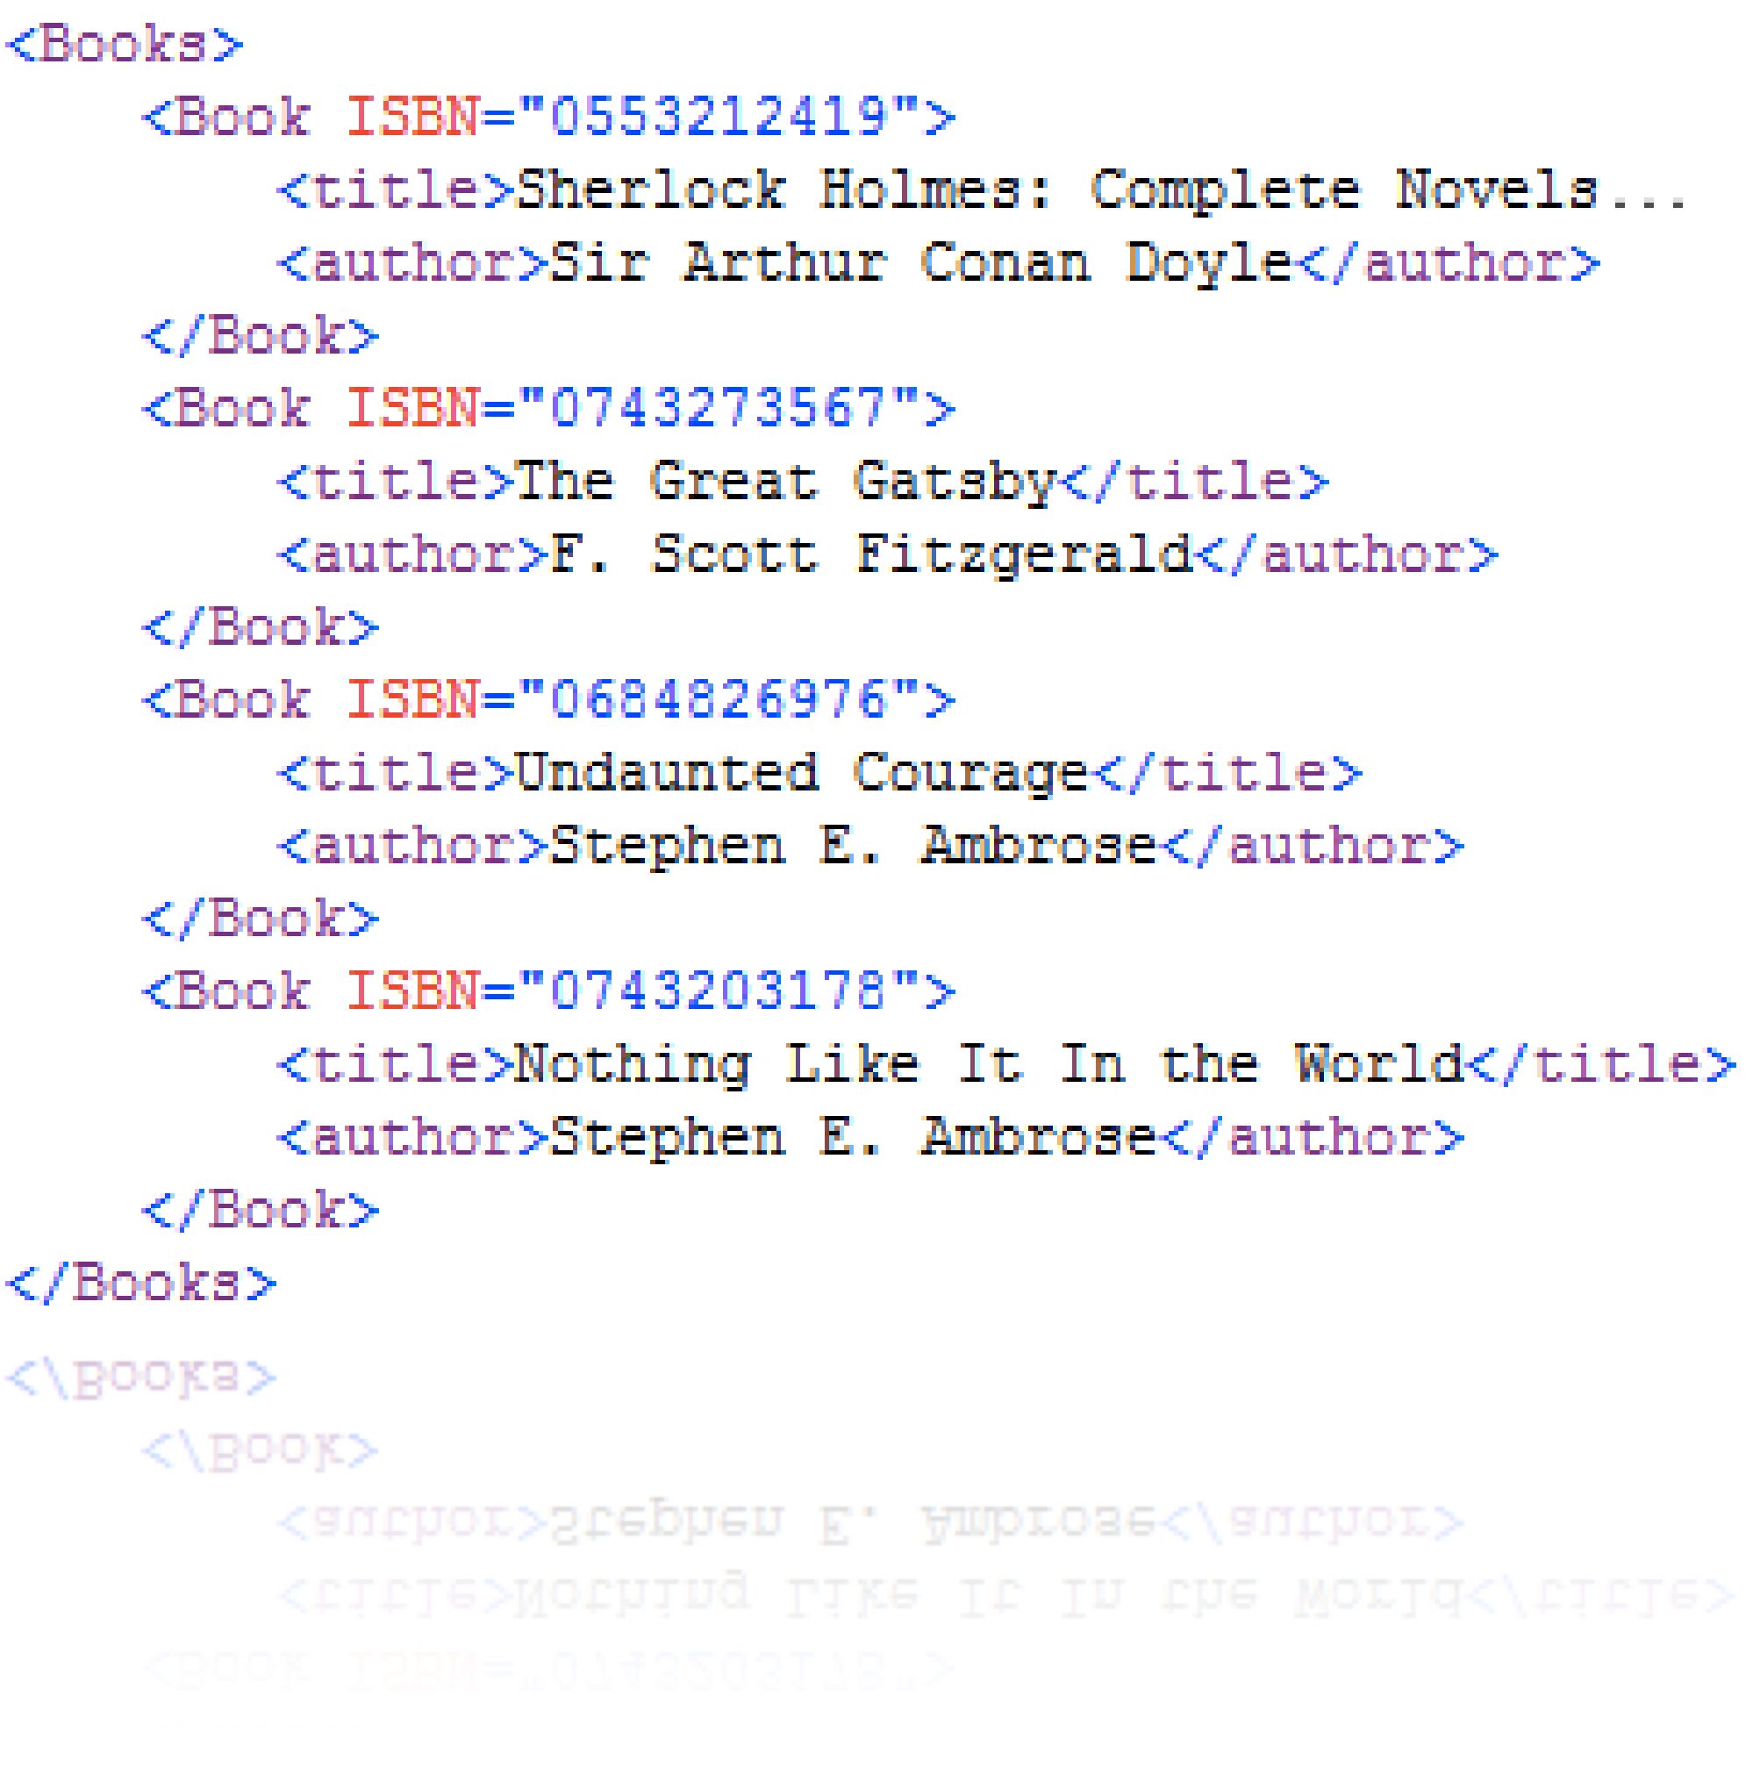
•
Industry standard in publishing
•
structured data
•
structured content
•
not many alternatives besides Indesign stuff…

Slide 24
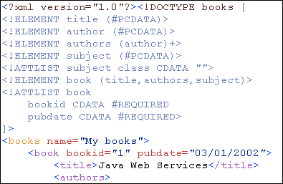
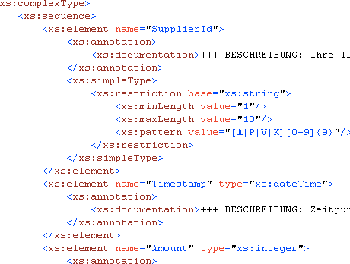
Advantages of XML
•
XML structure definition
•
Document Type Definition (DTD)
•
XML Schema (XSD)
•
RelaxNG
XML business rules
Schematron
•

Slide 25
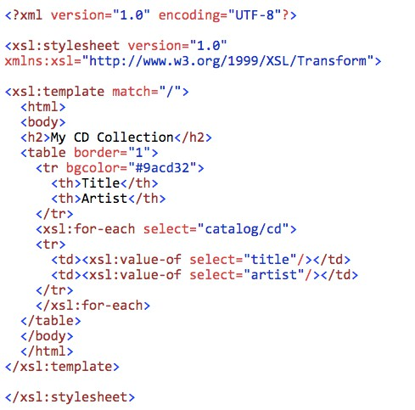
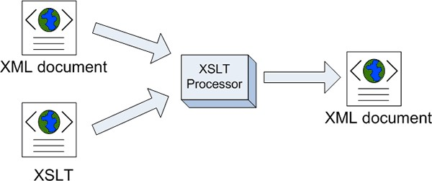
XML transformations
•
Transformations
•
XSLT (version 1-3)
•
rule based language
•
Transformation between XML dialects
•
or Python
•
or ……

Slide 26






















XML
transformation pipelines
XML 1
XSLT
XSLT
XSLT
XML 2
XML 1
Python
XSLT
Python
XML 2

Slide 27

Format: DOCX
DOCX is XML but the same crap as .DOC on a different level
all DOCX converters suck in their own special ways
dedicated Word templates require dedicated converters and special treatment
usually converted to some XML dialect (e.g. Docbook 4/5)
Tools
  past: LibreOffice/OpenOffice (HTML)
  currently: c-rex.net (dedicated XML schema)
  others: Transpect (Le-TeX)

Slide 28
Format: DITA
DITA = Darwin Information Typing Architecture
XML model for authoring
defacto industry standard for technical documentation
focus on content reuse
Information typing: Task, Concept, and Reference
key concepts: topics and maps
extensive metadata and specialization
Tools
  DITA toolkit for publishing (HTML, PDF, ODT, Docbook)
  XMLMind Ditac

Slide 29

Format: HTML5
•
HTML5 as primary source for quality publishing (vs. XML)? ……questionable
•
semantic elements <article>, <section>, <header>,
<figure>, <nav>…
•
freedom of structure (HTML5) vs. enforced structure and semantics (XML)
•
not really suitable for professional high-quality publishing (seen differently by others)
•
often used as intermediate format for CSS Paged Media with XML as primary format

Slide 30
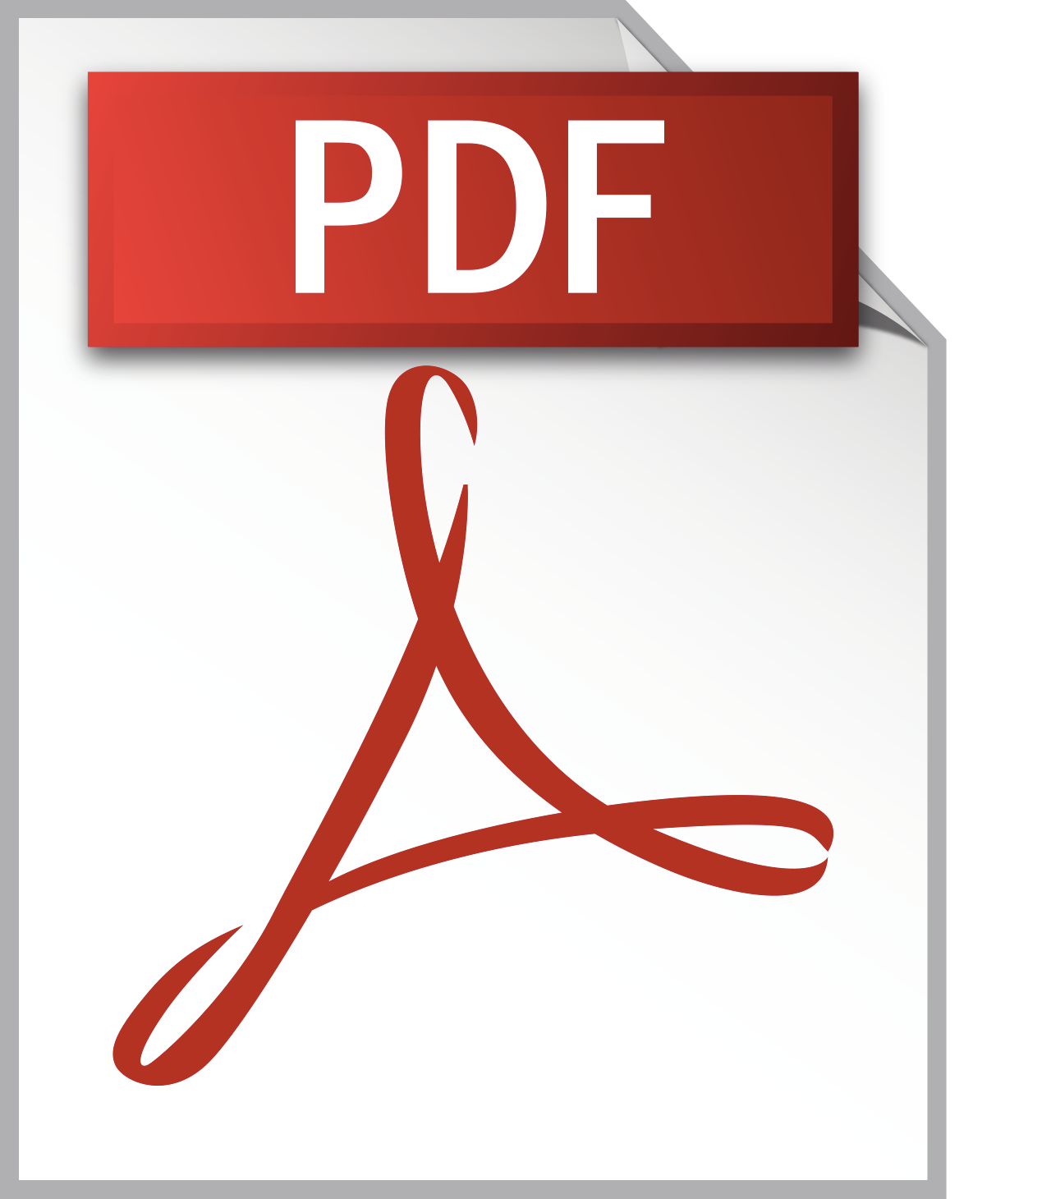


Format: PDF (1/2)
•
traditional: XML ➝ XSL-FO ➝ PDF
CSS Paged Media: HTML + CSS ➝ PDF
•
•
Tools (you get what you pay for, better quality=higher price)
WKHMLTOPDF (free), Weasyprint
PDFReactor (RealObjects)
PrinceXML (Prince)
PDFChip (Callas Software)
Antennahouse V6.2 CSS Formatter
Plone integration via Produce & Publish Plone Client Connector, collective.sendaspdf, abstract.wkhtmltopdf, eea.pdf
free
$$$$
•

Slide 31
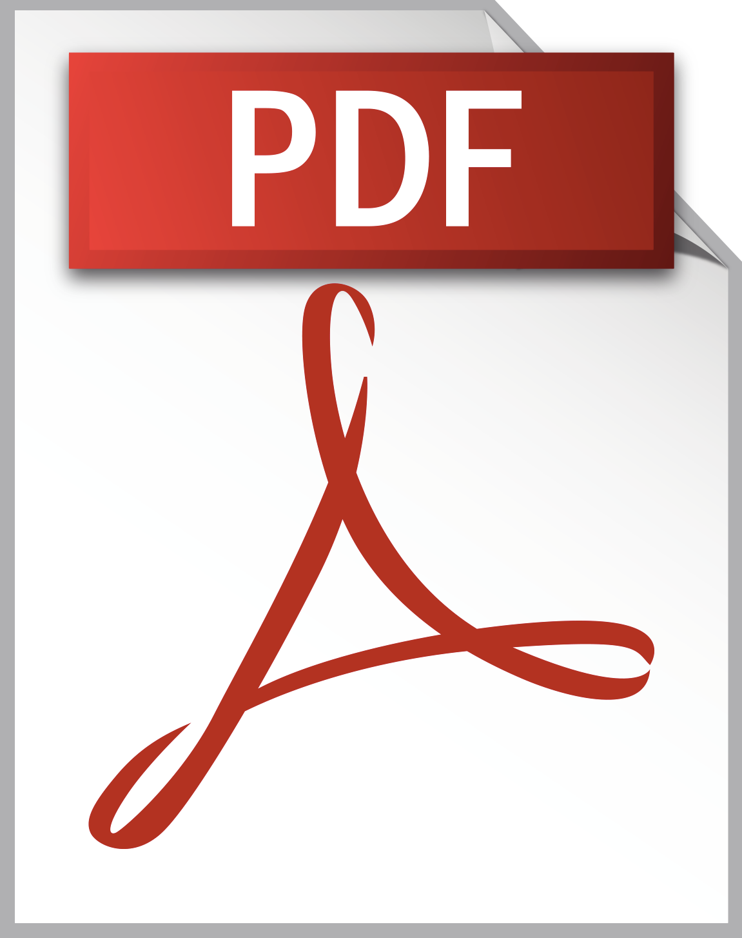
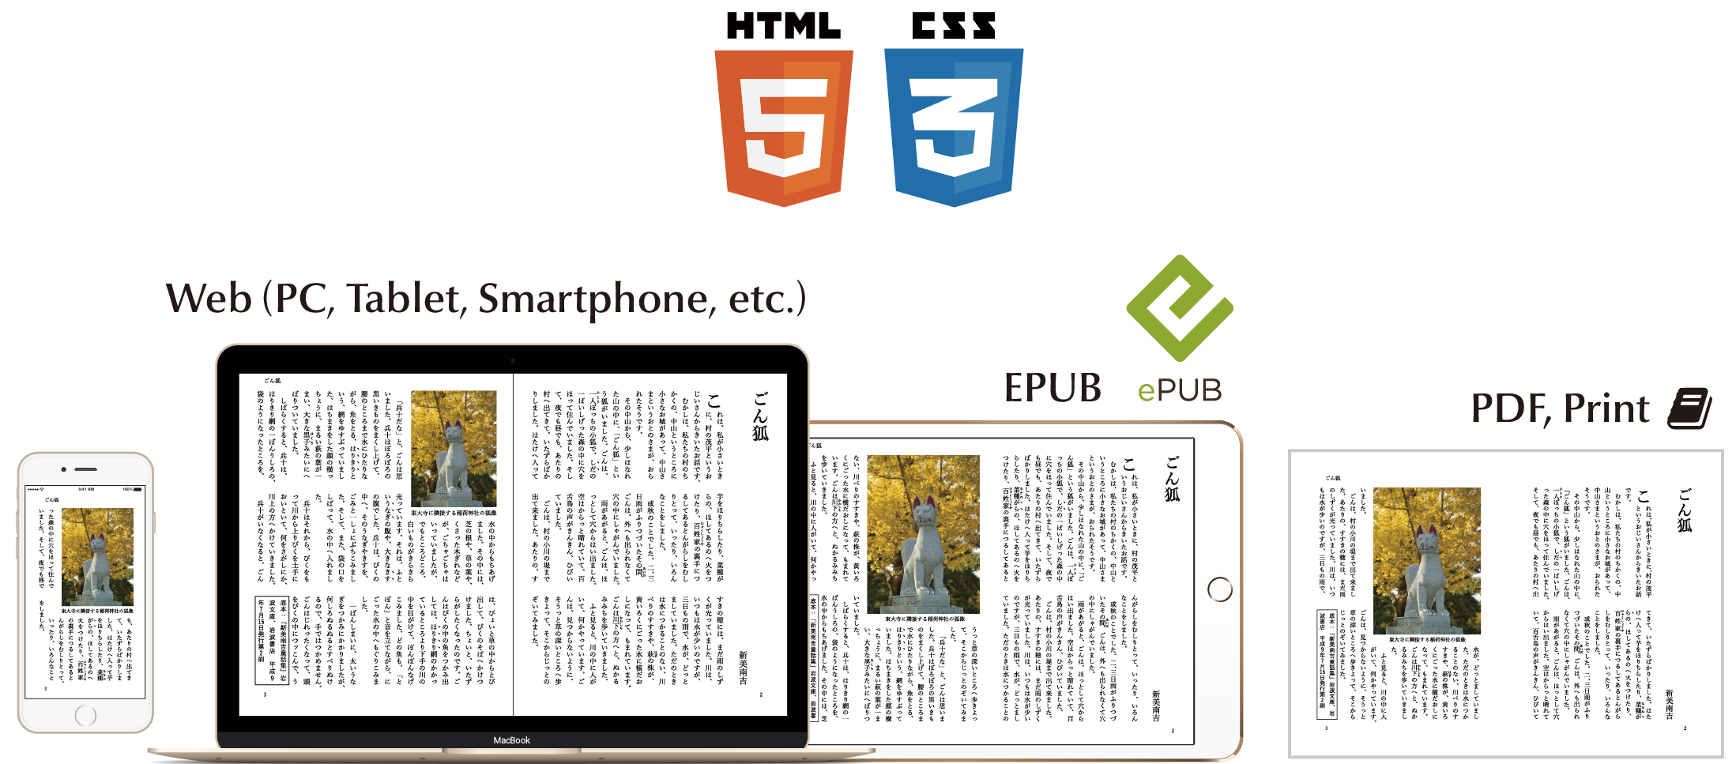
Format: PDF (2/2)
new project: Vivliostyle (open-source + commercial)
"One Source Multi-Use for making eBooks, Web, and Print books"
based on EPUB Adaptive Layout implementation http://www.idpf.org/epub/pgt/
fixes many limitations of the CSS Paged Media approach and EPUB limitations

Slide 32
Format: ODF
•
ODF is completely irrelevant in the publishing world (DOCX is (still) king)
•
Tools:
Pandoc
OpenOffice
LibreOffice

Slide 33
Format: TeX/LaTeX
•
Perfect for text-oriented layouts
•
unusable for complex layouts
•
Tools:
ftw.book
Pandoc
Transpect

Slide 34
Format: E-Books (1/2)
•
different ebook formats:
EPUB, EPUB3, Mobi, KF8, Apple's EPUB3
•
different hardware and software readers:
Kindle, iOS & Android devices, Kobo, Toliono, Sony, Nook
•
fixed format ebooks vs. reflowable ebooks vs. adaptive layouts
•
many limitations regarding typography, handling of images and tables
HUGE MESS

Slide 35
Format: E-Books (2/2)
•
Tools:
Calibre (Python)
eea.epub
Produce & Publish server (via Calibre)
web services like "Bookalope"

Slide 36
Plone as platform for publishing solutions

Slide 37


Questions?
www.xml-director.info demo.xml-director.info xmldirector.plonecore

