Slide 1

Collaborative Content Creation with plone and SMASHDOCS
Andreas Jung
info@zopyx.com, www.zopyx.com
www.creating-content-together.info

Slide 2
SMASHDOCS
Web-based collaborative editor
„Intelligent documents“
Easy integration with other web applications (REST API)
The „better“ version of Google Docs
Cloud-based or on-premise hosting (privacy)
Commercial

Slide 3
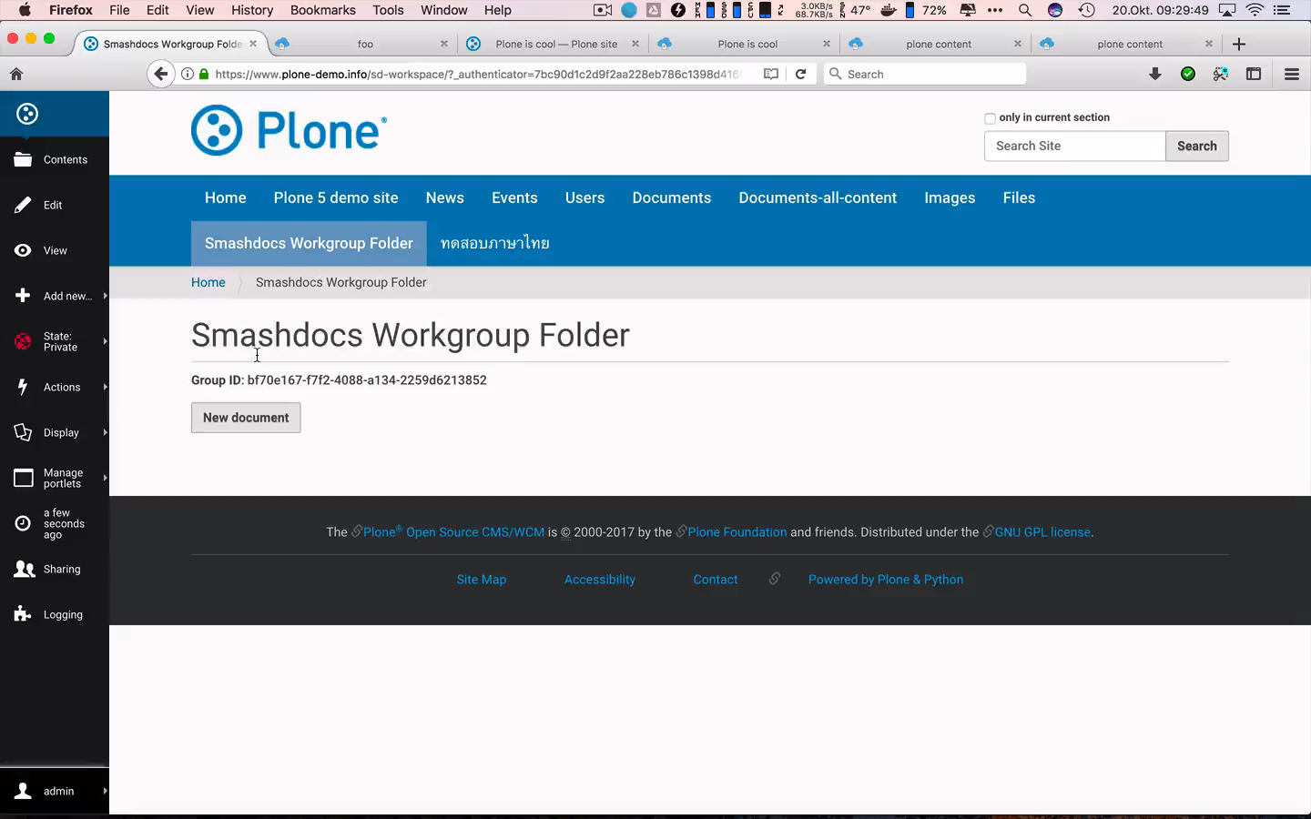

Slide 4
SMASHDOCS
Individual view on relevant content changes (keeps track who has seen what)
Concurrent editing
Tracking of changes
Chat and Diskussion about content changes (public or 1:N)
DOCX import/export
XML/HTML export
Roles: Editor | Commentator | Reader | Approver

Slide 5
SMASHDOCS
Individual view on relevant content changes (keeps track who has seen what)
Concurrent editing
Tracking of changes
Chat and Diskussion about content changes (public or 1:N)
DOCX import/export
XML/HTML export
Roles: Editor | Commentator | Reader | Approver

Slide 6
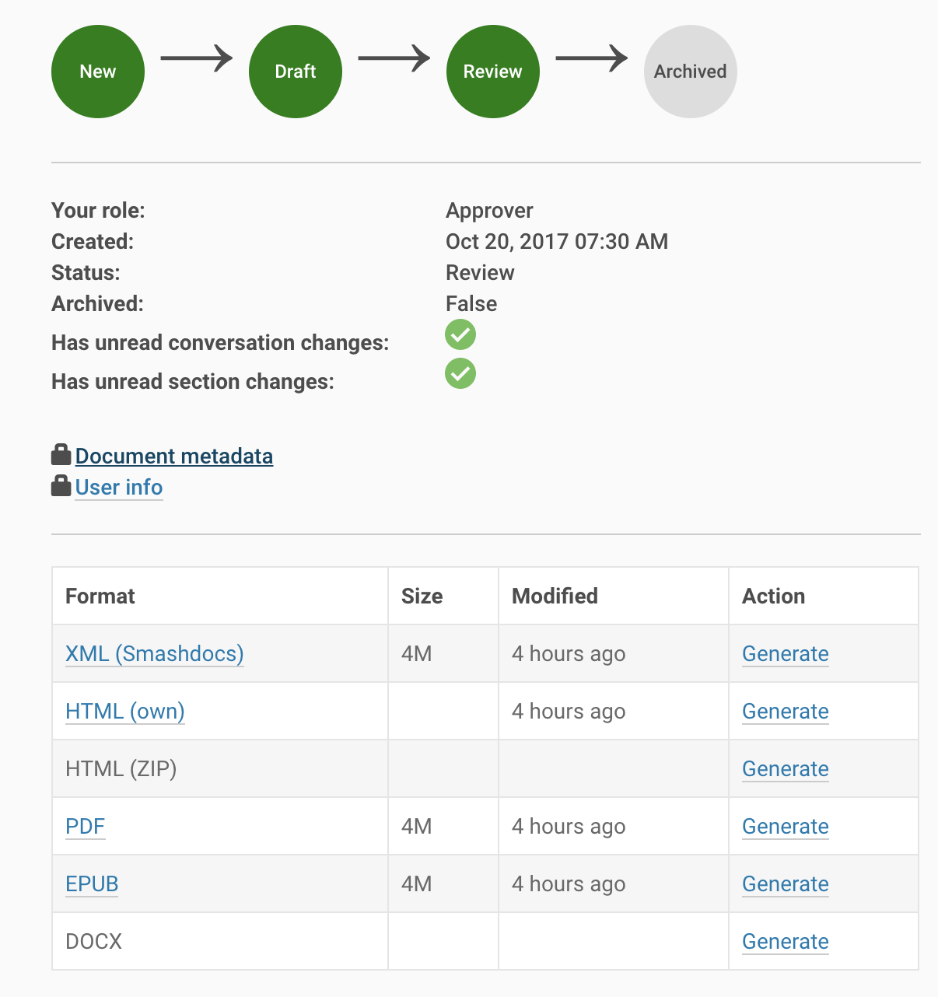
INTEGRATION WITH PLONE
Smashdocument and Smashfolder
@@sharing integration
Content lifecycle indicator
HTML view directly integrated with Plone
Optional PDF, EPUB, DOCX export (through Produce & Publish)

Slide 7


Integration in your own IT infrastructure
Your own application(s)
SMASHDOCs
Integration
Export
Partner API Wrapper
PHP, Python, NodeJS, C#
SMASHDOCs
Partner API
HTTP
CMS/Portal
DOCX
HTML
XML
Database

Slide 8
Links
www.creating-content-together.info
Test drive: www.plone-demo.info
zopyx.plone.smashdocs @ pypi
zopyx.smashdocs @ pypi
Andreas Jung,
info@zopyx.com
www.zopyx.com

