Slide 1


COLLABORATIVE CONTENT CREATION WITH PLONE AND SMASHDOCS
ANDREAS JUNG
INFO@ZOPYX.COM, WWW.ZOPYX.COM WWW.CREATING-CONTENT-TOGETHER.INFO

Slide 2
SMASHDOCS
Web-based collaborative editor
„Intelligent documents“ (personalized views on changes)
Easy integration with other web applications (REST API)
The „better“ version of Google Docs
Cloud-based or on-premise hosting (privacy)
Subscription-based

Slide 3



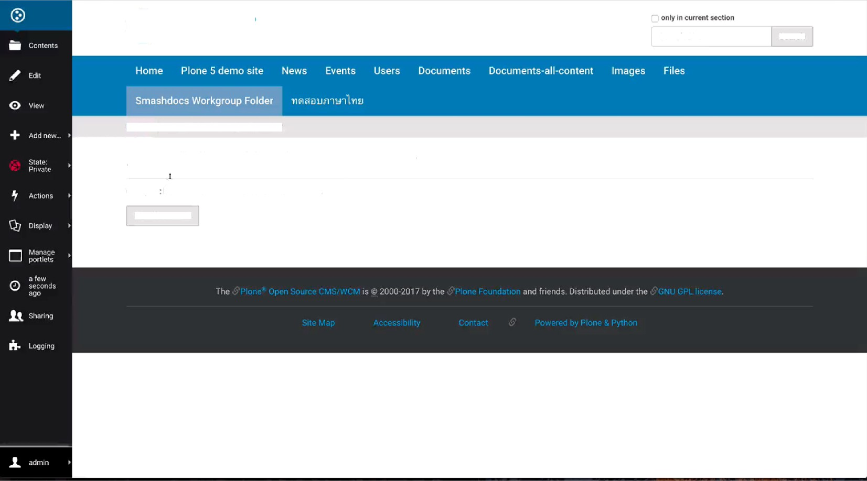

Firefox
File Edit View History Bookmarks Tools
Smashdocs Workgroup roi‹. loo
Window
Help
3.0K8,'s _{t 47°}
72% @
••• Ct @
20.Okt. 09:28:49
•
P'one is cooi — +°inne sii+
pione conte n'
plane cencer.:
Plone
Search Site
Sesrch
Home Smashdocs Workgroup Folder
Smashdocs Workgroup Folder
Group la bf7Oe167-f7f2-4O6B-a134-2259d6213852
Naw document

Slide 4
SMASHDOCS
Individual views on relevant content changes (keeps track who has seen what)
Simultaneous editing
Tracking of changes
Chat and Diskussion about content changes (public or 1:N)
DOCX import/export
XML/HTML export
Roles: Editor | Commentator | Reader | Approver

Slide 5

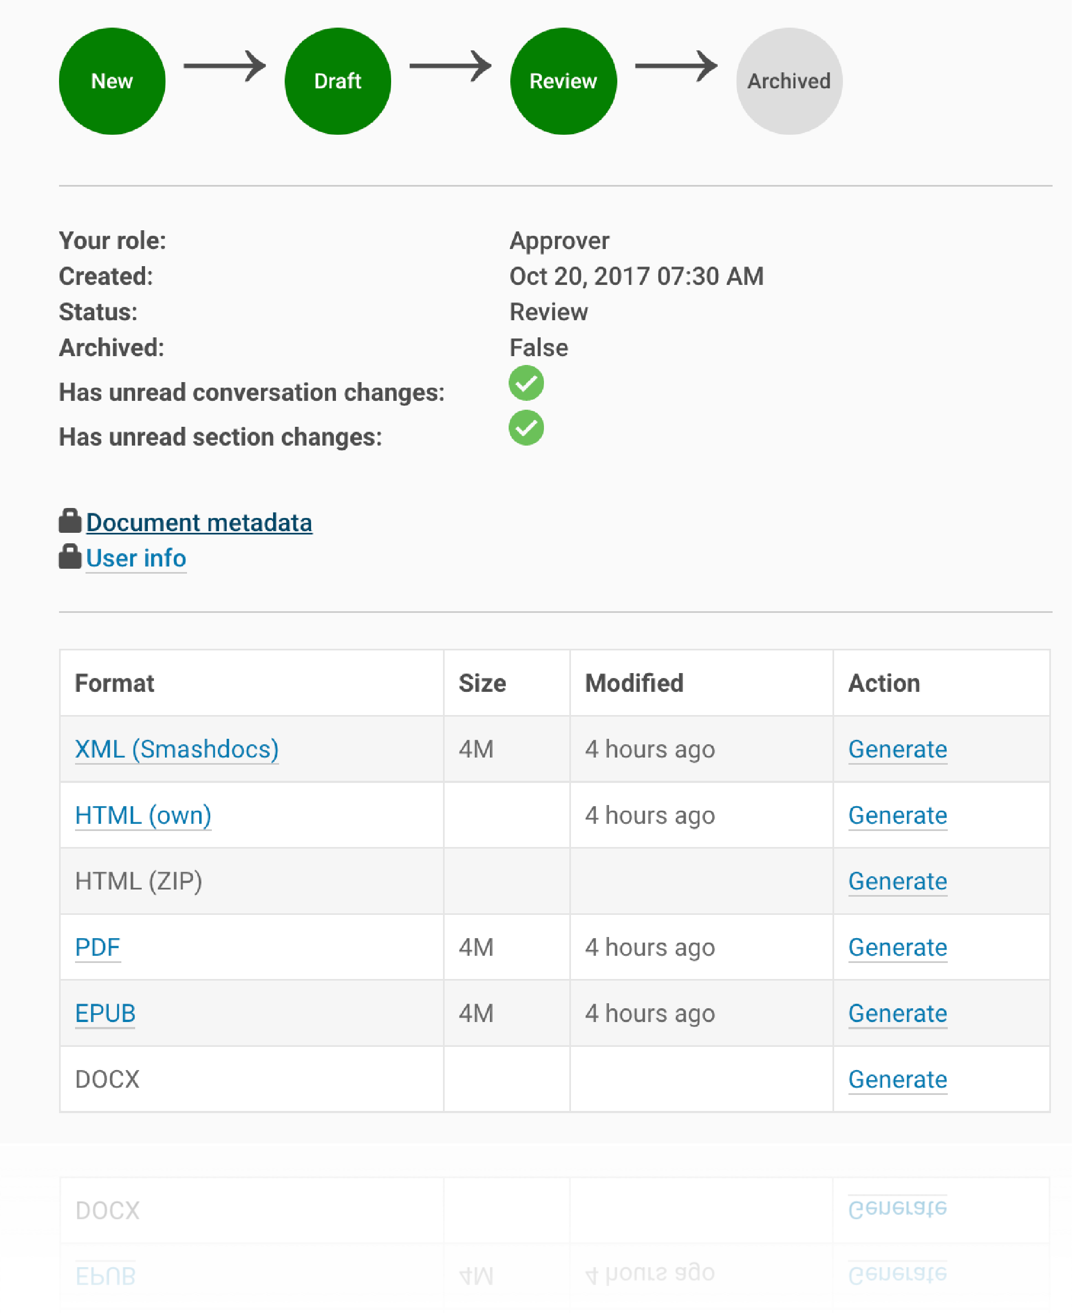
INTEGRATION WITH PLONE
SmashDocument and SmashFolder
@@sharing integration
Content lifecycle indicator
HTML view directly integrated with Plone
Optional PDF, EPUB, DOCX export (through Produce & Publish)

Slide 6




Integration in your own IT infrastructure
Your own application(s)
SMASHDOCs
Integration
Export
Partner API Wrapper PHP, Python, NodeJS, C#
SMASHDOCs
Partner API
HTTP
CMS/Portal
DOCX HTML XML
Database

Slide 7
SMASHDOCS INTEGRATIONS
SMASHDOCS API wrappers
  Python: https://pypi.python.org/pypi/zopyx.smashdocsPHP
  Javascript/NodeJS: https://github.com/zopyx/zopyx.nodejs.smashdocs
C#:
PHP:
CMS
  Plone (production)
  Drupal (Prototype)
https://github.com/zopyx/zopyx.csharp.smashdocs
https://github.com/zopyx/zopyx.php.smashdocs

Slide 8
LINKS
www.creating-content-together.info
Test drive: www.plone-demo.info (contact me)
zopyx.plone.smashdocs @ pypi
zopyx.smashdocs @ pypi
Andreas Jung info@zopyx.com www.zopyx.com

