Slide 1








Publishing with CSS Paged Media
A review of existing tools and techniques
Andreas Jung @MacYET ZOPYX • www.zopyx.com XML Prague 2015

Slide 2

Speaker
‣
20 years in electronic publishing
‣
Saarbrücker Zeitung, Haufe-Lexware
‣
Freelancer since 2004
Python, Zope, Plone development
content-management and large web apps
‣
‣
"Produce E Publish" publishing platform
using w/ CSS Paged Media in production since 2005 (csstoxslfo + FOP)
"XML is data, not a religion"
‣
‣
‣
www.produce-and-publish.com

Slide 3


Slide 4
The case against XSL-FO
‣
XSL-FO Working Group has disbanded
"We have closed the Working Group because not enough people were taking part."
Liam R. E. Quin (W3C XML Activity Lead) - November 2013
Too complicated, too verbose
Lack of experienced XSL-FO developers Publishers are on the move away from XSL-FO Vendors are on the move towards CSS support Customers are checking for alternatives
XSL-FO is going to die (slowly)
‣
‣
‣
‣
‣
‣
www.produce-and-publish.com

Slide 5

What is CSS Paged Media?
CSS Paged Media Module Level 3
W3C Working Draft 14 March 2013 (1st version in 2006)
‣
‣
Converter
www.produce-and-publish.com

Slide 6
Why HTML and not XML???
PDFreactor and PrinceXML work natively on HTML XML conversion supported through display property
‣
‣
mytable {
display: table;
}
mycell {
display: table-cell;
}
XML can be converted to HTML (easily, XSLT) Javascript processing works only on HTML DOM
‣
‣
www.produce-and-publish.com

Slide 7
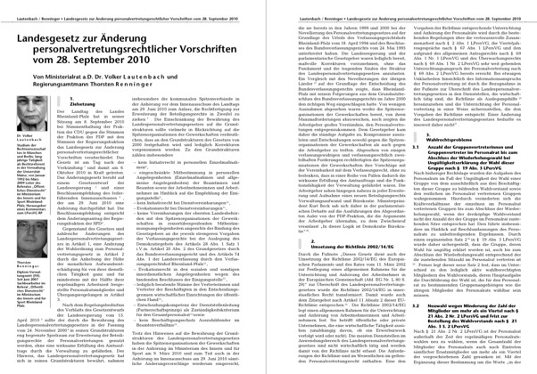
Supported publication types
Traditional automatic typesetting
one/multi-col layouts
images
footnotes
hyphenation
headers and footers
footnotes
cross-references
www.produce-and-publish.com

Slide 8



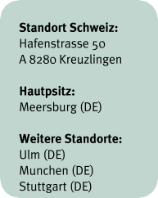
Supported publication types
Layout-oriented publications
absolute positioning of boxes
web-to-print applications
brochures
flyers
catalogs
·
www.produce-and-publish.com

Slide 9



Tools
‣
CSS Paged Media Tools with a XSL-FO history:
Antennahouse 6.2 with CSS Extensions cloudformatter.com (RenderX/XEP under the hood)
‣
‣
‣
Native CSS Paged Media Tools:
Pisa, Weasyprint (free, Python) WKHTMLTOPDF (free, open-source) PrinceXML (proprietary, 3800 USD) PDFreactor (proprietary, 2250 €)
‣
better
‣
‣
‣
www.produce-and-publish.com

Slide 10
@page rule
@page { size: a4;
margin: 1cm;
}
@page {
size: 20cm 10cm; margin: 1cm;
}
@page :left { margin-left: 2cm
}
@page :right { margin-right: 2cm
}
div.special {
page: special;
}
@page special { color: red
}
www.produce-and-publish.com

Slide 11
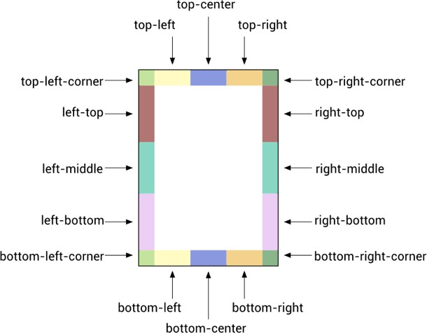
Page regions
@page :left { @bottom-left {
content: counter(page);
}
}
@page :right { @bottom-right {
content: counter(page);
}
}
(www.pdfreactor.com)
www.produce-and-publish.com

Slide 12
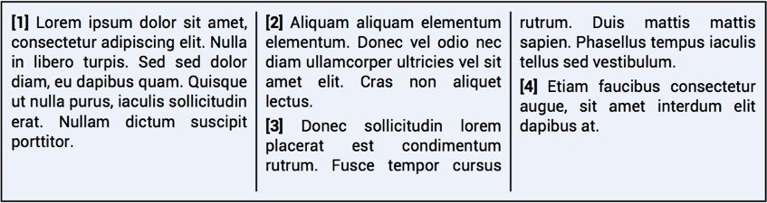
Multi column layouts
(src: PDFreactor documentation)
div {
column-count: 3; column-width: 5cm;
}
www.produce-and-publish.com

Slide 13
Images
Raster formats: PNG, GIF, JPG, TIFF, BMP Vector formats: SVG
Color spaces: RGB(A), CMYK (PDFreactor, AH) Positioning: relative or absolute
Size: CSS width and height properties CSS 3 transformations applicable
‣
‣
‣
‣
‣
‣
www.produce-and-publish.com

Slide 14

Images
www.produce-and-publish.com

Slide 15
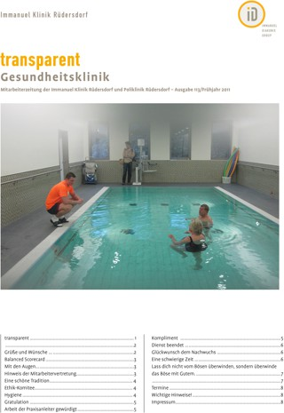
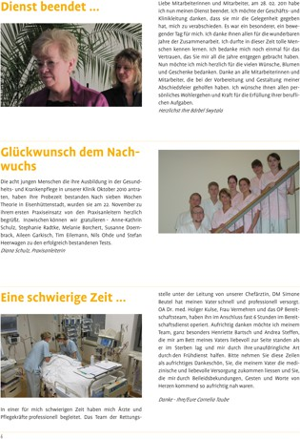
Images
www.produce-and-publish.com

Slide 16
Problems with images
Floating capabilities (PrinceXML has some options) Correct sizing and auto-placing of images
Auto-adjustment of image sizes using CSS
(min-width, max-width, min-height, max-height)
Some relief: rescaling the image through Javascript based on width/height of the outer container
‣
‣
‣
‣
www.produce-and-publish.com

Slide 17
Tables
Standard HTML table model with table head, body, foot Tables can span multiple pages
Table head repeating on successive pages Extra-wide tables:
‣
‣
‣
‣
table.wide {
page: widetable;
}
@page widetable { size: a4 landscape;
}
table.wide {
transform: rotate(90deg);
}
www.produce-and-publish.com

Slide 18
Tables
Bei relevanter Niereninsuffizienz muss eine individuelle Risikoabschätzung erfol- gen und ggf. eine Dosisreduktion des Bisphosphonates durchgeführt werden.
Aktuelle Daten der MRC-Studiengruppe, welche einen Überlebensvorteil für Pati- enten unter einer Bisphosphonattherapie mit Zoledronat bis zum Krankheitspro- gress zeigen, haben die Diskussion über die Dauer einer Bisphosphonattherapie verändert. So weichen einige Empfehlungen jetzt wieder von dem bisherigen Konsensus einer zweijährigen Bisphosphonatbehandlung ab und empfehlen eine langfristige Therapie mit Zoledronat bei Patienten, die keine CR erreichen.
Ein Nutzen für den Einsatz des Anti-RANKL Antikörpers Denosumab ist bei Patien- ten mit Multiplem Myelom nicht belegt.
Kriterien Status | M Protein Elektropho- rese | M Protein Immunfixa- tion | Freie Leichtket- ten (FLC-Quoti- ent¹) | Weichteil- Manifesta- tion | Plasmazellen im Knochenmark
 | kein M Protein in Serum und Urin nach- weisbar
PR⁵ | ≥ 50% Reduktion im Serum und ≥ 90% Reduktion im Urin oder < 200 mg/24h im Urin |  | > 50 % Reduk- tion des Quoti- enten, falls M- Protein nicht bestimmbar | > 50 % Reduktion (obligates Kriterium) | > 50 % Reduktion der Infiltration, falls Anteil vor Therapie > 30% und falls M- Protein und FLC Quotient nicht bestimmbar
SD⁶ | weder Kriterien von sCR, CR, VGPR, PR noch PD erfüllt
PD⁷ (mindestens ein Kriterium ist erfüllt, oder neue Symptome⁸) | ≥ 25% Anstieg im Serum und absolut ≥ 0,5 g/dl und/oder ≥ 25% Reduktion im Urin oder absolut ≥ 200 mg/24h |  | > 25 % Anstieg des Quotienten | Neuauftre- ten oder Progress | > 25 % Anstieg und absolut um > 10%
7. Verlaufskontrolle
2006 wurden durch die International Myeloma Working Group (IMWG) internatio- nal akzeptierte Kriterien vereinbart, um die Vergleichbarkeit von Studienergebnis- sen zu ermöglichen [54] . Wichtigste Änderung in Bezug auf die bis dahin im europäischen Raum benutzten Ansprechkriterien der EBMT ist die Implementie- rung der Bestimmung freier Leichtketten im Serum mittels FLC Assay, welche insbesondere die Verlaufskontrolle vieler oligo-sekretorischer und nicht-sekretori- scher Myelomformen ermöglicht. Weiterhin wurde die near complete response (nCR) in die very good partial response (VGPR) integriert und die stringent complete response (sCR) als vorerst höherwertige Remissionsqualität eingeführt.
FLC (Free Light Chain) – Quotient: Quotient aus beteiligter und nicht-beteiligter Leichtkette;
sCR (stringent Complete Remission) – stringente komplette Remission; ² CR (Complete Remis- sion) – komplette Remission; ⁴ VGPR (Very Good Partial Remission) – sehr gute partielle Remis- sion; ⁵ PR (Partial Remission) – partielle Remission; ⁶ SD (Stable Disease) – stabile Erkrankung;
⁷ PD (Progressive Disease) – progrediente Erkrankung; ⁸ weitere Kriterien sind: Neuauftreten oder Progress ossärer Manifestationen, MM-bedingte Hyperkalzämie;
Weitere Definitionen betreffen:
Refraktäres Myelom:
Kriterien Status | M Protein Elektropho- rese | M Protein Immunfixa- tion | Freie Leichtket- ten (FLC-Quoti- ent¹) | Weichteil- Manifesta- tion | Plasmazellen im Knochenmark
sCR² (alle Kriterien sind erfüllt) |  | nicht nach- weisbar in Serum und Urin | normalisiert | nicht nach- weisbar | ≤ 5 %; keine klonalen Plas- mazellen nachweis- bar (Immunhistoche- mie)
CR³ (alle Krite- rien sind erfüllt) |  | nicht nach- weisbar in Serum und Urin |  | nicht nach- weisbar | < 5 %
VGPR⁴ (alle Kriterien sind erfüllt) | ≥ 90% Reduktion im Serum und < 100 mg/ 24h im Urin oder | nachweis- bar
Fortschreiten der Erkrankung unter Therapie oder
innerhalb von 60 Tagen nach Therapie.
Minor response (MR) bei rezidivierten, refraktären Myelomerkrankungen
Reduktion des Serum M-Gradienten > 25%, aber < 49% UND
Reduktion des Urin M-Gradienten um 50-89% (>200mg/24h)
Größenreduktion von Weichteilmanifestationen um 24-49%
keine Zunahme in Anzahl und Größen von Osteolysen.
Übergang in ein aktives Myelom bei bestehendem Smouldering myeloma
Kriterien der PD nach IMWG oder
positive CRAB-Kriterien oder
Entwicklung extramedullärer Weichteilmanifestationen.
19
20
www.produce-and-publish.com

Slide 19
Tables
7.4 Anti-VEGF Therapie (Bevacizumab)
Erstautor / Jahr | Studie | Patienten | Kontrolle | Neue Therapie | _{N}1 | RR² | PFÜ⁴ (HR³) | ÜLZ⁵ | Anmerkung | DOI, PMID⁶
Miller, 2007 Gray, 2009 | E2100 | Erstlinie | Pac⁷ | Pac + Bev | 722 | 21,2⁶ vs 36,9 p < 0,001 | 5,9 vs 11,8 0,60¹⁰ p < 0,001 | n.s.⁹ |  | PMID: 18160686 DOI: 10.1200/ JCO.2008.21.6630
Miles, 2010 | AVADO | Erstlinie | Doc | Doc + Bev¹¹ | 488 | 46,4 vs 64,1 p = 0,0003 | 8,1 vs 10,0 0,67 p = 0,0002 | n.s. |  | DOI: 10.1200/ JCO.2008.21.6457
Valachis, 2010 |  | Erstlinie + spätere | Chemo | Chemo- + Bev | 3163 | 1,26 p < 0,00001 | 0,70 p < 0,0001 | n.s. | Metaanalyse | DOI:10.1007/ s10549-009-0727-0
60
www.produce-and-publish.com

Slide 20
Counters
<h1>title</h1>
<h2>subtitle</h1>
<h2>another subtitle</h2>
<h1>title 2</h1>
h1 {
counter-increment: c1; counter-reset: c2;
}
h2 {
counter-increment: c2;
}
h1:before {
content: counter(c1) "."
}
h2:before {
content: counter(c1) "."
counter(c2);
}
title
  subtitle
  another subtitle
2. title 2
www.produce-and-publish.com

Slide 21


Footnotes
<p>
Footnotes <span class="fn">A footnote is a note placed at
the bottom of a page of a book or manuscript that comments on or cites a reference for a designated part of the text.</span>
…
</p>
.fn {
float: footnote
}
www.produce-and-publish.com

Slide 22
Footnotes
Footnotes¹ are essential in printed documents and Prince knows how to generate them. Most readers will read the footnotes before they read the text from where the footnotes are anchored².
¹ A footnote is a note placed at the bottom of a page of a book or manuscript that comments on or cites a reference for a designated part of the text.
² Often, the most interesting information is found in the footnotes.
Limitation: no footnotes in multi-column layouts (Antennahouse?)
www.produce-and-publish.com

Slide 23

Cross references
<a class="pageref" href="#figure">see the figure</a>
a.pageref::after | {
content: " on | page | " | target-counter(attr(href), | page);
}
"…see the figure on page 22"
<div name="figure">This is a figure</div>
<a class="pageref" href="#figure">see the figure</a>
a.pageref: | {
content: | "See | '" | target-content(attr(href)) | "'";
}
"See 'this is a figure' "
www.produce-and-publish.com

Slide 24
Pagination E Page breaks
<h1>title</h1>
<div class=„sub“>…</p>
<div class=„content“>…</div>
h1 { page-break-before: always;} div.sub { page-break-after: always; }
<ul>
…
</ul>
ul {
page-break-inside: avoid;
}
<h1>title</h1>
<p>…</p>
h1 {
page-break-before: always;
}
www.produce-and-publish.com

Slide 25
Hyphenation, Orphans, Widows
<body lang=„de“>
<div lang=„en“> EN Text
</div>
<p>DE text</ep>
</body>
body {
hyphens: auto;
hyphenate-before: 4;
hyphenate-after: 4;
}
<p>
….long paragraph…
</p>
p {
orphans: 4;
widows: 3;
}
www.produce-and-publish.com

Slide 26
The Power of Javascript
‣
HTML represented internally as DOM (Document Object Model)
Javascript code interacts with the DOM as with browsers Use cases:
‣
‣
modification of content (table of content generation) index generation
adaptive image scaling
‣
‣
‣
‣
PrinceXML/PDFreactor support standard Javascript modules like jQuery
possibly a lot of potential (documentation problem)
‣
www.produce-and-publish.com

Slide 27
CSS Page Floats
‣
Float = content that can be moved ouf of the current text flow into a different place
Different implementations
AH: http://www.antennahouse.com/CSSInfo/float- extension.html
PrinceXML: http://www.princexml.com/doc/properties/float/
W3C: http://dev.w3.org/csswg/css-page-floats/
‣
‣
‣
‣
www.produce-and-publish.com

Slide 28
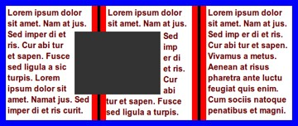
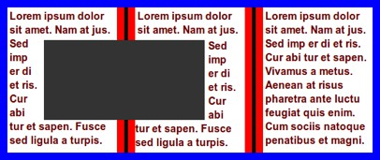
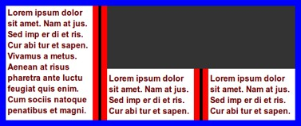
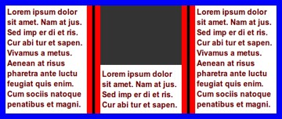
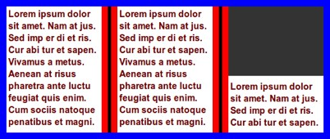
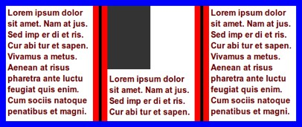
CSS Page Floats (W3C Draft)
www.produce-and-publish.com

Slide 29
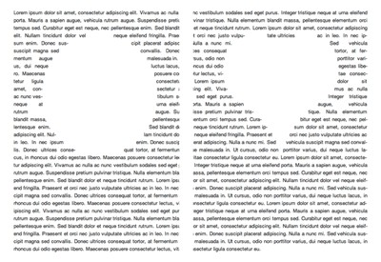
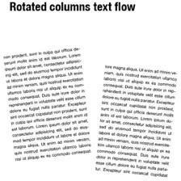
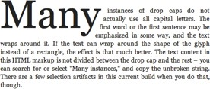
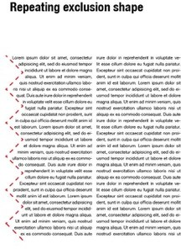
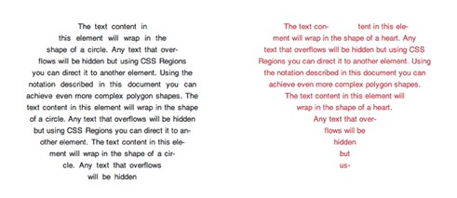
CSS Page Floats (W3C Draft)
www.produce-and-publish.com

Slide 30

Summary of tools
 | PrinceXML 9 | PDFreactor 7 | AH 6.2/CSS Extensions
Price | 3800 USD | 2250 € | 7000 USD+
Licence | proprietary (4 CPU) | proprietary (4 CPU) | proprietary (1 CPU)
Documentation | poor/inconsistent/ incomplete | good | average/incomplete
Support | good | good | limited/no experience
Javascript | yes/limited | yes/good support | no
Tagged PDF | no | yes | yes
PDF Metadata | yes | yes | yes
Signed PDF | no | yes | yes
Encrypted PDF | yes | yes | yes
www.produce-and-publish.com

Slide 31
Limitations of CSS Paged Media
Automatic typesetting means automatic
Limited influence on the typesetting process Manual interaction through specific CSS hints/rules
(sometimes time consuming) iterative interactive process (except using PDFreactor/Nimbudocs Editor)
Typical usecases
‣
‣
‣
‣
‣
‣
‣
‣
‣
Technical documentation, manuals Catalogs
Brochures
(Mass) Publications with similar layouts
www.produce-and-publish.com

Slide 32
Questions?
www.andreas-jung.com www.zopyx.com
www.produce-and-publish.com www.xml-director.info
‣
‣
‣
‣

