Slide 1
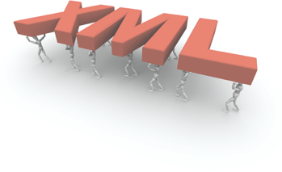



Structured Content Rocks!
Integration of eXist-db with Plone
Andreas Jung/@MacYET ZOPYX • www.zopyx.com
Plone Conference 2014 • Bristol, UK

Slide 2


Slide 3


Python, Plone, Zope nerd Publishing wizard
Dinosaur of Zope (Paul Everitt)

Slide 4



Slide 5

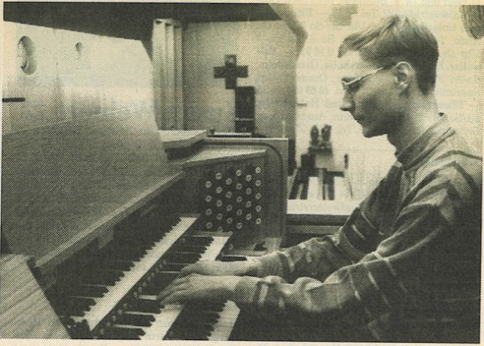

Slide 6


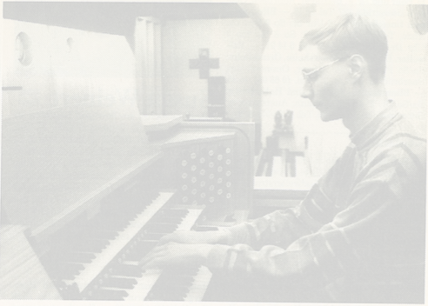

Slide 7



Slide 8
Agenda

Slide 9
Agenda
XML-based publication workflows context:
‣
‣
DOCX ➝ XML conversion XML➝ PDF/EPub conversion
‣
‣
‣
Integration of Plone with XML database eXist-db
www.produce-and-publish.com
Professional XML Publishing
(C) 2014 ZOPYX

Slide 10
What is Structured Content?
XML of course
HTML is not suitable for publishing purposes in general XML Schemas or Document Type Definition for
‣
‣
‣
defining the exact structure of a document syntactical and semantical validation industry standard in the publishing world
defacto exchange format with third-party applications
‣
‣
‣
‣
www.produce-and-publish.com
Professional XML Publishing
(C) 2014 ZOPYX

Slide 11

What is ?
A NoSQL Document Database and Application platform
Open-source XML database written in Java stores documents: XML/HTML
stores arbitrary (binary) data (DOCX, PDF, images, …)
XML technology: XPath 3, XForms, XSLT 2, XQuery 3, XUpdate comes with Lucence for fulltext indexing
open for all related Java XML technology
‣
‣
‣
‣
‣
‣
‣
www.produce-and-publish.com
Professional XML Publishing
(C) 2014 ZOPYX

Slide 12
Why ?
Hierarchical storage model (collections -> folders) Content and scripts accessible through WebDAV Scripting using XQuery
XQuery scripts callable through REST API Scripts results serializable to JSON, HTML, XML Very good experience during evaluation period
‣
‣
‣
‣
‣
‣
www.produce-and-publish.com
Professional XML Publishing
(C) 2014 ZOPYX

Slide 13
How do we use
?
storing XML documents indexing XML documents searching XML documents aggregation of XML documents manipulation of XML documents
‣
‣
‣
‣
‣
www.produce-and-publish.com
Professional XML Publishing
(C) 2014 ZOPYX

Slide 14
Onkopedia project?
‣
www.dgho-onkopedia.de www.onkopedia-guidelines.info
Plone project since 2010
Portal for medical guidelines for diagnosis and treatment of hematology and oncology diseases
DOCX ➝ HTML ➝ PDF (Produce E Publish)
Owned by Deutsche Gesellschaft für Hämatologie und Medizinische Onkologie in cooperation with further medical societies (AT, CH)
‣
‣
‣
‣
www.produce-and-publish.com
Professional XML Publishing
(C) 2014 ZOPYX

Slide 15
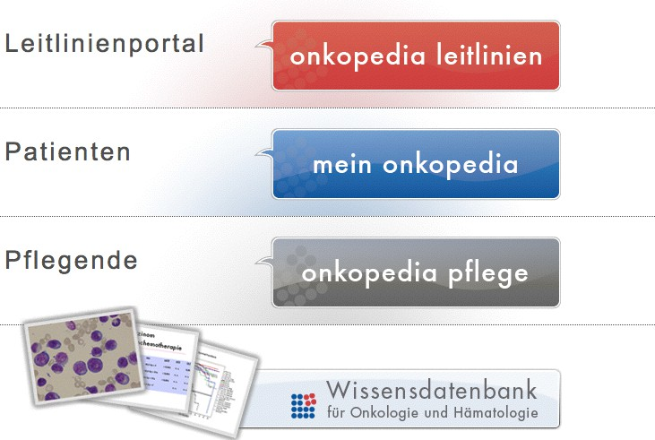

Slide 16
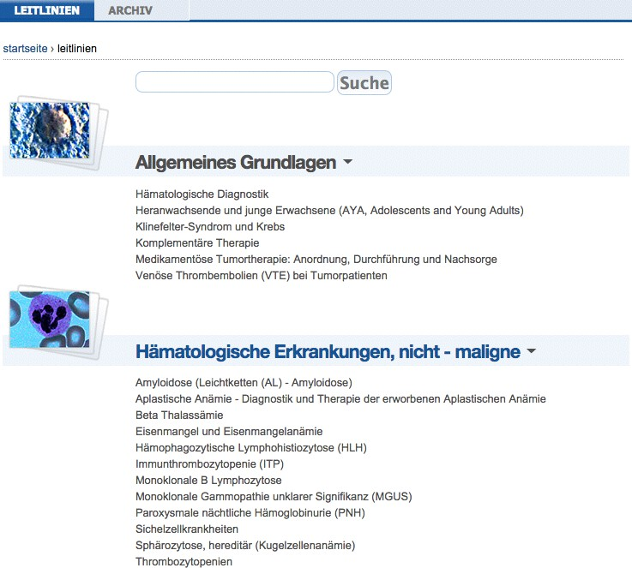

Slide 17
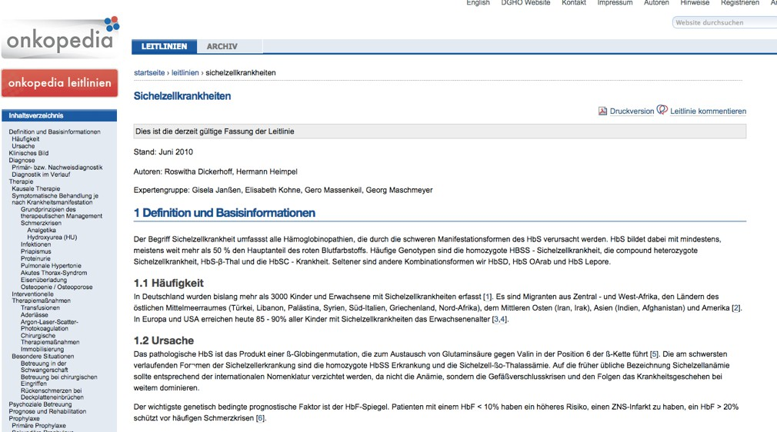

Slide 18
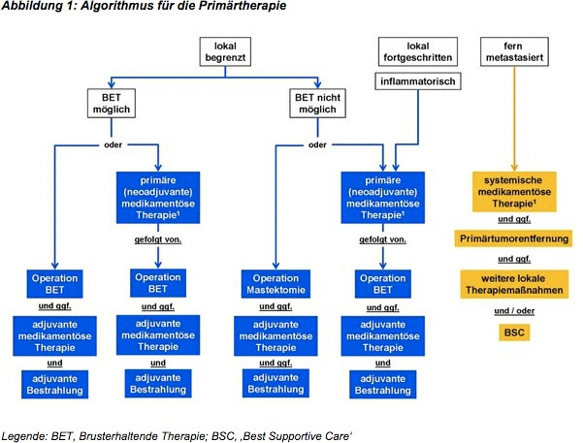

Slide 19
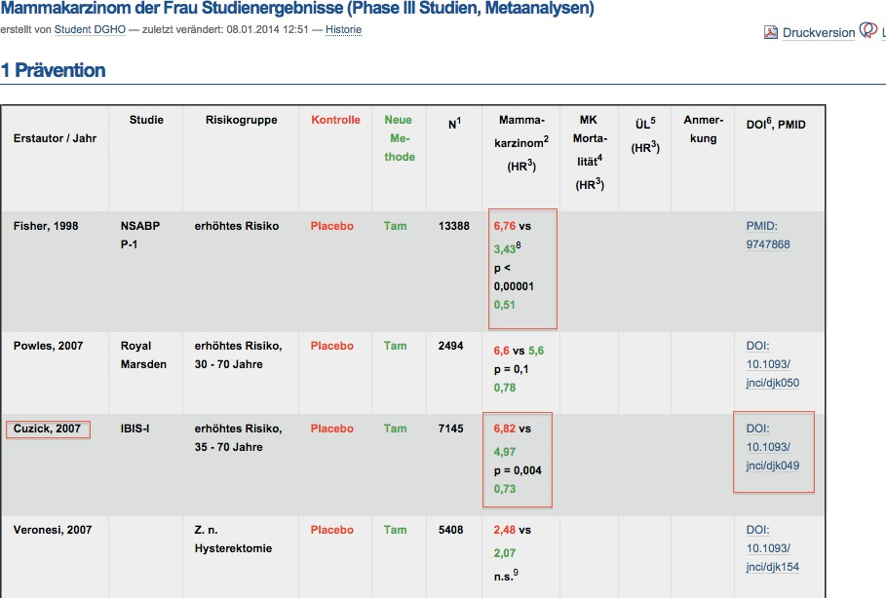

Slide 20



Slide 21
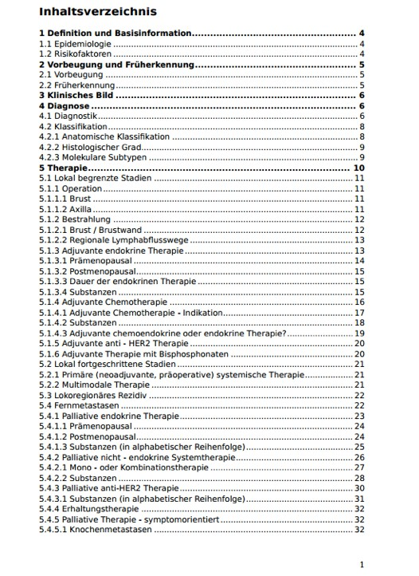



Slide 22
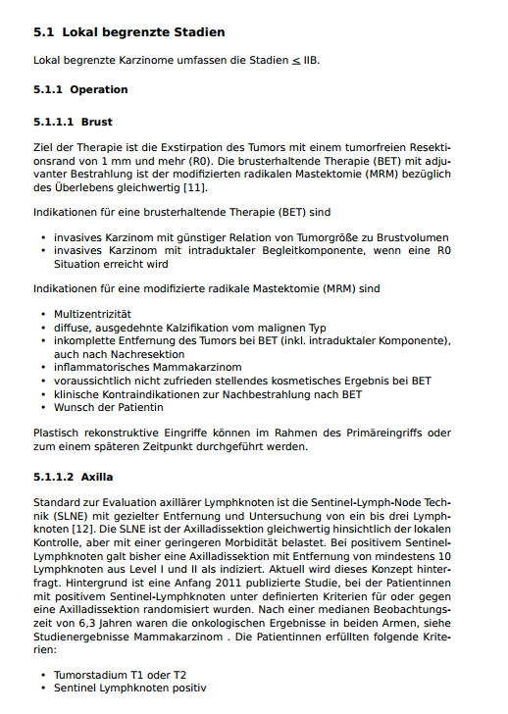
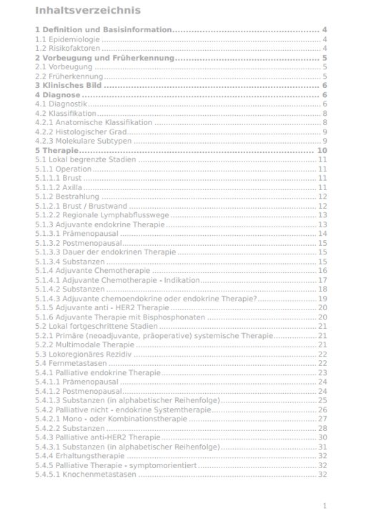


Slide 23
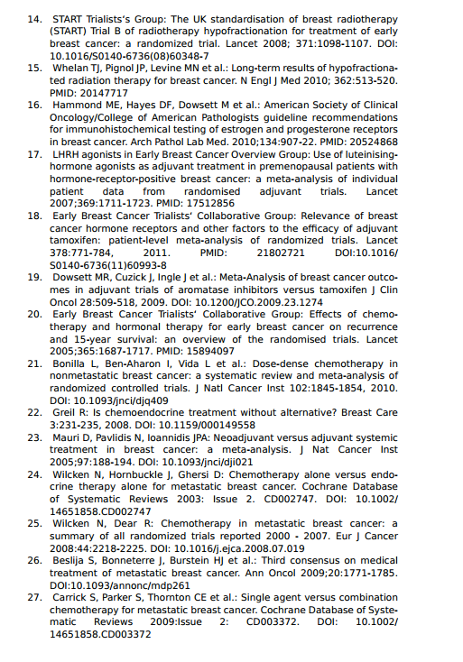



Slide 24

















Current editorial workflow
Word -> XHTML
(OpenOffice, webservice)
Editorial fine-tuning for images, imagemaps, linking
Conversion to EPUB and PDF
Publishing
www.produce-and-publish.com
Professional XML Publishing
(C) 2014 ZOPYX

Slide 25
Reasons for switching to XML
HTML not suitable for further requirements implementation too tight coupled to Plone
a lot of fragile and workaround code for Plone need for better production-safety
need for better automated production
interfaces and APIs for external systems requested by other vendors
‣
‣
‣
‣
‣
‣
www.produce-and-publish.com
Professional XML Publishing
(C) 2014 ZOPYX

Slide 26
Content structure inside eXist-db

Slide 27
mammakarzinom-der-frau
onkopedia
…
mammakarzinom-des-mannes
source
incoming.docx
xml
index.xml
html
index.html
draft
1.jpg
media
2.jpg
…
pdf
index.pdf
source incoming.docx
xml index.xml
html index.html 1.jpg
media 2.jpg
…
pdf index.pdf
current
de
my-onkopedia
mammakarzinom-der-frau
root
source incoming.docx
xml index.xml
html index.html
Version 25.03.2012 1.jpg
media 2.jpg
…
pdf index.pdf
archive
Version 01.04.2013
Version 07.08.2014
…
onkopedia-p
knowledge-database onkopedia
en
my-onkopedia

Slide 28
mammakarzinom-der-frau
…
mammakarzinom-des-mannes
source
incoming.docx
xml
index.xml
html
index.html
draft
1.jpg
media
2.jpg
…
pdf
index.pdf
source incoming.docx
xml index.xml
html index.html 1.jpg
media 2.jpg
…
pdf index.pdf
source incoming.docx
xml index.xml
html index.html
Version 25.03.2012 1.jpg
media 2.jpg
current
pedia
mammakarzinom-der-frau
archive
…
pdf index.pdf

Slide 29
mammakarzinom-der-frau
…
mammakarzinom-des-mannes
source
incoming.docx
xml
index.xml
html
index.html
draft
1.jpg
media
2.jpg
…
pdf index.pdf
source incoming.docx
xml index.xml
html index.htm
Publish
l
current
1.jpg
pedia
mammakarzinom-der-frau
media
2.jpg
…
pdf
index.pdf
source incoming.docx
xml index.xml
html index.html
Version 25.03.2012 1.jpg
media 2.jpg
…
pdf index.pdf
archive

Slide 30
html
index.html
draft
1.jpg
media
2.jpg
…
pdf
index.pdf
source
incoming.docx
xml
index.xml
html
index.html
current
1.jpg
mmakarzinom-der-frau
media
2.jpg
…
Archive
pdf index.pdf
source
incoming.docx
xml
index.xml
html
index.html
Version 25.03.2012
1.jpg
archive
media
2.jpg
…
pdf
index.pdf
Version 01.04.2013
Version 07.08.2014

Slide 31
mammakarzinom-der-frau
onkopedia
…
mammakarzinom-des-mannes
source
incoming.docx
xml
index.xml
html
index.html
draft
1.jpg
media
2.jpg
…
pdf
index.pdf
source
incoming.docx
xml
index.xml
html
index.html
current
1.jpg
de
my-onkopedia
mammakarzinom-der-frau
media
2.jpg
root
…
pdf
index.pdf
source
incoming.docx
xml
index.xml
html
index.html
Version 25.03.2012
1.jpg
archive
media
2.jpg
…
pdf
index.pdf
Version 01.04.2013
Version 07.08.2014
…
onkopedia-p
knowledge-database onkopedia
en
my-onkopedia

Slide 32
How to map this into Plone?

Slide 33
mammakarzinom-der-frau
onkopedia
…
mammakarzinom-des-mannes
source
incoming.docx
xml
index.xml
html
index.html
draft
1.jpg
media
2.jpg
…
pdf
index.pdf
source
incoming.docx
xml
index.xml
html
index.html
current
1.jpg
de
my-onkopedia
mammakarzinom-der-frau
media
2.jpg
root
…
pdf
index.pdf
source
incoming.docx
xml
index.xml
html
index.html
Version 25.03.2012
1.jpg
archive
media
2.jpg
…
pdf
index.pdf
Version 01.04.2013
Version 07.08.2014
…
onkopedia-p
knowledge-database onkopedia
en
my-onkopedia

Slide 34


mammakarzinom-des-mannes
source
incoming.docx
xml
index.xml
html
index.html
1.jpg
draft
Connector
media
2.jpg
…
pdf
index.pdf
source
incoming.docx
xml
index.xml
html
index.html
1.jpg
Connector
current
de
my-onkopedia
mammakarzinom-der-frau
media
2.jpg
…
pdf
index.pdf
source
incoming.docx
xml
index.xml
html
index.html
1.jpg
Version 25.03.2012
archive
media
2.jpg
…
pdf
index.pdf
Version 01.04.2013
Version 07.08.2014
Connector
…
http://host/de/my-onkopedia/mammakarzinom-der-frau/archive/version-25.03.2014/@@view/xml/index.xml
onkopedia-p
knowledge-database
onkopedia

Slide 35


mammakarzinom-des-mannes
source
incoming.docx
xml
index.xml
html
index.html
1.jpg
draft
media
2.jpg
…
pdf
index.pdf
source
incoming.docx
xml
index.xml
html
index.html
1.jpg
current
de
my-onkopedia
mammakarzinom-der-frau
media
2.jpg
…
pdf
index.pdf
source
incoming.docx
xml
index.xml
html
index.html
1.jpg
Version 25.03.2012
archive
media
2.jpg
…
pdf
index.pdf
Version 01.04.2013
Version 07.08.2014
Connector
http://host/de/my-onkope…dia/mammakarzinom-der-frau/archive/version-25.03.2014/@@view/xml/index.xml
onkopedia-p
knowledge-database
onkopedia

Slide 36
zopyx.existdb
Plone content-type (Dexterity)
maps a subtree from eXist-db into Plone (similar to Reflecto) traversal support
UI for managing collections (add, remove, rename)
ACE editor integration
pluggable view registry for eXist-db content (by-suffix)
ZIP import/export
support for XQuery scripts called through the RESTXQ layer of eXist-db persistent per-connector logging
small and extensible
Plone security E rights management apply on the connector level
‣
‣
‣
‣
‣
‣
‣
‣
‣
‣
‣
www.produce-and-publish.com
Professional XML Publishing
(C) 2014 ZOPYX

Slide 37
Use cases and anti patterns
Use cases:
Mapping existing collections of XML documents and associated resources into Plone
Building supplementary (web) applications and functionality on top of XML collections
Anti patterns:
not a general storage replacement for content-types
not a transparent storage like AttributeStorage, SQLStorage (AT) etc.
‣
‣
www.produce-and-publish.com
Professional XML Publishing
(C) 2014 ZOPYX

Slide 38





Architecture
Onkopedia
Onkopedia Editor (Intern)
Onkopedia Site Visitor
Plone CMS
Onkopedia Editor (Intern)
Produce & Publish XML to PDF
Word2XML
Onkopedia Site Visitor
Onkopedia Editor (Intern)
DOCX
HTML, XML + CSS
XML, Assets
PDF, EPUB
Authorization
JSON HTML XML
XQuery WebDAV
Authentication
Guidelines (XML) Addendums (XML) Assets (Images, Styles)
PDF DOCX
XQuery
HTTP REST API
XML, HTML, JSON
DGHO
Member Database
eXist-db XML database
WebDAV
Query Server
XML Editing, Assets Editing
External Systems Clinical systems Medical applications Medical databases
XML Editing, Assets Editing
WebDAV
Windows
Mac
www.produce-and-publish.com
Professional XML Publishing
(C) 2014 ZOPYX

Slide 39

Onkopedia
Onkopedia Editor (Intern)
Onkopedia Site Visitor
Plone CMS
Onkopedia Editor (Intern)
Produce & Publish
Onkopedia Site Visitor
Onkopedia Editor (Intern)
Word2XML
XML to PDF
DOCX
HTML, XML + CSS
XML, Assets
PDF, EPUB
Authorization
JSON HTML XML
XQuery WebDAV
entication

Slide 40
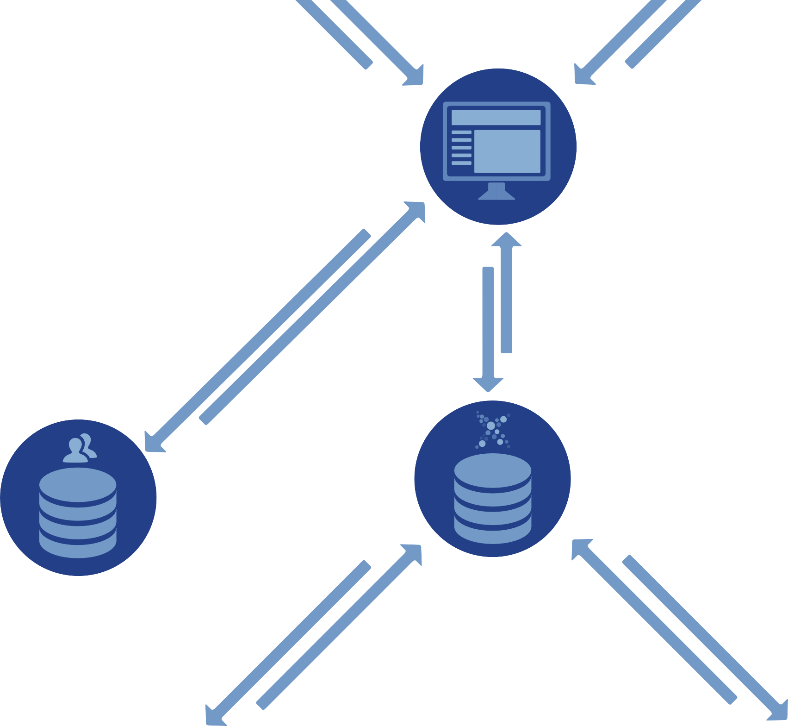






Produce & Publish
Plone CMS
Word2XML
ia Site Visitor
ite Visitor
Onkopedia
Onkopedia Ed
XML to PDF
DOCX
HTML, XML + CSS
XML, Assets
PDF, EPUB
Authorization
JSON HTML XML
XQuery WebDAV
Authentication
Guidelines (XML) Addendums (XML) Assets (Images, Styles)
PDF DOCX
XQuery
HTT REST
XML, HTML, JSON
DGHO
Member Database
eXist-db XML database
Query Server
WebDAV
XML Editing, Assets Editing
XML Editing, Assets Editing
WebDAV
Windows
Mac

Slide 41




Produce & Publish XML to PDF
Plone CMS
edia Site Visitor
ia Site Visitor
Onkopedia Ed
Onkopedia Edito
HTML, XML + CSS
XML, Assets
PDF, EPUB
Authorization
JSON HTML XML
XQuery WebDAV
Guidelines (XML) Addendums (XML) Assets (Images, Styles)
PDF DOCX
XQuery
HTTP REST API
XML, HTML, JSON
eXist-db XML database
Query Server
WebDAV
Editing, Assets Editing
External Systems Clinical systems Medical applications Medical databases
XML Editing, Assets Editing
WebDAV
Mac

Slide 42
Architecture
Onkopedia
Onkopedia Editor (Intern)
Onkopedia Site Visitor
Plone CMS
Onkopedia Editor (Intern)
Produce & Publish XML to PDF
Word2XML
Onkopedia Site Visitor
Onkopedia Editor (Intern)
DOCX
HTML, XML + CSS
XML, Assets
PDF, EPUB
Authorization
JSON HTML XML
XQuery WebDAV
Authentication
Guidelines (XML) Addendums (XML) Assets (Images, Styles)
PDF DOCX
XQuery
HTTP REST API
XML, HTML, JSON
DGHO
Member Database
eXist-db XML database
WebDAV
Query Server
XML Editing, Assets Editing
External Systems Clinical systems Medical applications Medical databases
XML Editing, Assets Editing
WebDAV
Windows
Mac
www.produce-and-publish.com
Professional XML Publishing
(C) 2014 ZOPYX

Slide 43
Hidden gem:
pyfilesystem

Slide 44
pyfilesystem
‣
unified Python API for accessing different filesystems
‣
‣
‣
‣
‣
‣
local WebDAV Dropbox SFTP/SSH S3
(Plone)
‣
Write portable code independent of the underlaying FS
the filesystem is just a configuration option
‣
www.produce-and-publish.com
Professional XML Publishing
(C) 2014 ZOPYX

Slide 45
pyfilesystem
from fs.contrib.davfs import davfs
handle = DAVFS(„http://host/existdb/webdavdb“)
files = handle.listdir()
with handle.open(„foo.txt“, „w“) as fp: fp.write(„hello world“)
www.produce-and-publish.com
Professional XML Publishing
(C) 2014 ZOPYX

Slide 46
Conclusion
‣
much better production-safety through XML by applying validations, schema/DTD checks etc.
replaced tons of Plone-specific and fragile Plone code well-defined DOCX ➝ XML conversion workflow
much smaller code base
easy to build Plone-XML apps on top of zopyx.existdb
‣
‣
‣
‣
www.produce-and-publish.com
Professional XML Publishing
(C) 2014 ZOPYX

Slide 47



Questions?

