Slide 1
Pragmatic Plone Projects
Plone Conference 2012
Arnhem
Andreas Jung
ZOPYX Ltd.
www.zopyx.com, info@zopyx.com

Slide 2
Speaker
long-time Python, Zope,
Plone developer and contributor
Lead developer and principal consultant of
ZOPYX Limited
  Zope, Python, Pyramid, Plone projects
  large portals, intranet, internet, extranet
  Electronic Publishing
  complex domain-specific applications

Slide 3
This talk is about
practical hints surviving your next
Plone project
best practices
lessons learned from our last
larger Plone project
stuff perhaps covered already by the
Plone trainings

Slide 4
Relaunch weishaupt.de
Weishaupt:
  major vendor of heating systems
  480 M€ revenue
Large company portal on top of Plone 4.2
Phase 1:
  implementation and DE content
  4 months
Phase 2:
  20 subsidaries
  more than 30 languages

Slide 5
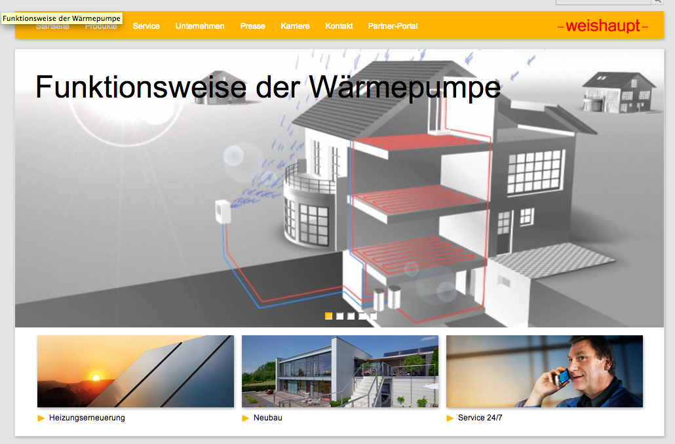
weishaupt.de

Slide 6
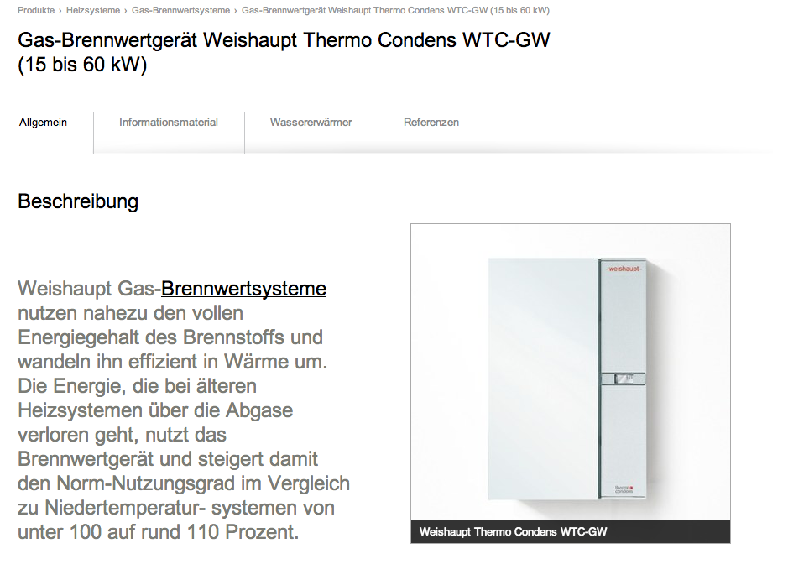
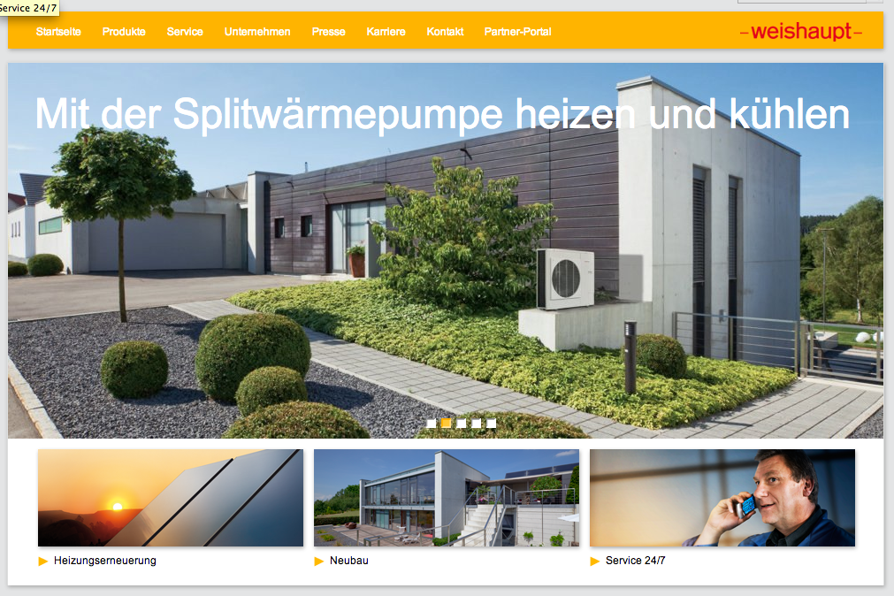
weishaupt.de

Slide 7
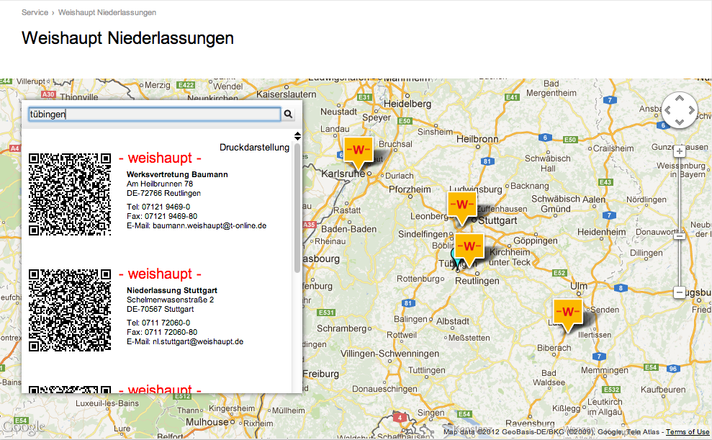
weishaupt.de

Slide 8
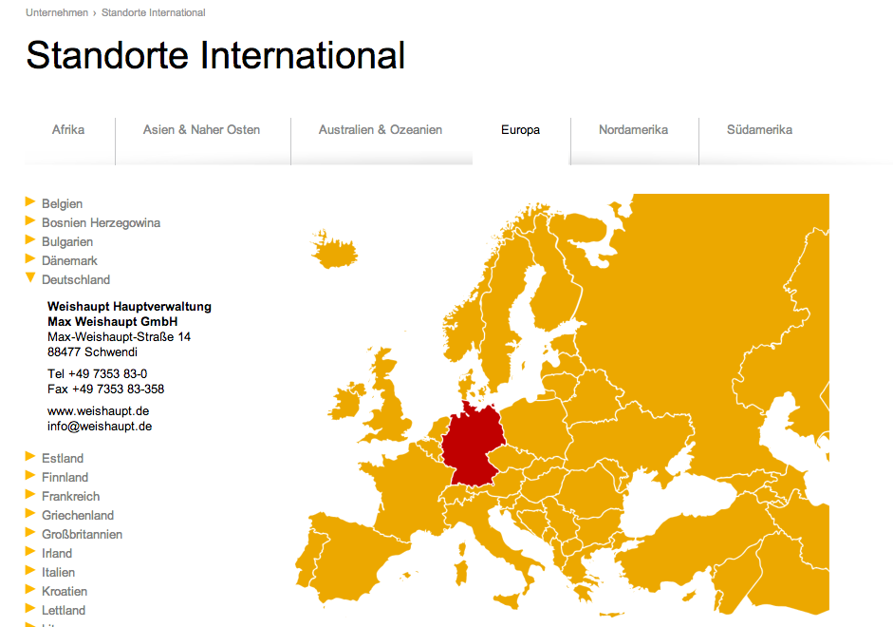
weishaupt.de

Slide 9
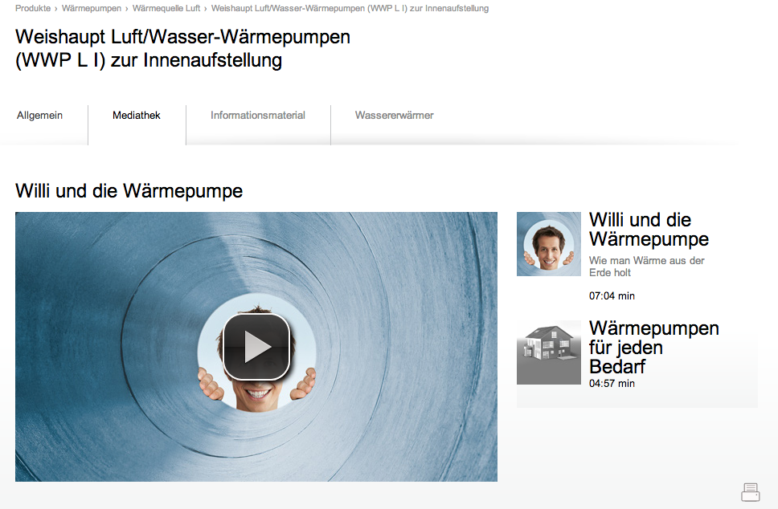
weishaupt.de

Slide 10
Project constraints (1/3)
There is no real-world project with
unlimited budget
unlimited human resources
unlimited time

Slide 11
Project constraints (2/3)
Resources
Time
Budget

Slide 12
Project constraints (3/3)
Conclusions
usually impossible finding the
„perfect“ solution
the „perfect“ solution is „mission impossible“

Slide 13
Getting things done
within a reasonable time-frame
on budget
with the available human resources

Slide 14
Common customizations
Bugs in Plone and 3rd-party packages
are all around you
Particular behavior of Plone or 3rd-party packages is a common project requirement
What must be usually customized:
  Python code (browser views, skin scripts)
  Resources (browser view templates, JS, CSS)

Slide 15
Where to fix things?
Package maintainer (Plone and 3rd-party) love
  bug reports
  bug fixes
  contributions
Stuff on Github: Fork & Pull request
SVN repositories: svn branch & svn merge
  check if the package is maintained
  ask the maintainer for merging your changes or merge yourself
  move packages to Github if appropriate

Slide 16
Where and how to customize things?
Is your required change of interest for the public?
  fork on Github
  branch in SVN
  speak with the package maintainers
Your change satisfies an absurd customer request?
  keep it for yourself.

Slide 17
(Monkey) Patching Python code
Monkey patching:
„dynamic modifications of a class or module at runtime“
(Source: Wikipedia)
MP in general should be considered evil and bad-style
MP may have side-effects
Use MP carefully (and only when you know what you are doing)

Slide 18
Monkey patching in Python
Original (foo.py) | Patched version (my_foo.py)
class Foo: def bar(self): return 42 | def my_bar(self): return 43 from foo import Foo Foo.bar = my_bar # or (needed in some situations) Foo.bar.func_code = my_bar.func_code

Slide 19
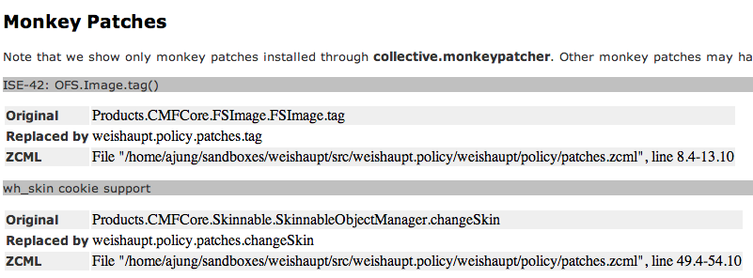
Monkey patching Plone
collective.monkeypatcher (patches.zcml)
ZCML-level configuration of patching information: module-level patches class-level patches | <configure...> <include package="collective.monkeypatcher" /> <monkey:patch description="ISE-42: OFS.Image.tag()" class="Products.CMFCore.FSImage.FSImage" original="tag" replacement=".patches.tag" /> </configure>
collective.monkeypatcherpanel (patches.zcml)

Slide 20
Patching resources (1/2) – overrides.zcml
Standard mechanism for overriding configuration settings introduced through a different package
overrides.zcml is an optional ZCML configuration file
Products.PloneGlossary (configure.zcml) | my.package (overrides.zcml)
<configure..> <browser:page name="glossary_main_page“ for="Products.PloneGlossary.IPloneGlossary" class=".pages.GlossaryMainPage" permission="zope2.View“ /> </configure> | <configure..> <browser:page name="glossary_main_page" for="Products.PloneGlossary.IPloneGlossary" class=".glossary.GlossaryView“ permission="zope2.View“ /> </configure>

Slide 21
Patching resources (2/2) – z3c.jbot
z3c.jbot allows you to override resources of other packages inside your own policy package
Limited to .pt, .cpt, .js?!
Configuration: <browser:jbot directory=“overrides“ />
Existing template: plone.app.search/plone/app/search/search.pt
Customization: your.package/your/package/overrides/plone.app.search.search.pt
Links
http://blog.keul.it/2011/06/z3cjbot-magical-with-your-skins.html
http://pypi.python.org/pypi/z3c.jbot

Slide 22
Unconfigure resource configurations
Sometimes you just don‘t want or need ZCML configurations introduced by other packages
z3c.unconfigure is your friend
some.package(configure.zcml) | my.package (configure.zcml)
<configure..> <browser:page name="glossary_main_page“ for="Products.PloneGlossary.IPloneGlossary" class=".pages.GlossaryMainPage" permission="zope2.View“ /> </configure> | <configure..> <include package="z3c.unconfigure" file="meta.zcml" /> <unconfigure> <browser:page name="glossary_main_page“ for="Products.PloneGlossary.IPloneGlossary" class=".glossary.GlossaryView“ permission="zope2.View“ /> </unconfigure> </configure>

Slide 23
Extending schemas
Plone comes with two content-type systems
Archetypes (old-style)
  use archetypes.schemaextender
  modify any AT-based content-type
  (modifying fields, adding fields)
  SchemaExtender, SchemaModifier
Dexterity (new-style)
  Dexterity introduces „behaviors“
  „A behavior is a re-usable aspect of an object that can be enabled or disabled without changing the component registry“
  (Source: Dexterity developer manual)

Slide 24

Keep your designer happy
Implementing CSS styles
requires representative content
http://localhost:8080/@@new-site?content=1

Slide 25
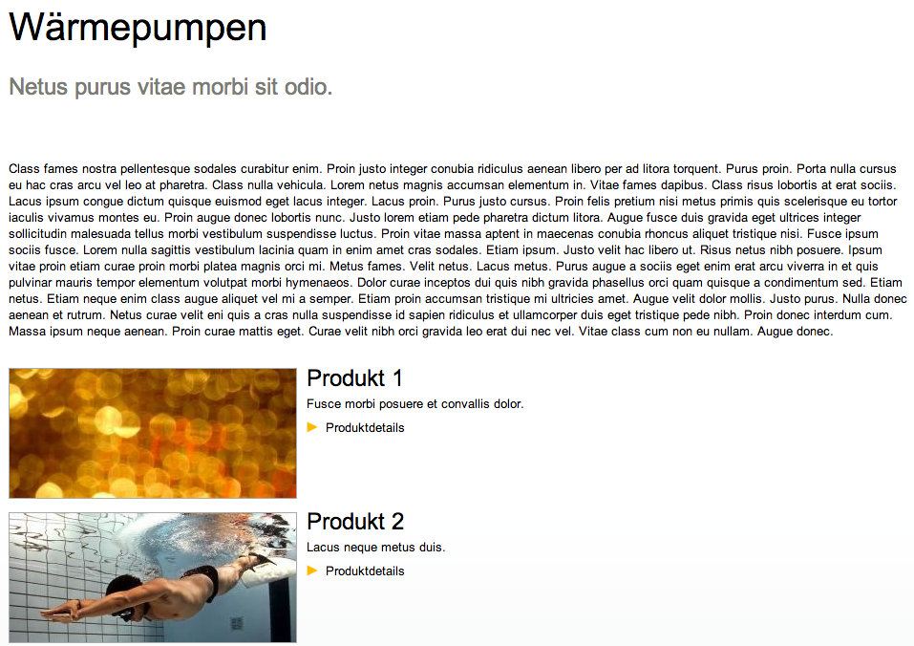
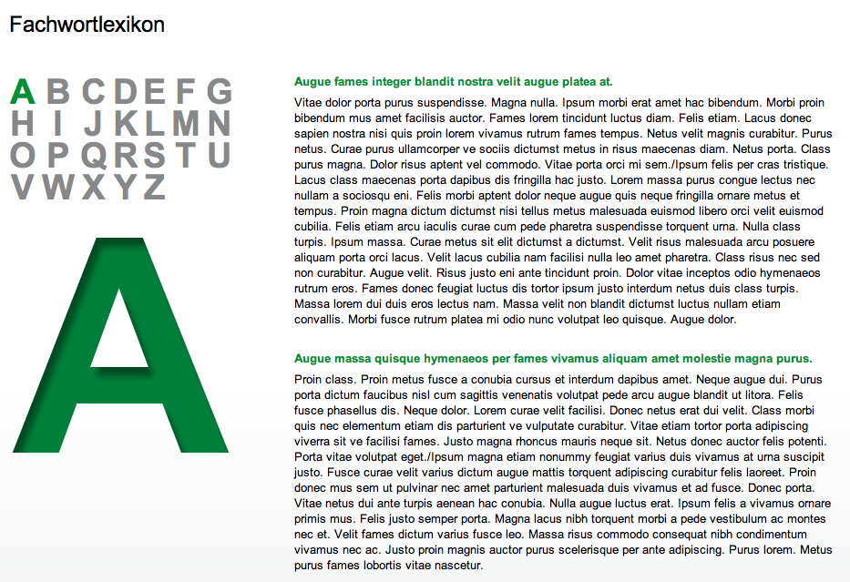

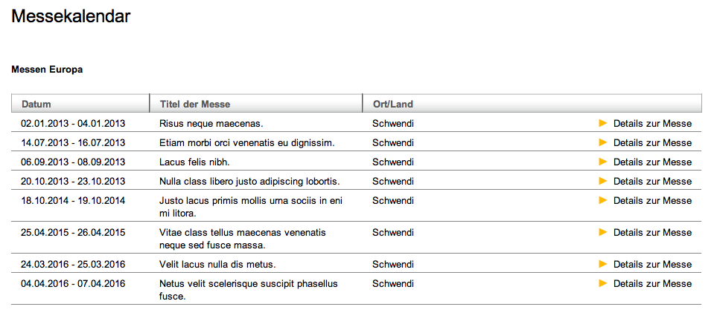

Auto-generated content

Slide 26
Predefined sample content
Write a browser view
  creating a Plone site with policy package + add-ons
  installing the basic site-structure
  creating example content for each content-type, content-listing etc
use http://lorempixel.com/600/400 ...
look at loremipsum, collective.loremipsum or zopyx.ipsumplone

Slide 27
Predefined sample content
Throw your sandbox/Plone working site away
as often as possible
sometimes I created 30-40 new Plone sites per day
Pragmatic side-effect
  the content fixture code can be used as unit test where all your content-types and site-infrastructure is created and tested in one run
  not the best solution but it works reasonably well

Slide 28
Some good hints
Never ever perform customizations in-place in existing 3rd-party packages. NEVER!!!
Customizations always belong into your own policy package.
Local customizations of 3rd-party package will be lost with the next version of customized package.

Slide 29
Questions?

