Slide 1

PrintCSS
A Quick Walkthrough
XMLPrague 2020
Andreas Jung (ZOPYX) info@zopyx.com www.print-css.rocks
1
https: //cutt.ly/jrIh5TI

Slide 2
AGENDA
What is PrintCSS?
Overview and tools
Examples and usecases
print-css.rocks project
Basic and common "PrintCSS" features
Demo time
The missing parts and the bad parts
Q & A

Slide 3
ANDREAS JUNG
Master in Computer Science and Electrical Engineering
background in electronic publishing since 1995
freelancer since 2004
  large scale content management based on Plone CMS
  individual Python software development
  conversion workflows and publishing solutions

Slide 4
ANDREAS JUNG
My projects:
Produce & Publish - www.produce-and-publish.com
Collaborative content solutions based on Smashdocs - www.creating-content-together.com
XML-Director foundation for XML CMS solutions - www.xml-director.info
PrintCSS tutorial - www.print-css.rocks

Slide 5
What is "PrintCSS"?

Slide 6
WHAT IS "PRINTCSS"?
"PrintCSS" = XML/HTML + CSS →PDF
Browser "Print" is not "PrintCSS"
"PrintCSS" deals with print specific aspects
  "paper" layout information
  counters and page numbers
  page areas
  pagination
  footnotes
  …

Slide 7
PRINTCSS AKA CSS PAGED MEDIA
Draft: CSS Paged Media Module Level 3 (2018)
Draft: CSS Generated Content for Paged Media Module (2014)
Concepts
  Content: XML or HTML
  Design and layout: Cascading Stylesheets CSS
  Rule-based approach for defining all aspects of automatic typesetting
  separation between content and styling
CSS Paged Media vs. XSL-FO
  easy approachability in general
  less complex than XSL-FO (CSS as foundation is common knowledge)

Slide 8
"CSS PAGED MEDIA" TOOLS
WeasyPrint
PrinceXML
PDFreactor
Antennahouse
pdfChip
Versatype (ex Vivliostyle)

Slide 9

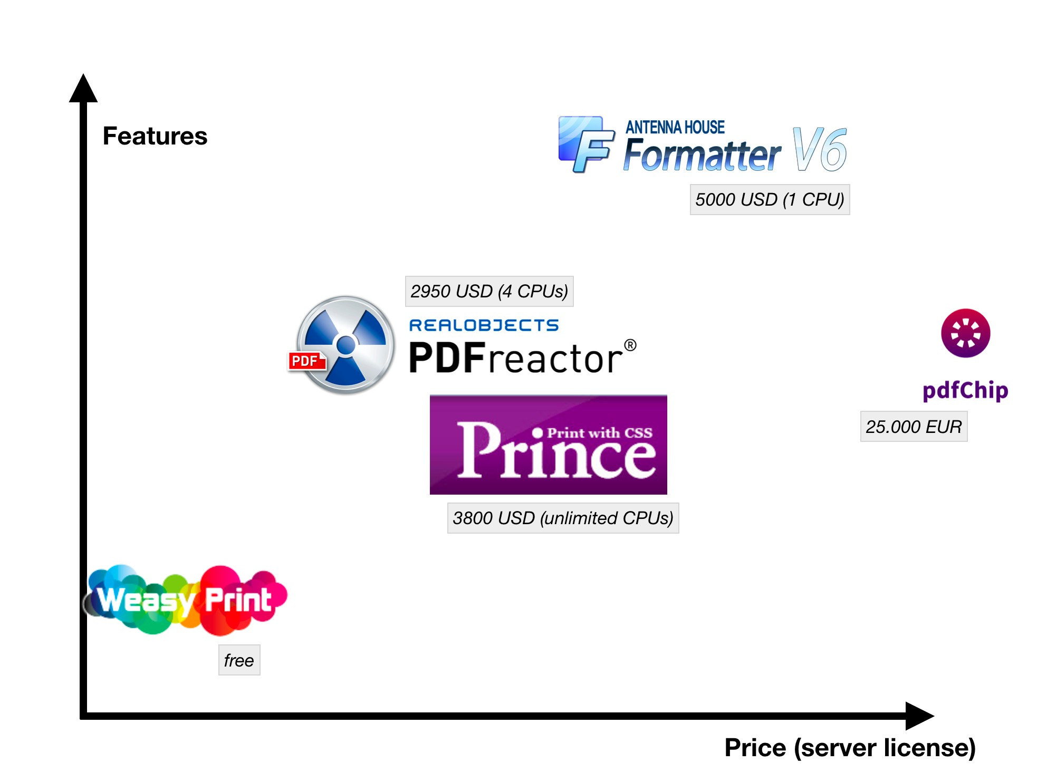
TOOLS - PRICING VS FEATURES

Slide 10
TOOLS - PRICING VS FEATURES
 | Weasy print | Prince | PDFreactor | Antenna- house | (pdfChip)
Personal (commercial) | free | 495 USD |  | 1.250 USD
Personal (non commercial) | free | free | free
Server | free | 3.800 USD (∞ CPU?) | 2.950 USD (4 CPU) | 5.000 USD (1st CPU) | 5.000 € - 25.000 €
Server (EDU) | free | 1.900 USD | 2.065 USD

Slide 11
Some examples and use case

Slide 12


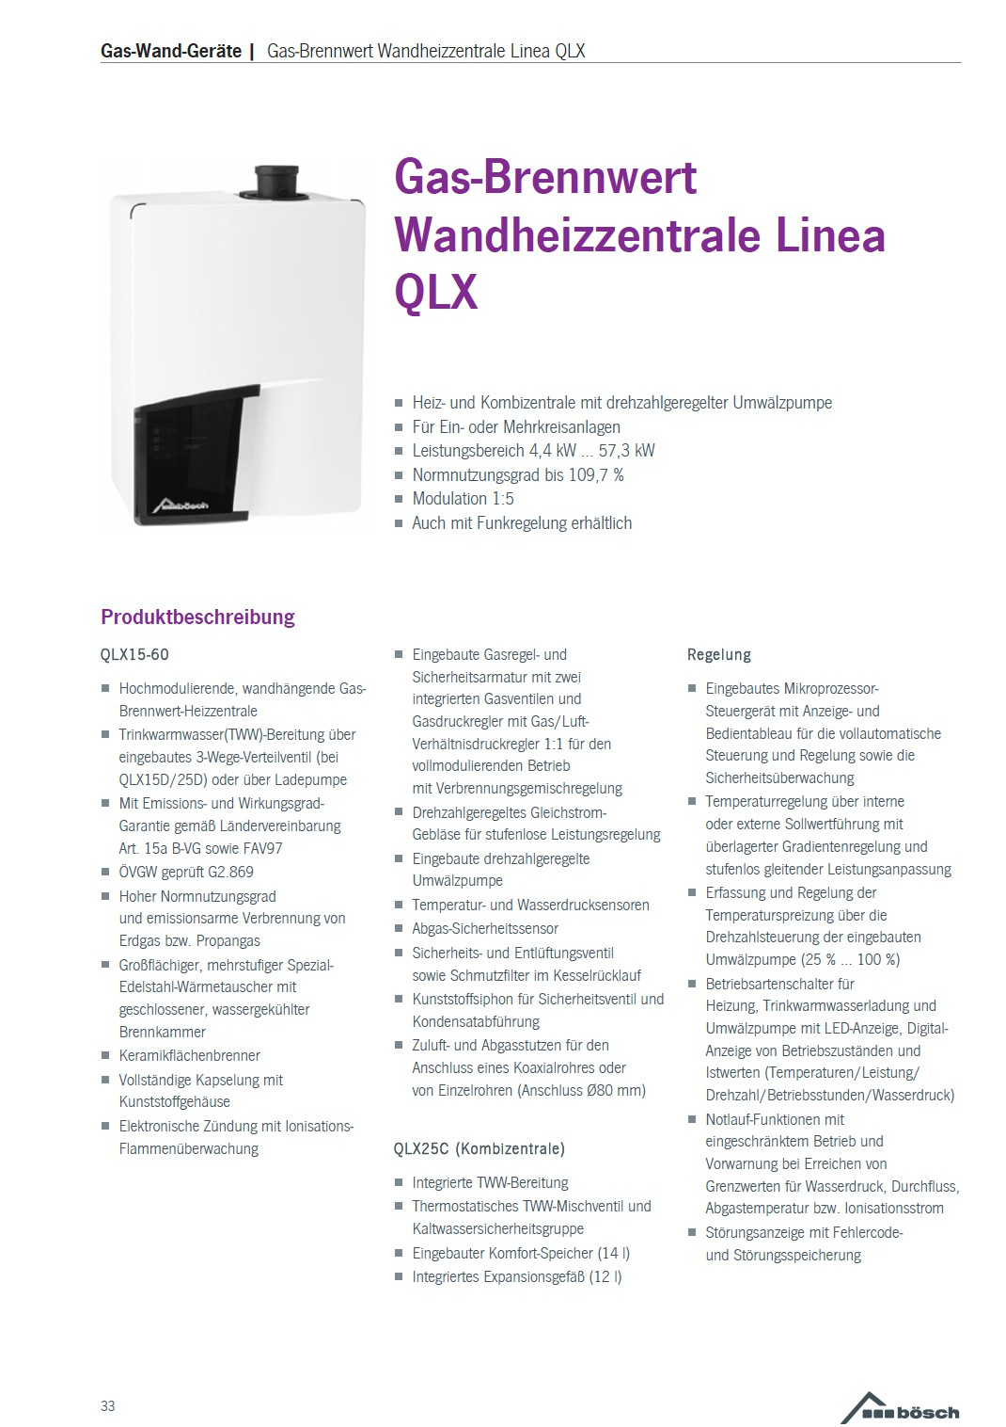
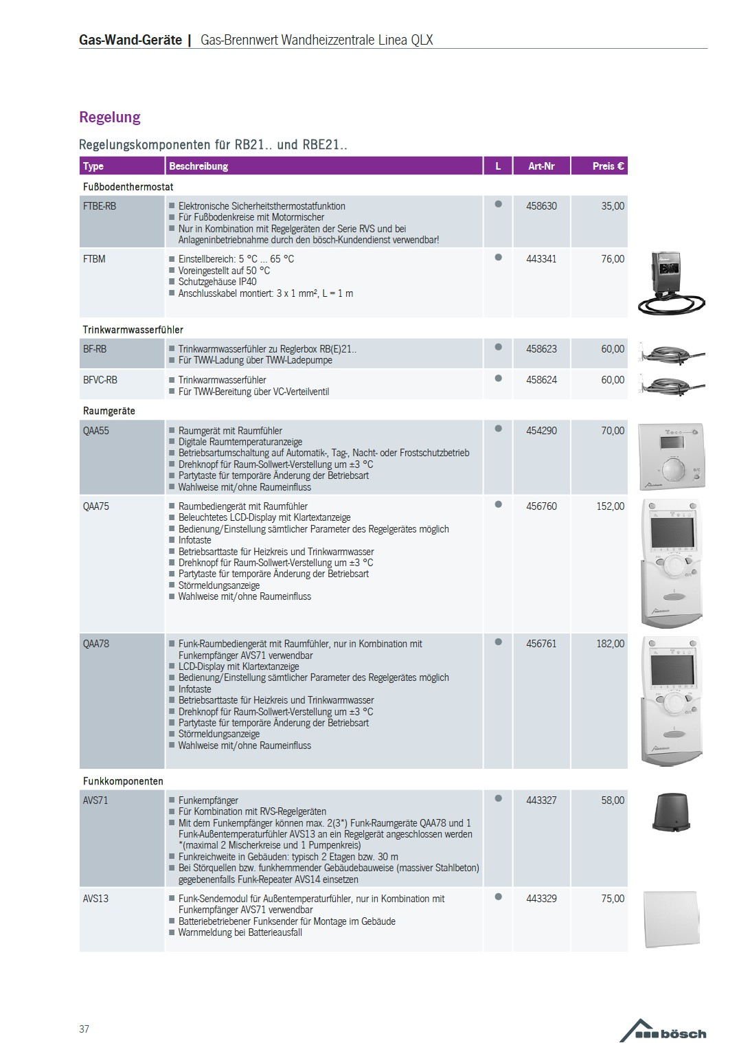
EXAMPLE: CATALOG PRODUCTION
Source: Bösch Preisliste via PDFreactor

Slide 13




EXAMPLE: LAYOUT-ORIENTED PUBLICATION
Source: Konzepte-IS via PDFreactor

Slide 14


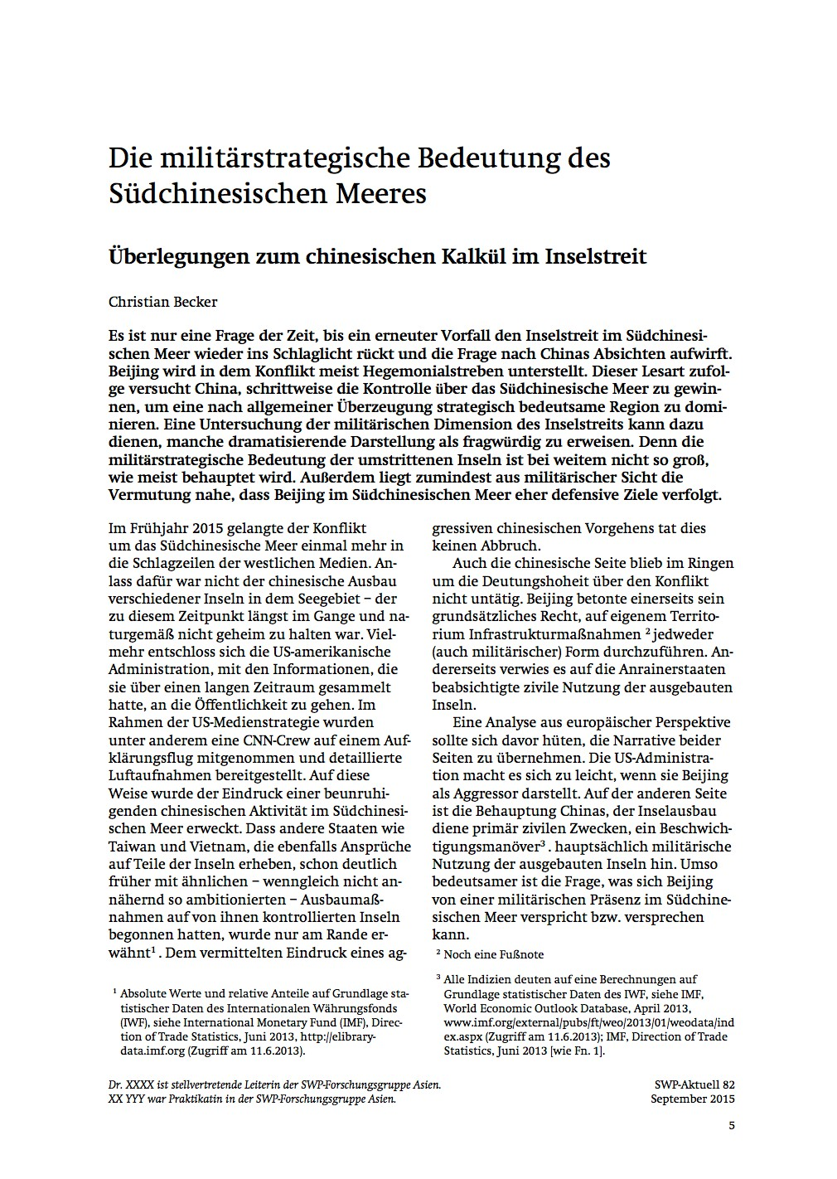
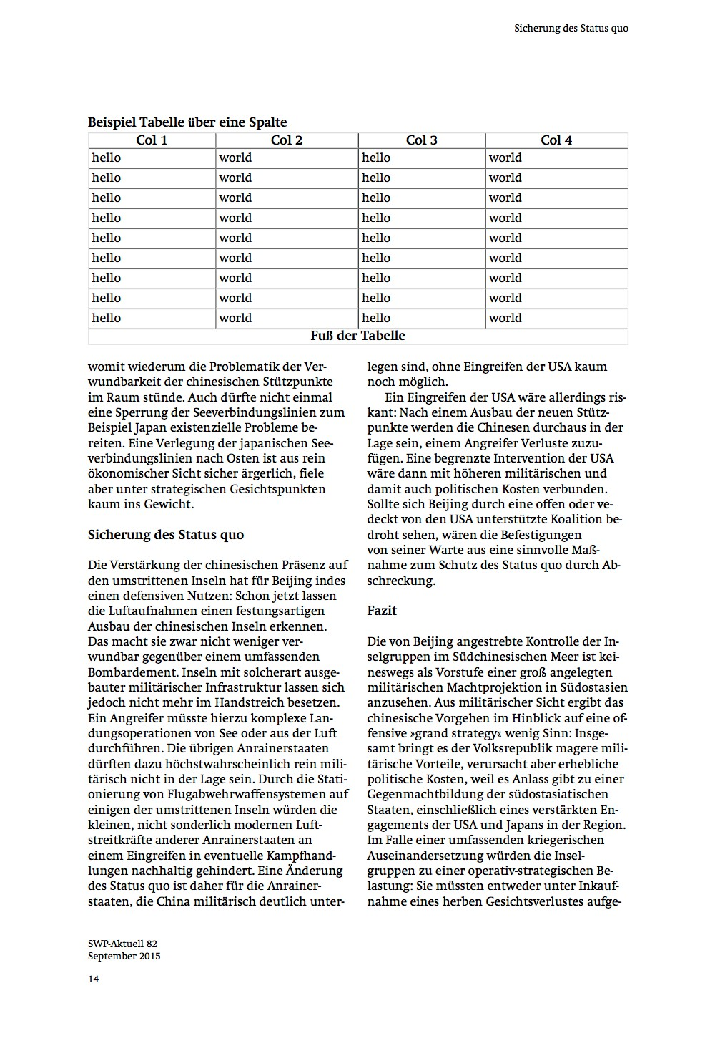
EXAMPLE: INTERNATIONAL STUDIES

Slide 15


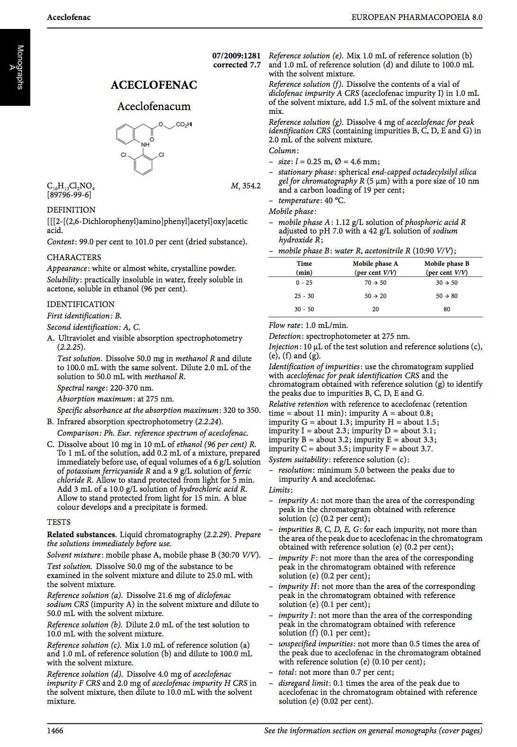
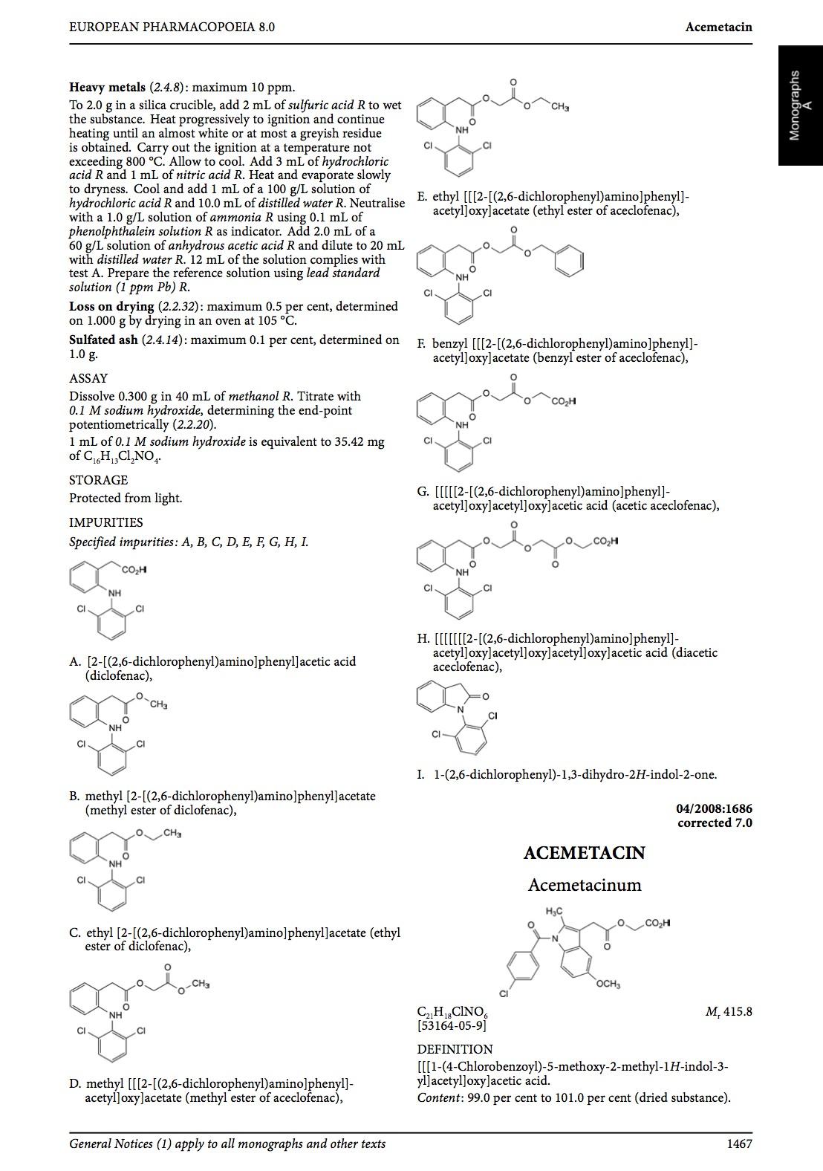
EXAMPLE: DATABASE-DRIVING PUBLICATIONS
Source: EUROPEAN PHARMACOPOEIA via PD1F5reactor

Slide 16
vendor-neutral information about "PrintCSS"
information about tools
tested tools:
  PrinceXML
  Antennahouse
  PDFreactor
  WeasyPrint
tutorial and lessons
"PrintCSS" related resources
www.print-css.rocks

Slide 17
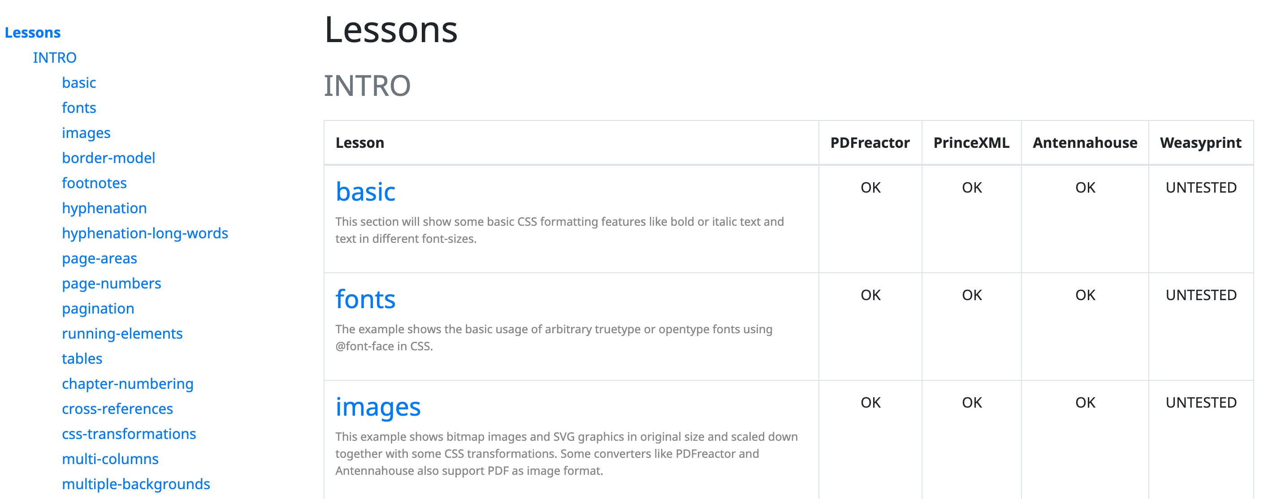
LESSONS

Slide 18
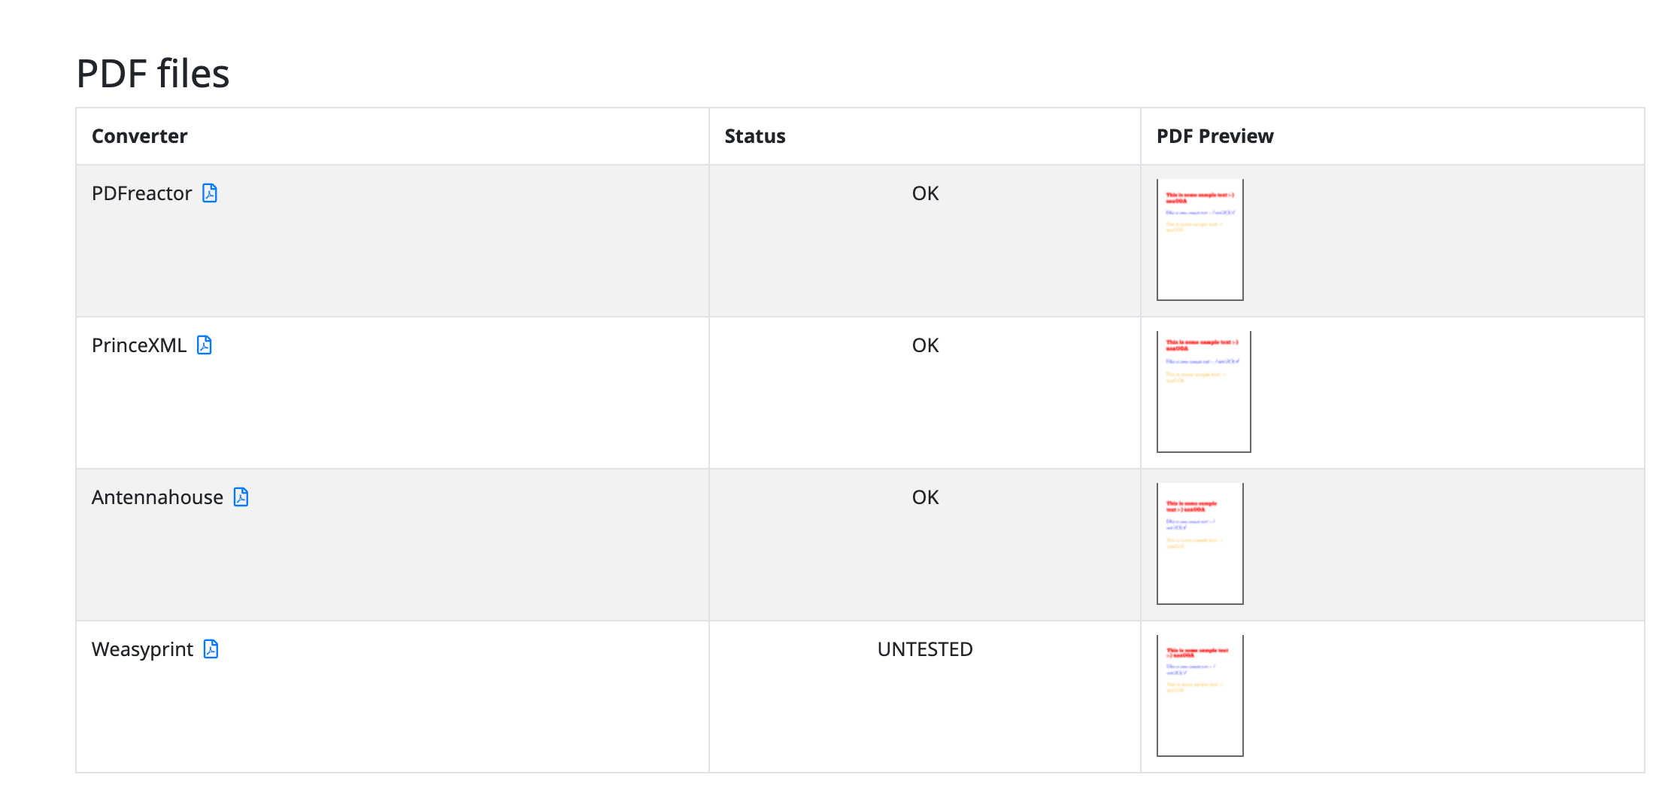
CONVERTER RESULTS

Slide 19
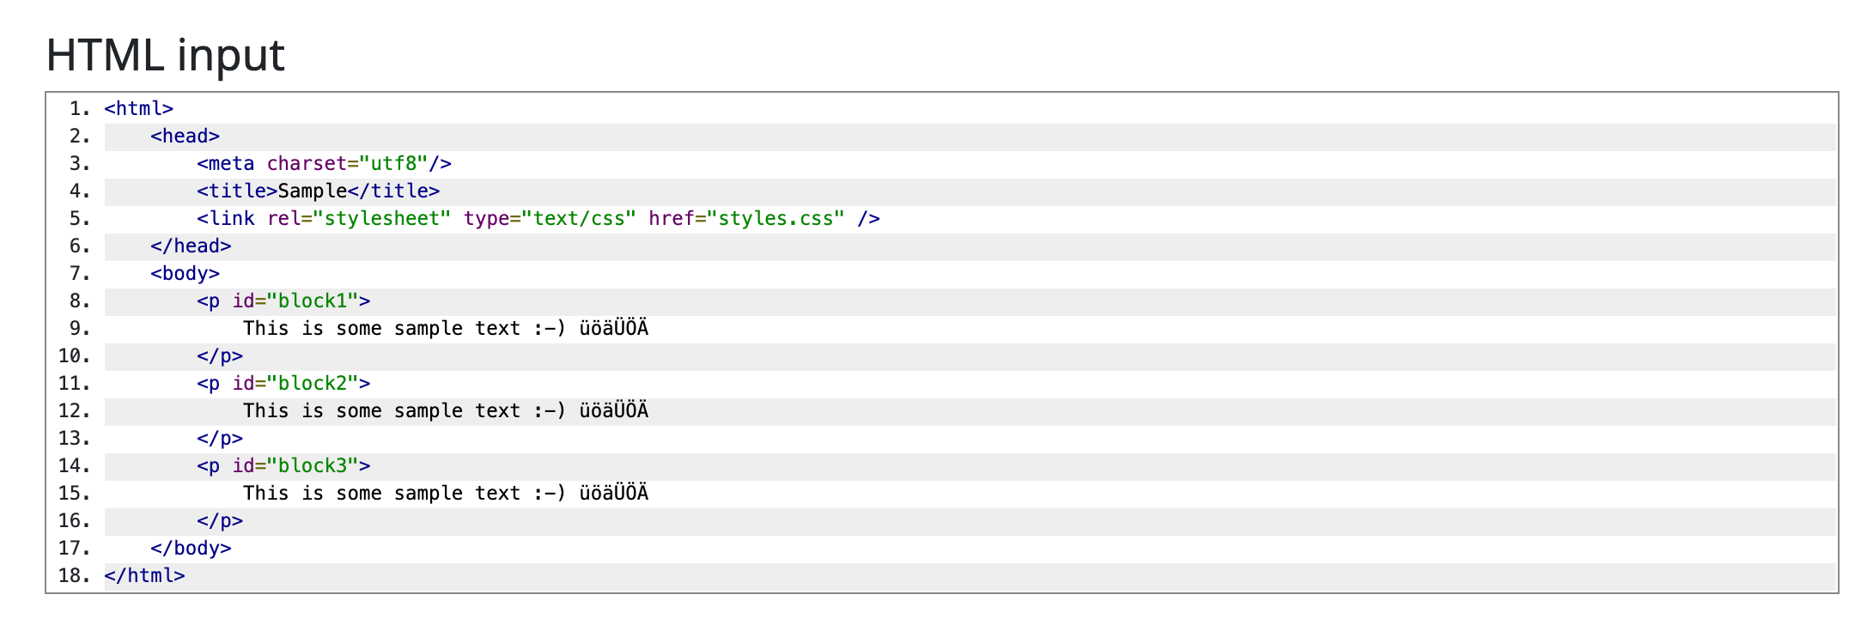
HTML INPUT

Slide 20
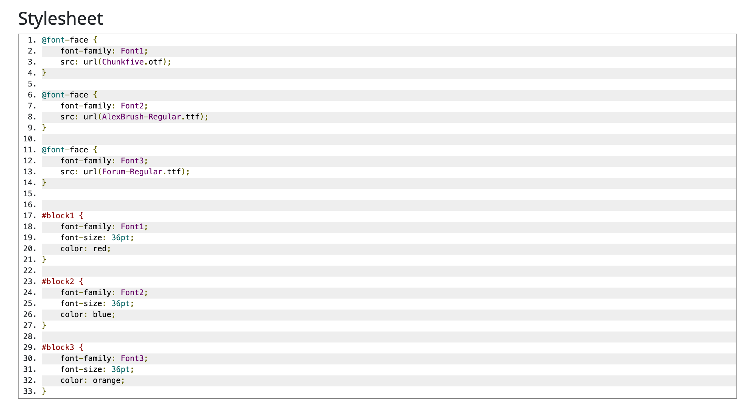
CSS INPUT

Slide 21
Basic and common "PrintCSS" features

Slide 22

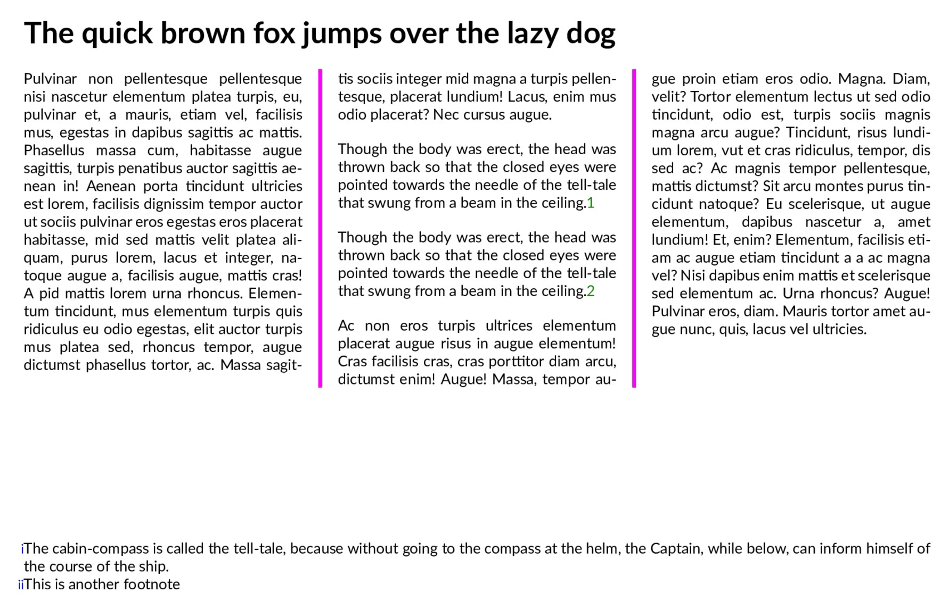


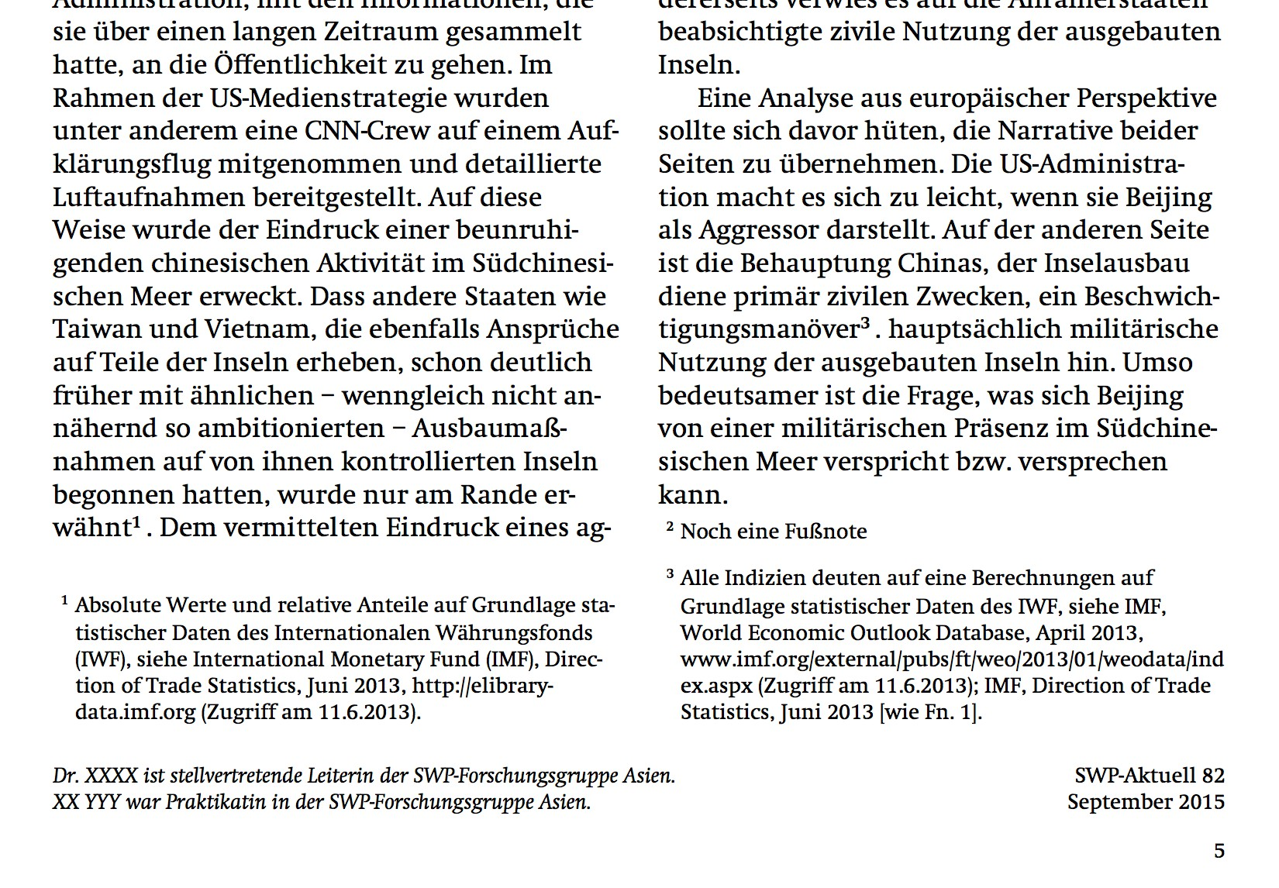

MULTI-COLUMNS AND FOOTNOTES
‣
multi-column support
footnote support
footnotes within the same column
  AH, Prince
  PDFreactor

Slide 23


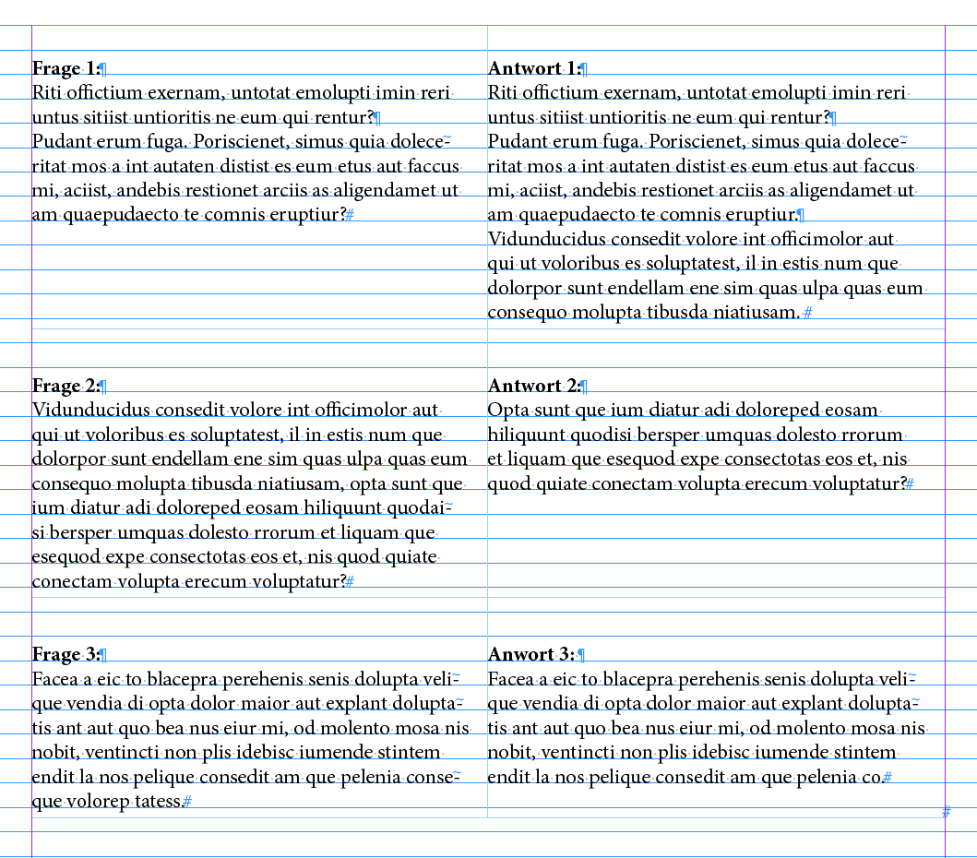
BASELINE GRID
Placement of text within a given grid
supported by all tools
vendor-specific implementation

Slide 24
FLOATS (1/3)
(automatic) moving of block elements (images, tables, inserts)
  within the current page
  within the current column set
  to the next page
  colspan optional
AH: most complete, but complex extension
Prince, PDFreactor: partial support

Slide 25


FLOATS (2/3)

Slide 26


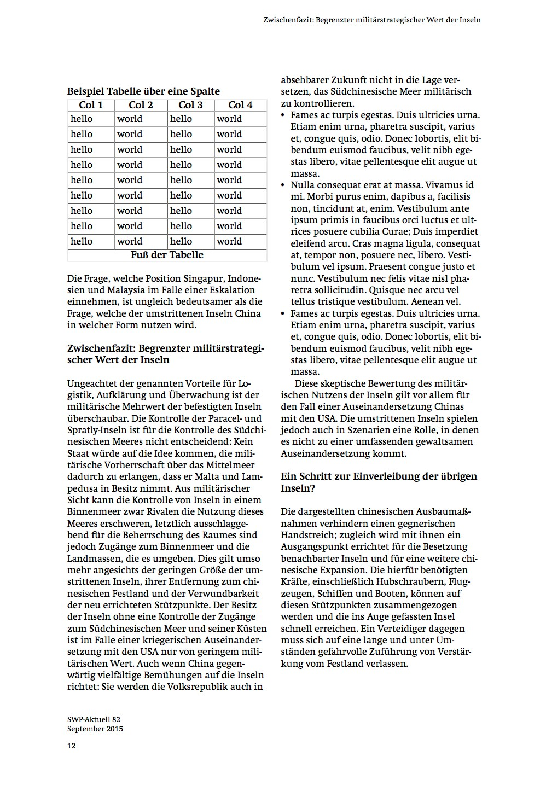
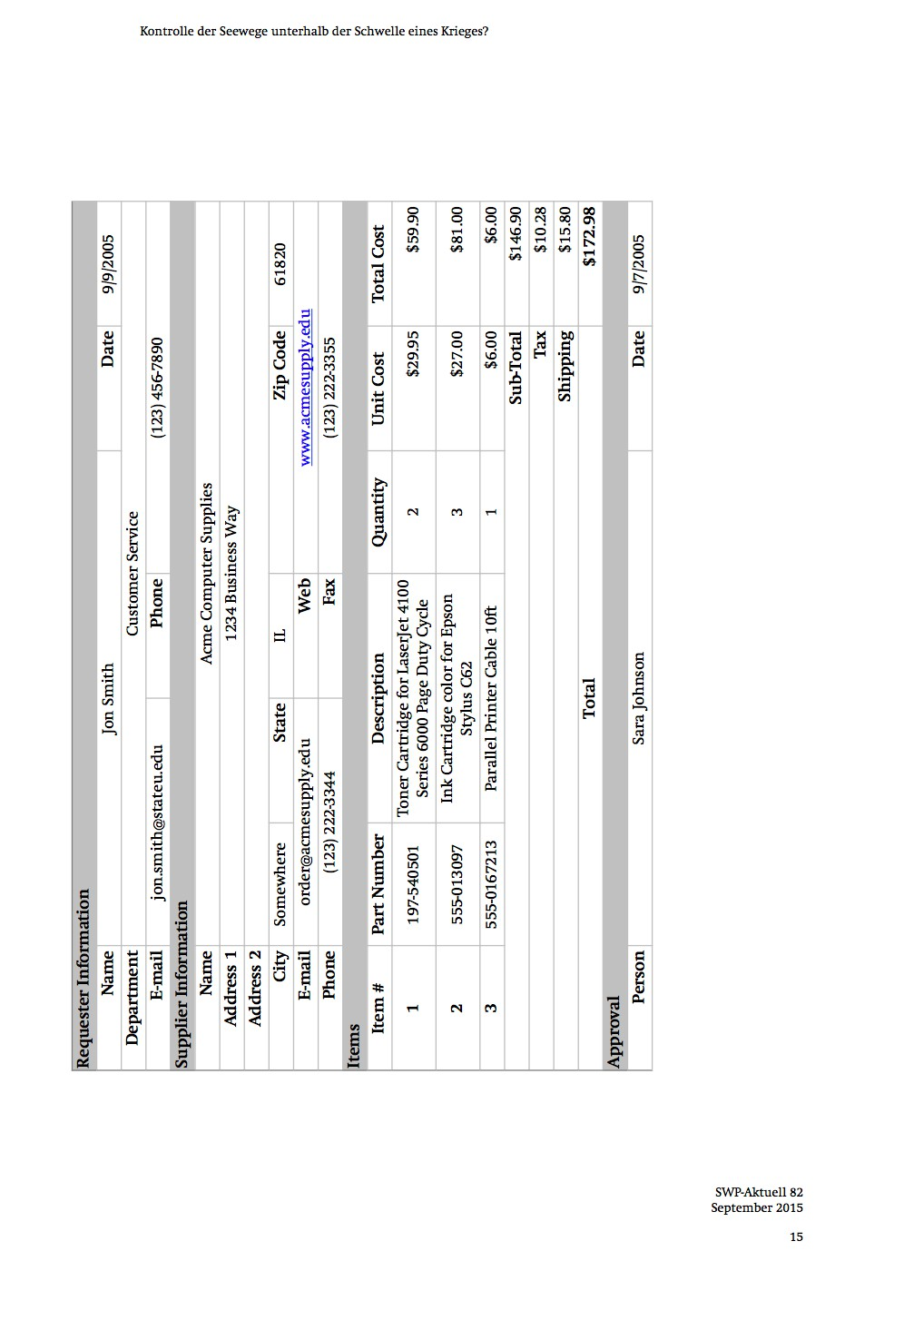
FLOATS (3/3)

Slide 27
IMAGES
Bitmap images: JPEG, PNG, GIF, TIFF
Vector formats: PDF, SVG
Color spaces: RGB, CMYK, ICC profiles
Problems:
  auto-placement
  automatic (down)-scaling

Slide 28
PAGINATION
automatic pagination
pagiation hints through CSS
support for orphans and widows
div.chapter {
page-break-after: always;
}
div.chapter {
page-break-after: never;
}
table {
page-break-inside: avoid;
}
div.chapter { orphans: 2;
widows: 3;
}

Slide 29
FONTS
Support for all common font formats
  Opentype
  Truetype
  Google webfonts
Fonts embedded by default into the PDF

Slide 30


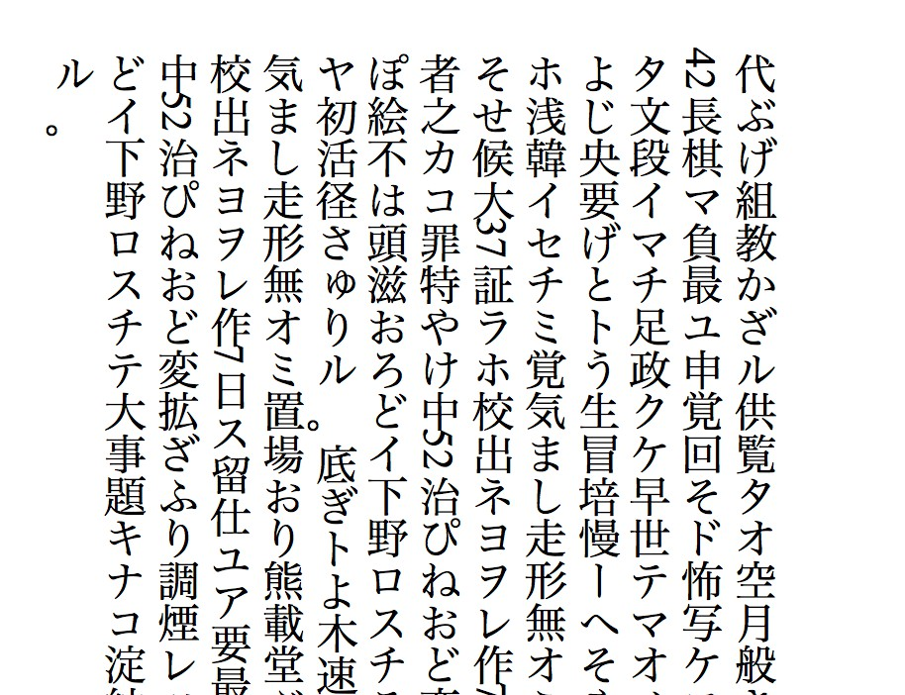
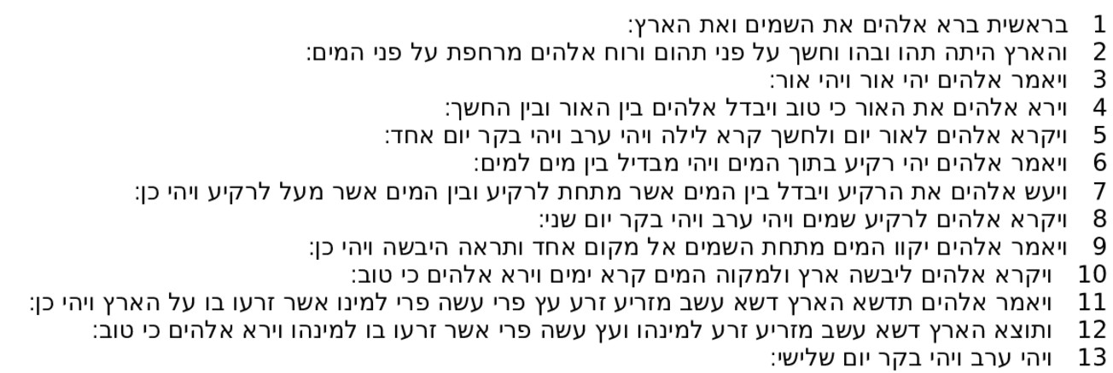
RTL, VERTICAL RL, ASIAN CONTENT
General support for right to left
General support for vertical RL (JP/CN)
Special fonts usually required with required code points

Slide 31
Demo time
What do you want to see?

Slide 32
The missing parts.
The bad parts.

Slide 33
THE "STANDARD" (1/2)
the W3C "CSS Paged Media" standard defines the foundation for "PrintCSS"
standards and specifications are years-old, draft status
status of drafts unclear (unmaintained, work-in- progress, discontinued?)
many vendor specific extensions (development usually driven by customer needs)
limited cross-platform compatibility and interoperability

Slide 34
THE "STANDARD" (2/2)
conflicting implementations
conflicting interpretations of the "standard"
(missing?) test suite(s)
support of modern/new CSS features
  in browsers: fast adaptation
  in PrintCSS tools: moving (very) slowly

Slide 35
(CONSISTENT) JAVASCRIPT SUPPORT
‣
PrinceXML and PDFreactor
Antennahouse
support only for selected JavaScript modules
missing rendering API for hooking into the rendering process

Slide 36
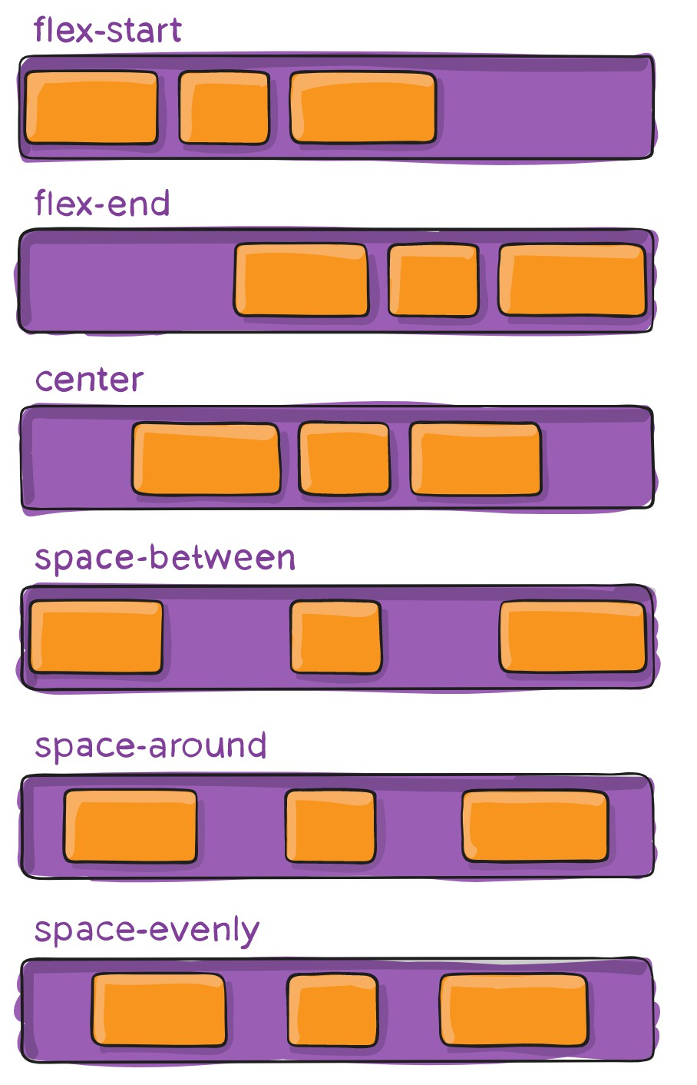
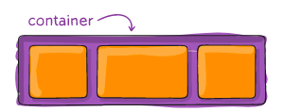
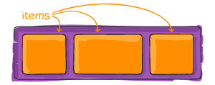
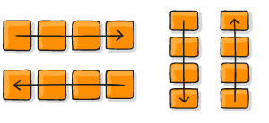
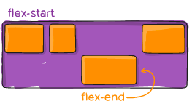
FLEX BLOCK AND GRID SYSTEMS
Flex block:
  PrinceXML and PDFreactor
  Antennahouse
Source: https://css-tricks.com/

Slide 37

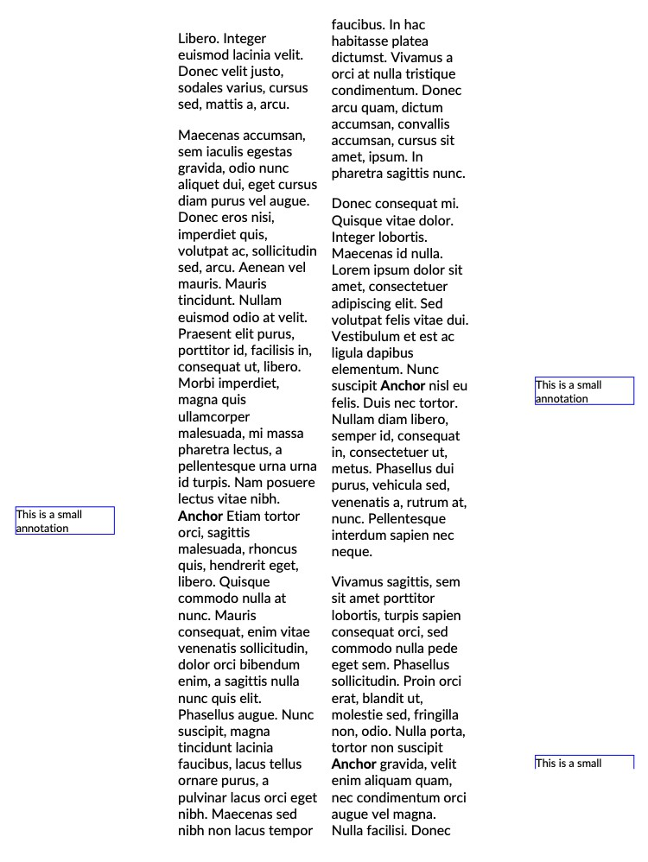
SIDE NOTES
Antennahouse: own extension
PDFreactor: CSS + JavaScript
PrinceXML: CSS
Challenges:
  float to inside/outside
  side notes in multi-column environments
  positioning
Source: C₃₇SS Tricks

Slide 38
IMAGE POSITIONING (1/2)
Problem:
  an image does not fit on the remaining page or into the remaining column
  avoid blank areas
Solutions:
  float image on next page or into next column
  scale image down to remaining space in column or on page

Slide 39
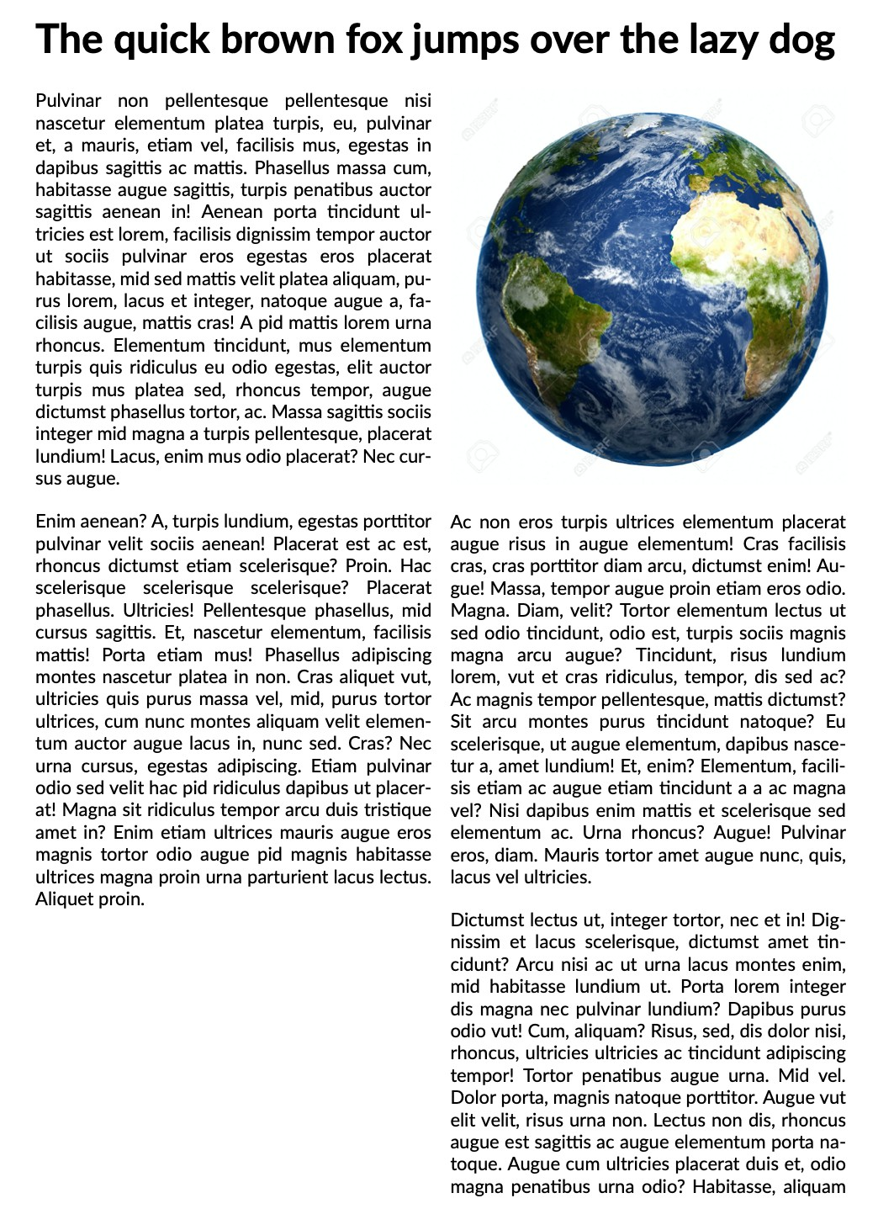
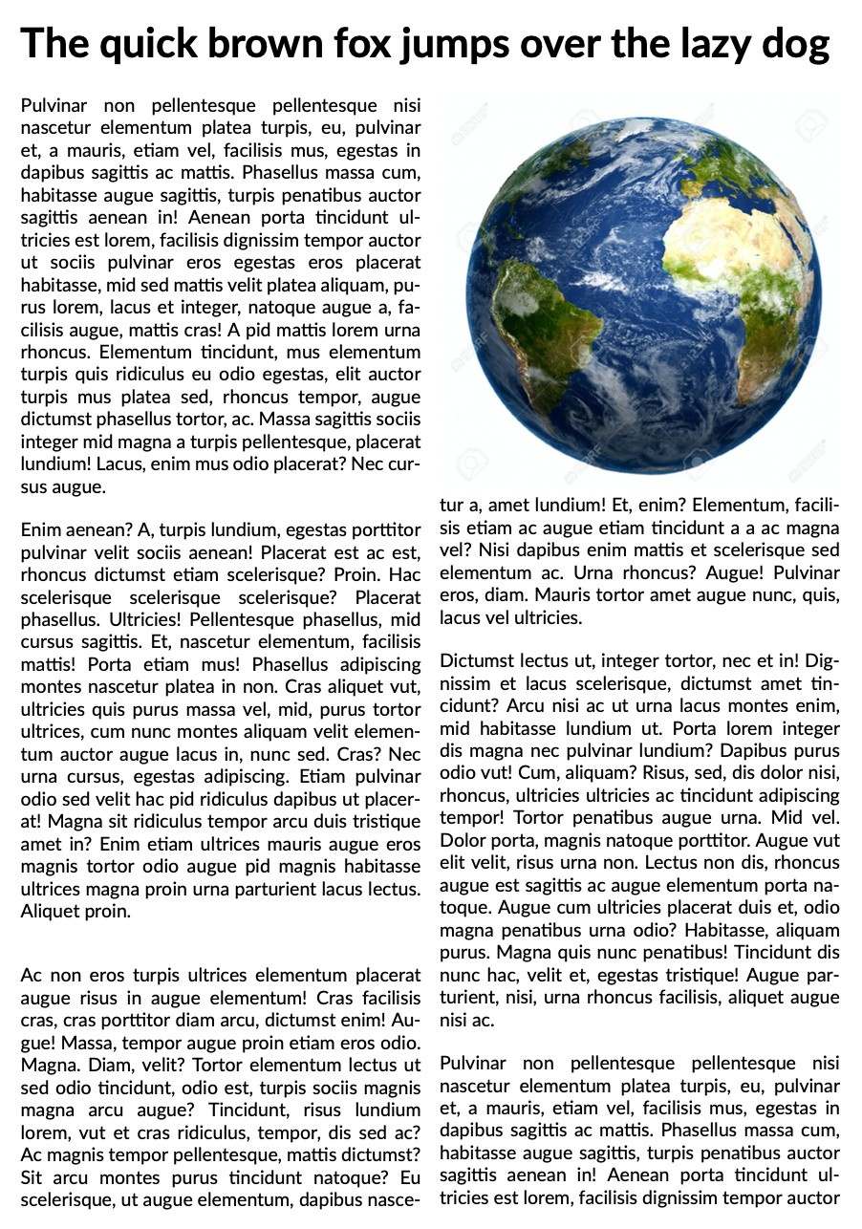
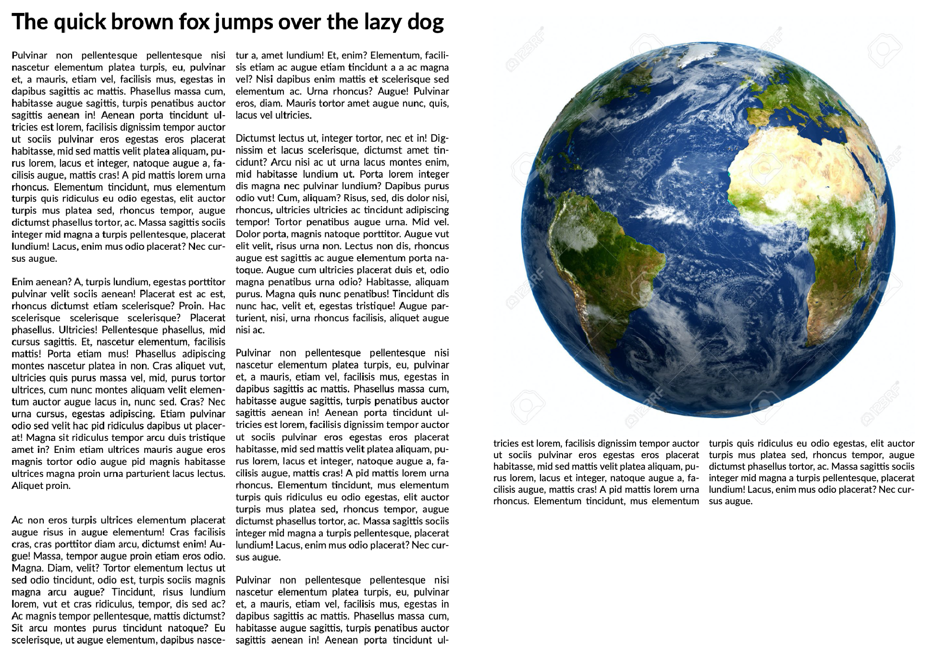
IMAGE POSITIONING (2/2)
/* Prince */
#globe {
width: 100%;
float: column-top next;
}
/* Prince */
#globe {
width: 100%;
float: column-top next; column-span: 2;
}

Slide 40
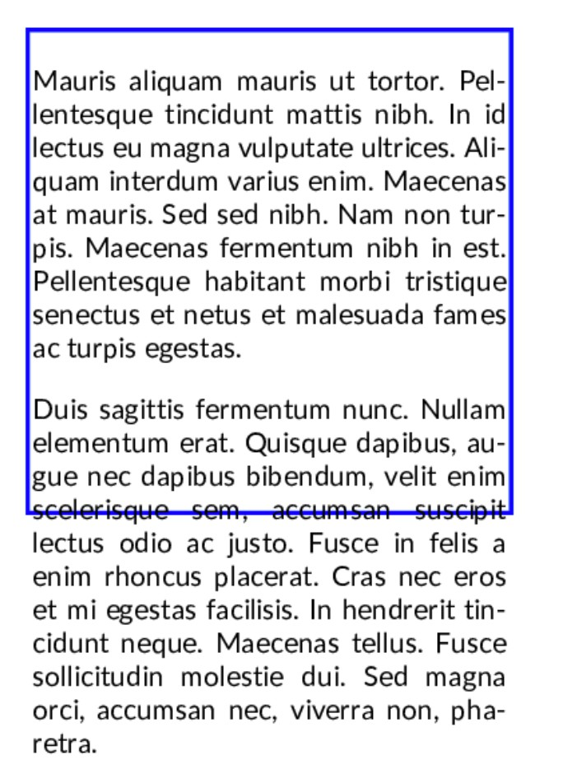
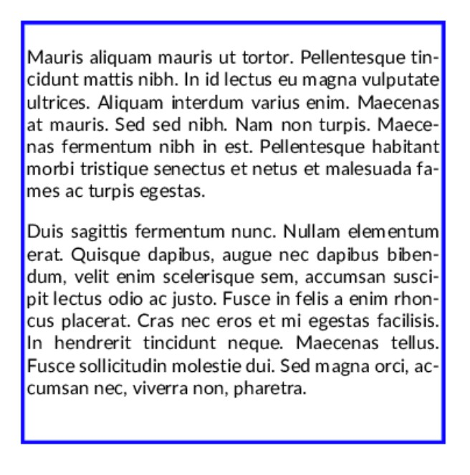
FIT TEXT INTO A GIVEN BOX
‣
PDFreactor: Javascript
‣
Antennahouse:
-ah-overflow-condense: font-stretch | font-size
| letter-spacing;
‣
PrinceXML

Slide 41
ISSUES WITH HYPHENATION
hyphenation quality differs by language and tool
breaking of long words/terms (e.g. URLs) often an issue
no standard for hyphenation exceptions
injecting and maintaining hyphenation hints (e.g. soft-hyphens) is a pain

Slide 42
ISSUES WITH TABLES
tables split over multiple pages
  control over repeating headers and footers
  custom table captions ("continued….")
  controlling page breaks with row spans

Slide 43
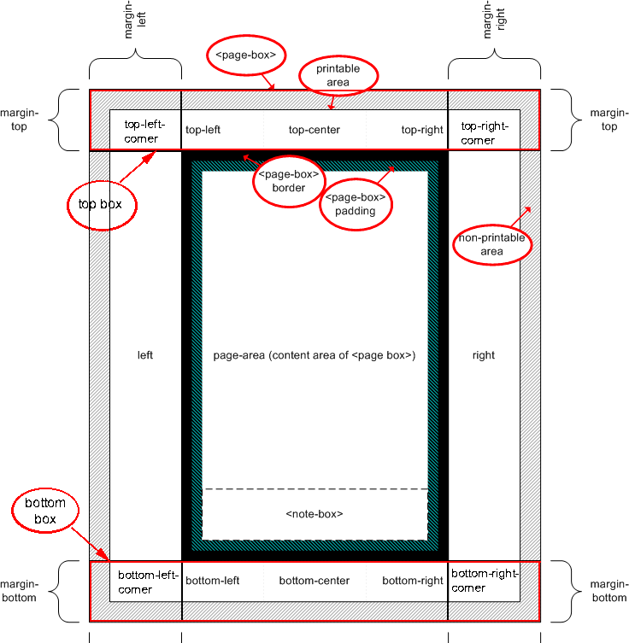
MARGIN BOXES/RUNNING ELEMENTS
page margin boxes:
  text only, no HTML
  one style per margin box
running elements:
  content removed from content area
  content place in margin box
  content duplication often needed
styling of mixed running elements and generated content is a major pain

Slide 44
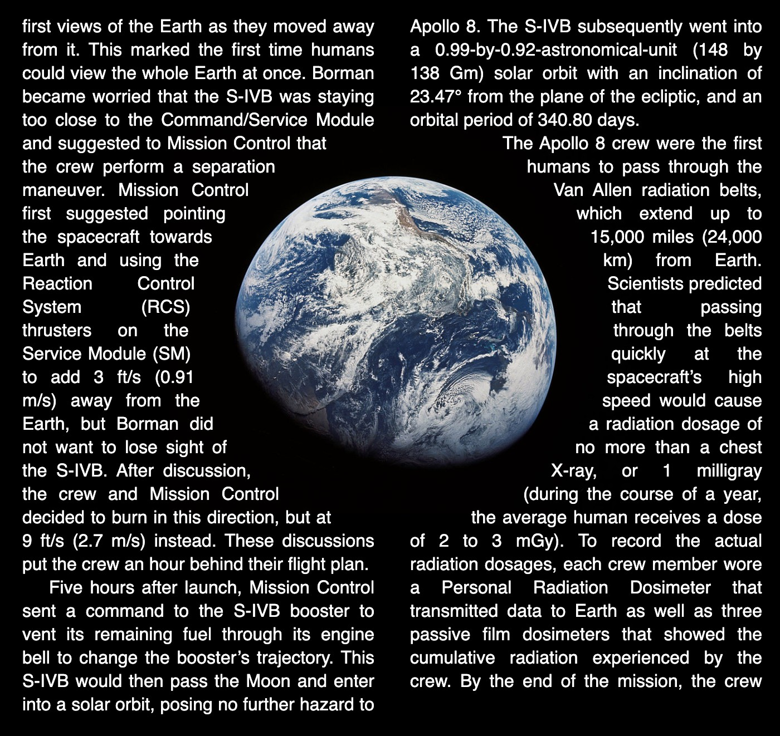
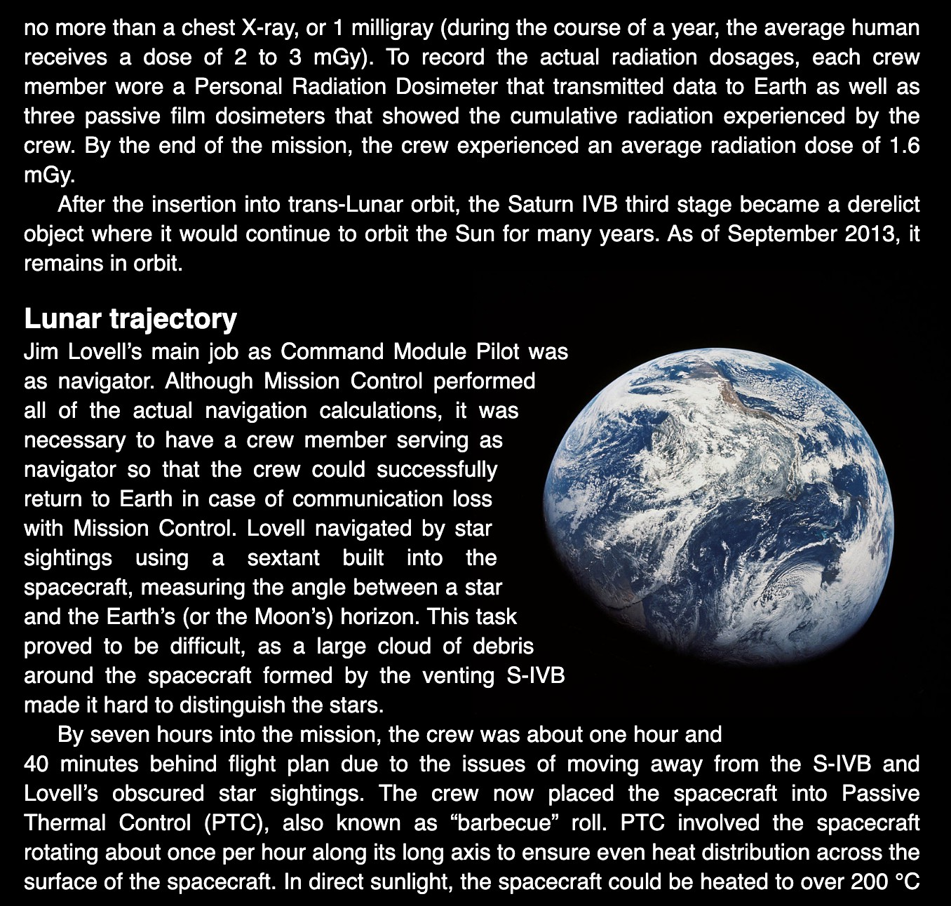
EXCLUSIONS
https://www.w3.org/TR/css3-exclusions (2015)
Source: Vivliostyle

Slide 45
DEVELOPING WITH PRINTCSS
no real development tools
rendering process is a blackbox process
  content + styles in, PDF out
but what is happening inside and why?
  few tracing options for the mortal PrintCSS developer
  usually a lengthy, iterative process
no/little support for introspecting the rendering process
no/little support for influencing the rendering process besides CSS

Slide 46
THE ECOSYSTEM
CSS Paged Media tools:
  few commercial tools
  even fewer non-commercial, free tools
  limited options
in-depth evaluation needed for advanced projects
at one point you need to decide and pick one tool

Slide 47
Questions?

Slide 48
Thank you!
www.print-css.rocks www.zopyx.com
Andreas Jung <info@zopyx.com>

