Slide 1



Slide 2
Andreas Jung
Python, Zope & Plone developer since 1993
Co-founder and chairman
Python Software Verband (former DZUG)
Director of the Zope Foundation
ZOPYX Limited:
  Software development w/ Python, Zope & Plone
  Electronic Publishing

Slide 3

Agenda
What is Single-Source
Multi-Channel-Publishing?
What is Produce & Publish?
Produce & Publish Demo
Looking under the hood
Plone extensions in P&P

Slide 4
Single-Source Multi-Channel Publishing (1/2)
Single Sourcing (or Multi-Channel Publishing) allows the same content to be used across different documents or formats. The labour-intensive and expensive work required to create and deliver content need only be carried out once, on one source.
Transformations to a specific document output and/or output format are then carried out automatically. It is even possible to add new output formats as needs develop.
Each output could also offer differing levels of detail for each audience profile and automatically adjust layout to suit the channel of delivery e.g. content and layout repurposed for display on a small screen.
(Source: http://www.mekon.com/)

Slide 5
Single-Source Multi-Channel Publishing (2/2)
Produce & Publish
Word
Web
service
Templates
PDF
Web
HTML
Stylesheets
Word
EMail
XML
Logos...
ODT
Export
Hyphenation
EPUB
Dropbox
Grafiken
Importieren/Bearbeiten
Konvertieren
Publizieren
Fonts
RTF
Print
HTML
S5

Slide 6
What is Produce & Publish?
Platform for web-to-print and automatic typesetting
Output formats: high-quality, EPUB, Word, Open-Office, RTF
Input formats: HTML orXML
Styling: CSS
open architecture
language and platform-neutral

Slide 7
Features and usecases
Web-to-Print | Automatic type-setting
Layout oriented documents Aggregation of data and templtes Alternative to expensive web-to-print solutions for simple to medium complex layouts | Quality comparable to TeX/LaTeX Foonotes, marginals Multi-lingual, Unicode Support for text columns Multi-linguag hyphenation LTR/RTL support Tables (spreading pages) Images, image captions Table lising, image listing Table of contents generation Cover pages PDF bookmarks High quality PDF documents

Slide 8
Produce & Publish
A quick walkthrough

Slide 9

Produce & Publish Architecture (1/2)
- Full Python/Plone Stack -
Plone 4
Produce & Publish Server
Authoring Environment
zopyx.convert2
Plone Client Connector
Calibre
XINC
PISA
PrinceXML
Apache FOP
XFC
P&P ZIP Client
XML-RPC

Slide 10
Produce & Publish Architecture (1/2)
- Non-Python Integration -
Typo 3
Produce & Publish Server
Typo 3
zopyx.convert2
Calibre
XINC
PISA
PrinceXML
Apache FOP
XFC
P&P PHP Client
XML-RPC

Slide 11
Import and
Content Management

Slide 12
Import and content management (1/3)
Plone as content management system
  user friendly
  fine-grained rights and security concept
  workflows
HTML as primary input format (XML possible)
Content repository within Plone
Editing of all content within Plone
Management of all assets within Plone

Slide 13
Import and content management (2/3)
Handling of author drafts
  Copy & paste from Word into Plone
  Export from Word to HTML into Plone
  Manual editorial work within Plone
Problems
  Word „HTML“
  Plone‘s HTML filtering too unspecific
  High costs for manual work (error-prone, bad user experience and usability)

Slide 14
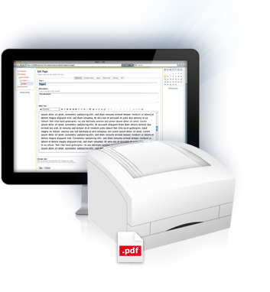


Import and content management (3/3)
DOC/DOCX
Upload
HTML
CSS
Images
Web service
Produce & Publish
HTTP/POST
(Word/ZIP)
HTML/CSS/Grafiken

Slide 15
Aggregation

Slide 16
Aggregation (1/3)
Chapter 1
Section 1.1
Section 1.2
Chapter 2
Subsection 1.1.1
Subsection 1.1.2
Section 2.1
Section 2.2
Subsection 2.2.1
Chapter 3
Section 3.1
...

Slide 17
Aggregation (2/3)
Integration with Plone
  Folder determine document structure (chapter, section..)
  Page for the contents
  support for custom content-types
Usage of the Zope Component Architecture
  content-types provide @@asHTML view
  @@asHTML() returns an HTML snippet
One aggregated and consolidated HTML document as basis for all further conversion steps (single-source)

Slide 18
Aggregation (3/3)
<div class=„boundary-level-0“>
<div class=„portal-type-document“>
<h1>...</h1>
<div class=„description>..</div>
<div class=„body“>...</div>
</div>
<div class=„boundary-level-1“>
<div class=„portal-type-document“>
<h1>...</h1>
<div class=„description>..</div>
<div class=„body“>...</div>
</div>
</div>
<div class=„portal-type-myevent“>
<h1>Mein Termin</h1>
<div class=„startdate“>12.09.2011</div>
<div class=„enddate“>13.09.2011</div>
</div>
</div>

Slide 19
Transformations

Slide 20
Transformations (1/2)
Indentical HTML input for all conversions
every output format requires some more specific information for the conversion process
  table of contents, image listing for PDF
  aggregated HTML or chapterwise HTML for publication on the web
  images in print resolution for PDF
  images with 72dpi resolution for EPUB

Slide 21
Transformations (2/2)
aggregated HTML
aggregeated HTML
Transformations
exportImages
addImageList
addTOC
addTableList
imagesOriginal
imagesCaptions
Transformations
exportImages
HTML for PDF conversion
imagesPreview
imageCaptions
HTML for EPUB conversion
cleanupEPUB
lxml-based transformation pipeline

Slide 22
Conversion

Slide 23
Conversion (1/2)
Output format specific HTML as basis for conversions
Conversion service implement as
client-server architecture
Converter | Format | Licence | Quality | Features | Support in P&P
PrinceXML | PDF | commercial | very high | very high | Yes
PISA | PDF | free | limited | limited | (Yes)
FOP | PDF | free | limited | limited | No
Calibre | EPUB | free | good | very high | Yes
XINC | PDF | commercial | good | high | Yes
XFC | RTF, ODT, DOC(X) | commercial | good | high | Yes

Slide 24

Conversion (2/2)
Python Pyramid
Produce & Publish Server
Produce & Publish
(Plone)
XML-RPC
XINC
PrinceXML
Calibre
Apache FOP
PISA

Slide 25
Publishing

Slide 26
Publishing
Publishing of generated output for download
HTML (aggregated/chapterwise) +
individual formats
Export as ZIP archive
Publish-to-Dropbox

Slide 27




Publishing

Slide 28
Plone Extensions

Slide 29
PDF generation Print vs. Web
PDF format required both for print media
and electronic media
  Print: high image resolution: 300dpi
  Ebooks/tablets: med image resolution: 150 dpi
  Desktop PC/notebook: low image resolution: 72dpi
Solution:
  Export the original/highest scale stored within Plone
  Generate PDF with the high-res images
  Downsampling of the images using Ghostscript during post-processing

Slide 30
Plone extensions (1/3)
Major problem of Produce & Publish:
  Usability of WYSIWYG editors
  editors are used to work with Word
  Editing of longer texts through-the-web is a pain
  all web-based editors are crap
  TinyMCE is partly usable
  Products.TinyMCE is pretty much outdated

Slide 31
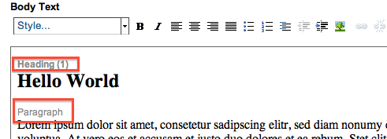
Plone extensions(2/3)
TinyMCE improvements
  display document structure

Slide 32
Plone extensions (3/3)
TinyMCE improvements
  LinkTool for managing cross-references to
    headings
    tables
    images
    list (-items)

Slide 33
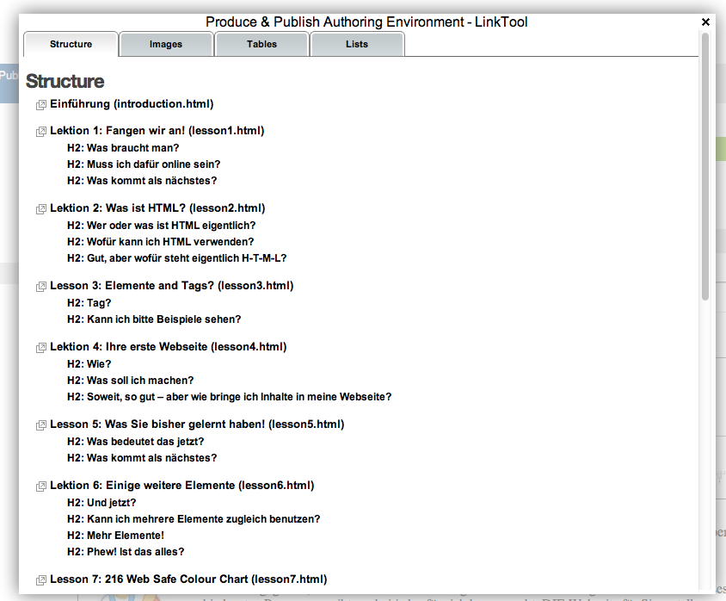
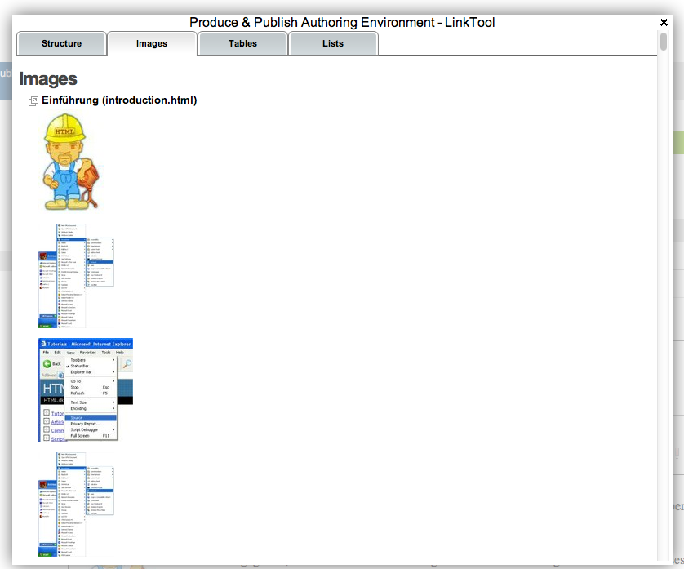
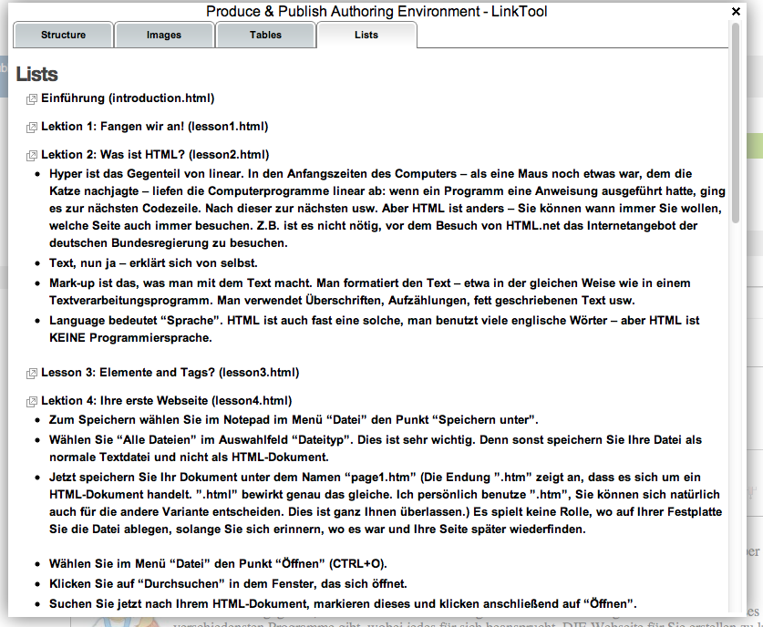
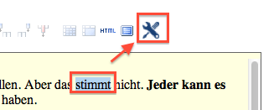
Plone Plone extensions(3/3)
Verbesserungen an TinyMCE
  LinkTool für Querverweise auf
    Headings
    Tabellen
    Grafiken
    Listen(-elemente)

Slide 34

Produce & Publish options
In-House installation
SaaS options:
  P&P
  Authoring Environment
  P&P Server:
  Conversion to PDF
  and EPUB

Slide 35
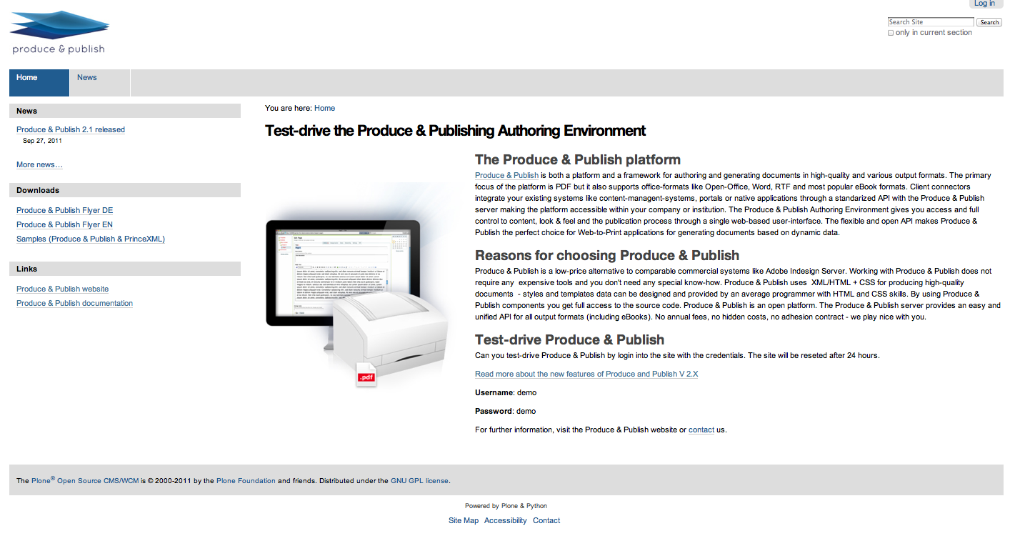
demo.produce-and-publish.com

Slide 36

Questions

Slide 37

Thank you for
your interest
Further information
www.produce-and-publish.com
Demo
demo.produce-and-publish.com
www.zopyx.com

