Slide 1









ce documents
with Plone
Plone Conference 2007, Naples,
Andreas
CO
D-7 2070 Tübingen, Germany
ZO X CO,

Slide 2
















About
working
Zope si
1999
Zope 2 release manager
Co-founder and 2nd chairman German Zope User
Group
0 various software #OP
Zope/Plone:
Tel Inde NG PloneCollectorN ,
zopyx.convert, z3 c.sqlalchemy
OÓ
CO.
focused on e-publishing solutions (Python, Zope, Plone)

Slide 3








Plone has
ex
ce íormats

Slide 4
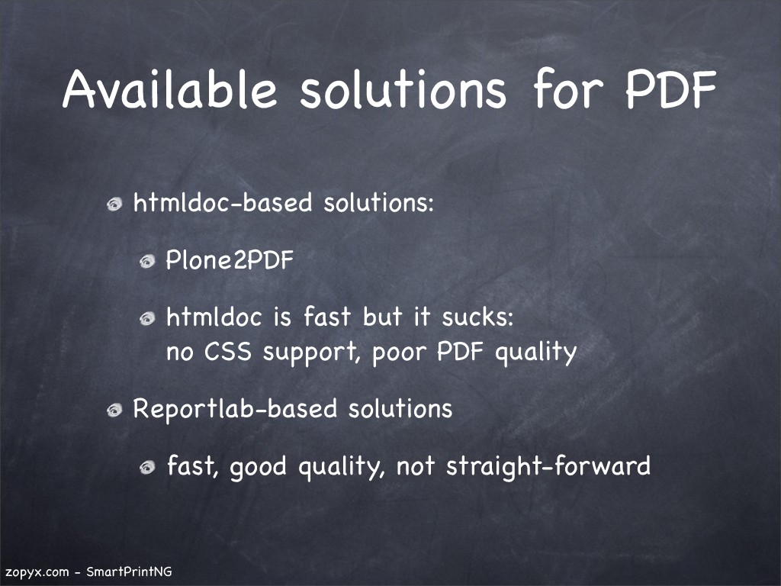

Slide 5














Ptone
No
out-of-the-box
solution
available:
generating PDF and other re
formats
RTF,
stylesheet
cont gu ab e
and content

Slide 6












SmartPrintNG
exports Plone content İO PDF,
ftTF,
per content-type con
gurable
content-aggregation
and styles
out-of-the-box with any content-type
and customizable

Slide 7



uick
x.com

Slide 8



uick look under
the hood
SmartPrintNG

Slide 9


















latform
solution
Build on
OÓ
technology
Extensible Stylesheet Longuoge-
Formatting
a W3C recommendation
consider OS a łypesełting system
simi
İO TAX
n’cer
hyphena ion

Slide 10
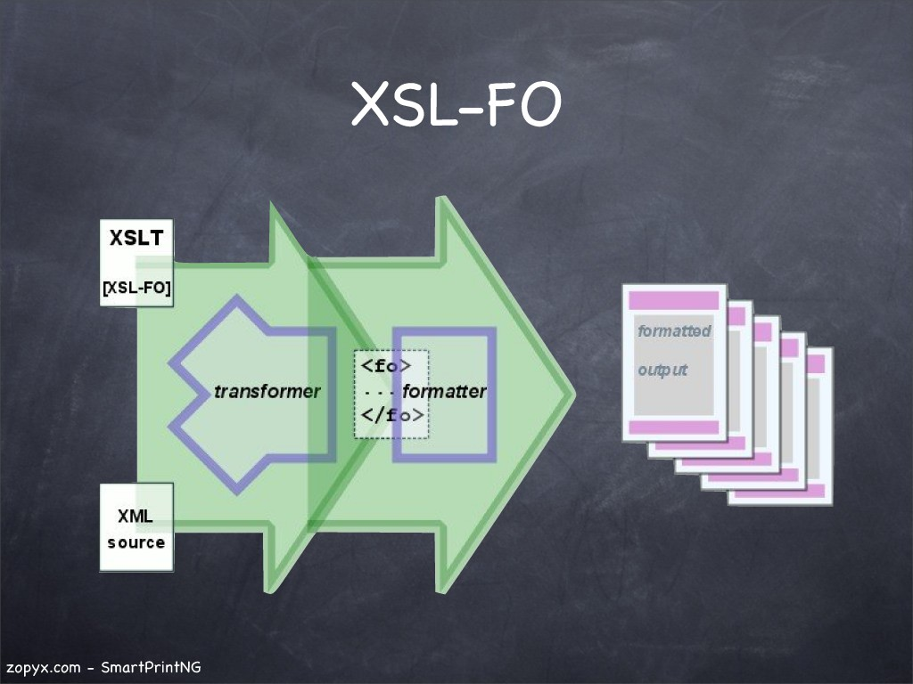

Slide 11














Historical
based approach
n use
the
Hume ioesk p|ottform
Zope cross-platt form
framework
content-retrieval
lications
.
in use since 2005
deployed İO
than customers
customers running Zope on
(means.
Windows desktop)

Slide 12



XSL-FO wants
but we have
HTML!

Slide 13




hail css2xs
npu :
OP
document
Java-based

Slide 14
From XSL-FO
POF friends

Slide 15













rocessors
the
a processor converts a
document İO some
XINC ( . unasil.com):
format
format: POF
XFC (www.
mind.com):
formats• RTF,
ODT

Slide 16



















XSL-FO
rocessors
XFC
Java-based
cross-platt form
just works
commercial
(
but worth their money
ore even
expensive
500-600
core/server

Slide 17
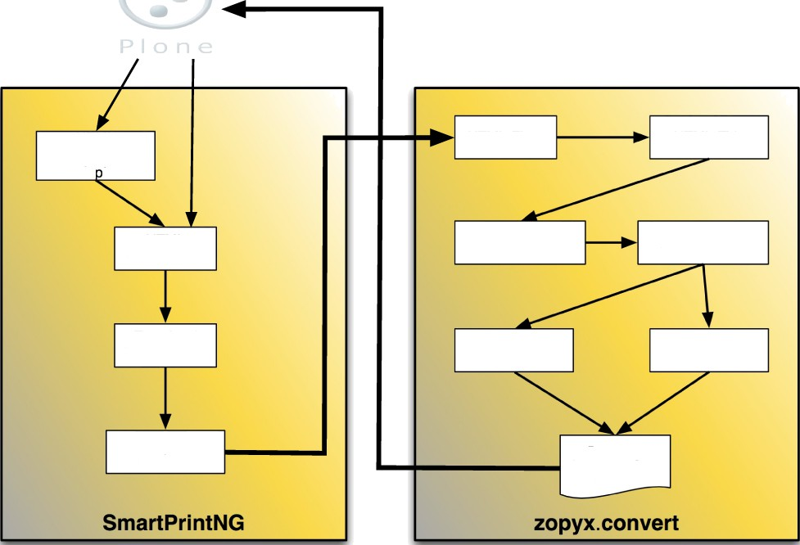
HTML
aggregation
ada ter
HTML-Fixed
HTML-Tldy
HTML
manipulator
css2xslfo (Java)
XSL-FO fixer
Template/ CSS chooser
X NC java)
XFG (Java)
Template
tenderer
Document (PDF, RTF, ODT,
DOCXj

Slide 18










con
wrtpri»t»g:re
vr«eoire«t y
rin €e ča e ers= 'P oduef s . A'r0 on te neTypes . Once rf ace . Once rf ace s . i A'rDo eve n€
a'reut y=’d"u-eat'
Fi

Slide 19














SmartPrintNG
more Features
con
gurable
footer regions
within HTML
support
(e.g.
counters)
conditional output
and
poges
-column support
hyphenation support

Slide 20











SLt
images
Plone
external
images
converted internally
IO
open issues•
resolu ion se ec tion
ng moges inło a
xed Í0 Ouİ

Slide 21















encapsulates the complete
conversion
logi
wœps
2xsl Ê0
a
Package
Input:
RTF
WML
avai
as
use a non-Zope
environment

Slide 22


Slide 23

z¢pyx am— Srr ¢ IP
i nING

Slide 24
z¢pyx am— Srr ¢ IP
i nING

Slide 25
















Free
alternatives*
Apache
processor:
old
0.4 sucked
new
0.9.X
less, moving slowly
only POF
ce (server mode)
not słable enough
another
dependency

Slide 26















SmartPrintNG
Free
non-commerci al
educational institutions
NGOs
charity org niziations
projects
com e ci license n
usage (fo
comme ci
buying an
license)

