Slide 1


Python and MongoDB
The perfect Match
Andreas Jung, www.zopyx.com

Slide 2
Trainer Andreas Jung
Python developer since 1993
Python, Zope & Plone development
Specialized in Electronic Publishing
Director of the Zope Foundation
Author of dozens add-ons for Python, Zope and Plone
Co-Founder of the German Zope User Group (DZUG)
Member of the Plone Foundation
using MongoDB since 2009

Slide 3
Agenda (45 minutes per slot)
Introduction to MongoDB
Using MongoDB
Using MongoDB from Python with PyMongo
(PyMongo extensions/ORM-ish layers or Q/A)

Slide 4
Things not covered in this tutorial
Geospatial indexing
Map-reduce
Details on scaling (Sharding, Replica sets)

Slide 5
Part I/4
Introduction to MongoDB:
  Concepts of MongoDB
  Architecture
  How MongoDB compares with relational databases
  Scalability

Slide 6
MongoDB is...
an open-source,
high-performance,
schema-less,
document-oriented
database

Slide 7
Let‘s agree on the following or leave...
MongoDB is cool
MongoDB is not the multi-purpose-one-size-fits-all database
MongoDB is another additional tool for the software developer
MongoDB is not a replacement for RDBMS in general
Use the right tool for each task

Slide 8
And.....
Don‘t ask me about how to do JOINs in MongoDB ☺

Slide 9
Oh, SQL – let‘s have some fun first
A SQL statement walks into a bar and sees two tables. He walks and says: „Hello, may I join you“
A SQL injection walks into a bar and starts to quote something but suddenly stops, drops a table and dashes out.

Slide 10
The history of MongoDB
10gen founded in 2007
Started as cloud-alternative GAE
  App-engine ed
  Database p
  Javascript as implementation language
2008: focusing on the database part: MongoDB
2009: first MongoDB release
2011: MongoDB 1.8:
  Major deployments
  A fast growing community
  Fast adoptation for large projects
  10gen growing

Slide 11










Major MongoDB deployments

Slide 12
MongoDB is schema-less
JSON-style data store
Each document can have its own schema
Documents inside a collection usually share a common schema by convention
{‚name‘ : ‚kate‘, ‚age‘:12, }
{‚name‘ : ‚adam‘, ‚height‘ : 180}
{‚q‘: 1234, ‚x‘ = [‚foo‘, ‚bar‘]}

Slide 13
Terminology: RDBMS vs. MongoDB
RDBMS | MongoDB
Database | Database
Tables | Collections
Rows | Documents
Indexes | Indexes
SQL as query language | JSON-style syntax

Slide 14
Characteristics of MongoDB (I)
High-performance
Rich query language (similar to SQL)
Map-Reduce (if you really need it)
Secondary indexes
Geospatial indexing
Replication
Auto-sharing (partitioning of data)
Many platforms, drivers for many languages

Slide 15
Characteristics of MongoDB (II)
No transaction support, only atomic operations
Default: „fire-and-forget“ mode for high throughput
„Safe-Mode“: wait for server confirmation, checking for errors

Slide 16
Typical performance characteristics
Decent commoditiy hardware:
  Up to 100.000 read/writes per second (fire-and-forget)
  Up to 50.000 reads/writes per second (safe mode)
Your mileage may vary – depending on
  RAM
  Speed IO system
  CPU
  Client-side driver & application

Slide 17
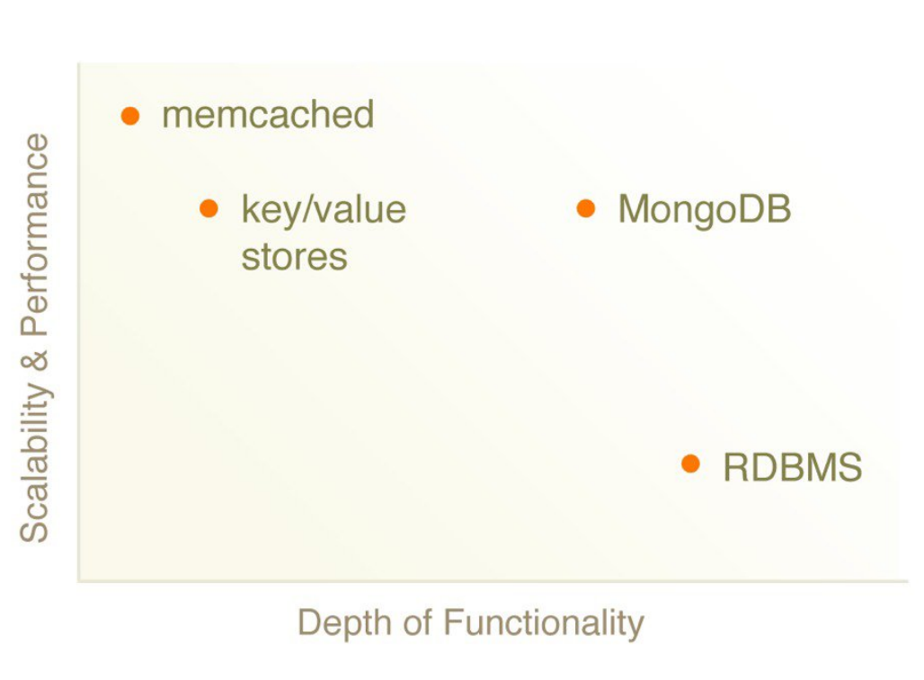
Functionality vs. Scability

Slide 18
MongoDB: Pros & Cons
Pros | Cons
Good for the web | Not for highly transactional apps
Caching | Ad-hoc business intelligence (dataware-house apps)
High volumne, low volume apps | Can not replace complex SQL queries
Scalability
Speed

Slide 19
Durability
Default: fire-and-forget (use safe-mode)
Changes are kept in RAM (!)
Fsync to disk every 60 seconds (default)
Deployment options:
  Standalone installation: use journaling (V 1.8+)
  Replicated: use replica sets(s)

Slide 20
Differences from Typical RDBMS
Memory mapped data
  All data in memory (if it fits), synced to disk periodically
No joins
  Reads have greater data locality
  No joins between servers
No transactions
  Improves performance of various operations
  No transactions between servers

Slide 21
Replica Sets
Cluster of N servers
Only one node is ‘primary’ at a time
  This is equivalent to master
  The node where writes go
Primary is elected by concensus
Automatic failover
Automatic recovery of failed nodes

Slide 22
Replica Sets - Writes
A write is only ‘committed’ once it has been replicated to a majority of nodes in the set
Before this happens, reads to the set may or may not see the write
On failover, data which is not ‘committed’ may be dropped (but not necessarily)
  If dropped, it will be rolled back from all servers which wrote it
For improved durability, use getLastError/w
  Other criteria – block writes when nodes go down or slaves get too far behind
Or, to reduce latency, reduce getLastError/w

Slide 23
Replica Sets - Nodes
Nodes monitor each other’s heartbeats
  If primary can’t see a majority of nodes, it relinquishes primary status
If a majority of nodes notice there is no primary, they elect a primary using criteria
  Node priority
  Node data’s freshness

Slide 24
Replica Sets - Nodes
Member 1
Member 2
Member 3

Slide 25
Replica Sets - Nodes
{a:1}
Member 1
SECONDARY
{a:1}
{b:2}
Member 2
SECONDARY
{a:1}
{b:2}
{c:3}
Member 3
PRIMARY

Slide 26
Replica Sets - Nodes
{a:1}
Member 1
SECONDARY
{a:1}
{b:2}
Member 2
PRIMARY
{a:1}
{b:2}
{c:3}
Member 3
DOWN

Slide 27
Replica Sets - Nodes
{a:1}
{b:2}
Member 1
SECONDARY
{a:1}
{b:2}
Member 2
PRIMARY
{a:1}
{b:2}
{c:3}
Member 3
RECOVERING

Slide 28
Replica Sets - Nodes
{a:1}
{b:2}
Member 1
SECONDARY
{a:1}
{b:2}
Member 2
PRIMARY
{a:1}
{b:2}
Member 3
SECONDARY

Slide 29
Replica Sets – Node Types
Standard – can be primary or secondary
Passive – will be secondary but never primary
Arbiter – will vote on primary, but won’t replicate data

Slide 30
SlaveOk
db.getMongo().setSlaveOk();
  Syntax varies by driver
Writes to master, reads to slave
  Slave will be picked arbitrarily

Slide 31
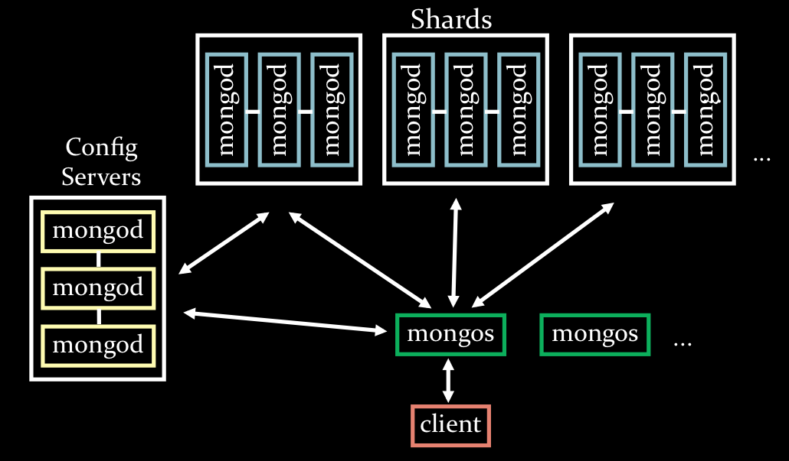
Sharding Architecture

Slide 32
Shard
A replica set
Manages a well defined range of shard keys

Slide 33
Shard
Distribute data across machines
Reduce data per machine
  Better able to fit in RAM
Distribute write load across shards
Distribute read load across shards, and across nodes within shards

Slide 34
Shard Key
Collection | Min | Max | location
users | {name:’Miller’} | {name:’Nessman’} | shard 2
users | {name:’Nessman’} | {name:’Ogden’} | Shard 4
…
{ user_id: 1 }
{ lastname: 1, firstname: 1 }
{ tag: 1, timestamp: -1 }
{ _id: 1 }
  This is the default

Slide 35
Mongos
Routes data to/from shards
db.users.find( { user_id: 5000 } )
db.users.find( { user_id: { $gt: 4000, $lt: 6000 } } )
db.users.find( { hometown: ‘Seattle’ } )
db.users.find( { hometown: ‘Seattle’ } ).sort( { user_id: 1 } )

Slide 36
Differences from Typical RDBMS
Memory mapped data
  All data in memory (if it fits), synced to disk periodically
No joins
  Reads have greater data locality
  No joins between servers
No transactions
  Improves performance of various operations
  No transactions between servers
A weak authentication and authorization model

Slide 37
Part 2/4
Using MongoDB
  Starting MongoDB
  Using the interactive Mongo console
  Basic database operations

Slide 38
Getting started...the server
wget http://fastdl.mongodb.org/osx/mongodb-osx-x86_64-1.8.1.tgz
tar xfz mongodb-osx-x86_64-1.8.1.tgz
cd mongodb-osx-x86_64-1.8.1
mkdir /tmp/db
bin/mongod –dbpath /tmp/db
Pick up your OS-specific package from
http://www.mongodb.org/downloads
Take care of 32 bit bs. 64 bit version

Slide 39
Getting started...the console
bin/mongod
mongod listens to port 27017 by default
HTTP interface on port 28017
> help
> db.help()
> db.some_collection.help()

Slide 40
Datatypes...
Remember: MongoDB is schema-less
MongoDB supports JSON + some extra types
JSON | BSON
string integer boolean double null array object | date object id binary regular expression code

Slide 41
A small address database
Person:
  firstname
  lastname
  birthday
  city
  phone

Slide 42
Inserting
> db.foo.insert(document)
> db.foo.insert({‚firstname‘ : ‚Ben‘})
every document has an „_id“ field
„_id“ inserted automatically if not present

Slide 43
Querying
> db.foo.find(query_expression)
> db.foo.find({‚firstname‘ : ‚Ben‘})
Queries are expressed using JSON notation with JSON/BSON objects
query expressions combined using AND (by default)
http://www.mongodb.org/display/DOCS/Querying

Slide 44
Querying with sorting
> db.foo.find({}).sort({‚firstname‘ :1, ‚age‘: -1})
sorting specification in JSON notation
1 = ascending, -1 = descending

Slide 45
Advanced querying
$all
$exists
$mod
$ne
$in
$nin
$nor
$or
$size
$type
http://www.mongodb.org/display/DOCS/Advanced+Queries

Slide 46
Updating
> db.foo.update(criteria, obj, multi, upsert)
update() updates only one document by default (specify multi=1)
upsert=1: if document does not exist, insert it

Slide 47
Updating – modifier operations
$inc
$set
$unset
$push
$pushAll
$addToSet
$pop
$pull
$pullAll
$rename
$bit
http://www.mongodb.org/display/DOCS/Updating

Slide 48
Updating
> db.foo.update(criteria, obj, multi, upsert)
update() updates only one document by default (specify multi=1)
upsert=1: if document does not exist, insert it

Slide 49
Removing
db.foo.remove({}) // remove all
db.foo.remove({‚firstname‘ : ‚Ben‘}) // remove by key
db.foo.remove({‚_id‘ : ObjectId(...)}) // remove by _id
Atomic removal (locks the database)
db.foo.remove( { age: 42, $atomic : true } )
http://www.mongodb.org/display/DOCS/Removing

Slide 50
Indexes
working similar to index in relational databases
db.foo.ensureIndex({age: 1}, {background: true})
one query – one index
CompoundIndexes
db.foo.ensureIndex({age: 1, firstname:-1}
Ordering of query parameters matters
http://www.mongodb.org/display/DOCS/Indexes

Slide 51
Embedded documents
MongoDB docs = JSON/BSON-like
Embeeded documents similar nested dicts in Python
db.foo.insert({firstname:‘Ben‘, data:{a:1, b:2, c:3})
db.foo.find({‚data.a‘:1})
Dotted notation for reaching into embedde documents
Use quotes around dotted names
Indexes work on embeddes documents

Slide 52
Arrays (1/2)
Like (nested) lists in Python
db.foo.insert({colors: [‚green‘, ‚blue‘, ‚red‘]})
db.foo.find({colors: ‚red‘})
Use indexes

Slide 53
Arrays (2/2) – matching arrays
db.bar.insert({users: [
{name: ‚Hans‘, age:42},
{name:‘Jim‘, age: 30 },
]})
db.bar.find({users : {‚$elemMatch‘: {age : {$gt:42}}}})

Slide 54
Part 3/4
Using MongoDB from Python
  PyMongo
  Installing PyMongo
  Using PyMongo

Slide 55
Installing and testing PyMongo
Install pymongo
  virtualenv –no-site-packages pymongo
  bin/easy_install pymongo
Start MongoDB
  mkdir /tmp/db
  mongod –dbpath /tmp/db
Start Python
  bin/python
  > import pymongo
  > conn = pymongo.Connection(‚localhost‘, 27127)

Slide 56
Part 4/4
? High-level PyMongo frameworks
  Mongokit
  Mongoengine
  MongoAlchemy
? Migration SQL to MongoDB
? Q/A
? Looking at a real world project done with Pyramid and MongoDB?
? Let‘s talk about..

Slide 57
Mongokit (1/3)
  schema validation (wich use simple python type for the declaration)
  doted notation
  nested and complex schema declaration
  untyped field support
  required fields validation
  default values
  custom validators
  cross database document reference
  random query support (which returns a random document from the database)
  inheritance and polymorphisme support
  versionized document support (in beta stage)
  partial auth support (it brings a simple User model)
  operator for validation (currently : OR, NOT and IS)
  simple web framework integration
  import/export to json
  i18n support
  GridFS support
  document migration support

Slide 58
Mongokit (2/3)
class BlogPost(Document):
structure = {
'title': unicode,
'body': unicode,
'author': pymongo.objectid.ObjectId,
'created_at': datetime.datetime,
'tags': [unicode],
}
required_fields = ['title','author', 'date_creation']
blog_post = BlogPost()
blog_post['title'] = 'my blog post'
blog_post['created_at'] = datetime.datetime.utcnow()
blog_post.save()

Slide 59
Mongokit (3/3)
  Speed and performance impact
  Mongokit is always behind the most current pymongo versions
  one-man developer show
  http://namlook.github.com/mongokit/

Slide 60
Mongoengine (1/2)
  MongoEngine is a Document-Object Mapper (think ORM, but for document databases) for working with MongoDB from Python. It uses a simple declarative API, similar to the Django ORM.
  http://mongoengine.org/

Slide 61
Mongokit (2/2)
class BlogPost(Document):
title = StringField(required=True)
body = StringField()
author = ReferenceField(User)
created_at = DateTimeField(required=True)
tags = ListField(StringField())
blog_post = BlogPost(title='my blog post', created_at=datetime.datetime.utcnow())
blog_post.save()

Slide 62
MongoAlchemy (1/2)
  MongoAlchemy is a layer on top of the Python MongoDB driver which adds client-side schema definitions, an easier to work with and programmatic query language, and a Document-Object mapper which allows python objects to be saved and loaded into the database in a type-safe way.
  An explicit goal of this project is to be able to perform as many operations as possible without having to perform a load/save cycle since doing so is both significantly slower and more likely to cause data loss.
  http://mongoalchemy.org/

Slide 63
MongoAlchemy(2/2)
from mongoalchemy.document import Document, DocumentField
from mongoalchemy.fields import *
from datetime import datetime
from pprint import pprint
class Event(Document):
name = StringField()
children = ListField(DocumentField('Event'))
begin = DateTimeField()
end = DateTimeField()
def __init__(self, name, parent=None):
Document.__init__(self, name=name)
self.children = []
if parent != None:
parent.children.append(self)

Slide 64
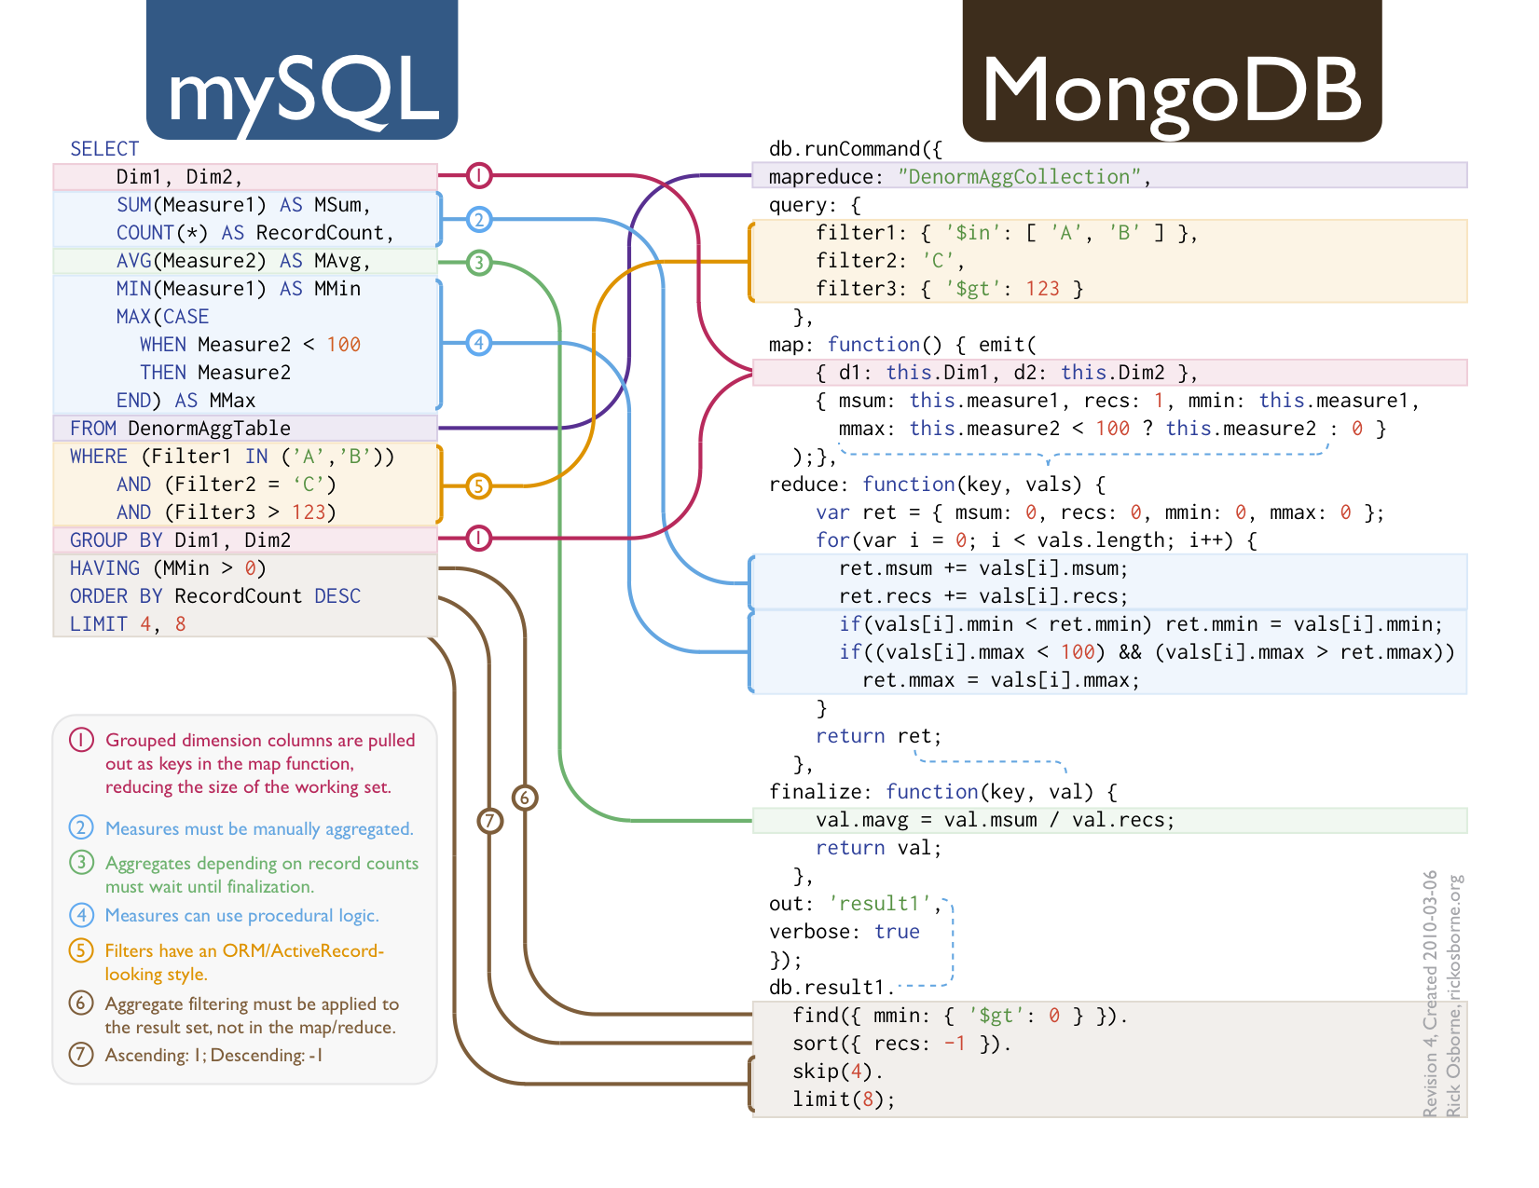
From SQL to MongoDB

Slide 65
The CAP theorem
Consistency
Availablity
Tolerance to network Partitions
Pick two...

Slide 66
ACID versus Base
Atomicity
Consistency
Isolation
Durability
Basically Available
Soft state
Eventually consistent

