Slide 1



The hunt for the right
NoSQL database
Why we
Andreas Jung @MacYET
info@zopyx.com • www.zopyx.de

Slide 2







/about
Python developer since 1993
Freelancer since 2004
Python, Zope, Plone …
individual software development
Electronic Publishing
(Publishing workflows DOCX→XML→PDF | EPUB | HTML, XML consulting)
Founded publishing projects
  XML-Director
  Produce & Publish

Slide 3
Disclaimer
•
This talk is completely
biased
opinionated
unscientific
not affiliated with ArangoDB GmbH

Slide 4
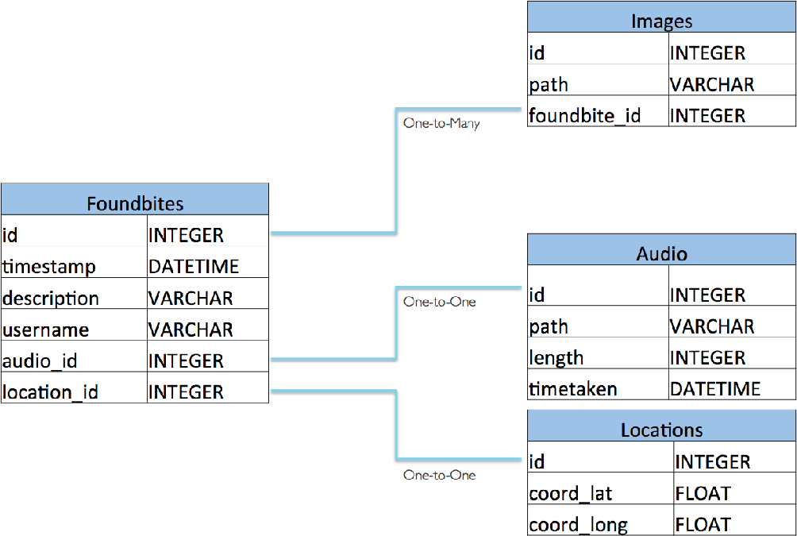
Relational databases
•
well understood
•
common data model
•
long history:
System R (1974)
Oracle (1979)
Structured Query Language (Standards: ISO/IEC 9075 + 13249)
•
•
theoratically interoperable if you stick to the SQL standard

Slide 5

NoSQL = not SQL

Slide 6
NoSQL = non-relational

Slide 7
“NoSQL is not about performance, scaling, dropping ACID or hating SQL — it is about choice. As NoSQL databases are somewhat diﬀerent it does not help very much to compare the databases by their throughput and chose the one which is faster. Instead—the user should carefully think about his overall requirements and weight the diﬀerent aspects. Massively scalable key/value stores or memory-only systems can archive much higher benchmarks. But your aim is to provide a much more convenient system for a broader range of use-cases— which is fast enough for almost all cases.”
Jan Lenhardt (CouchDB)

Slide 8
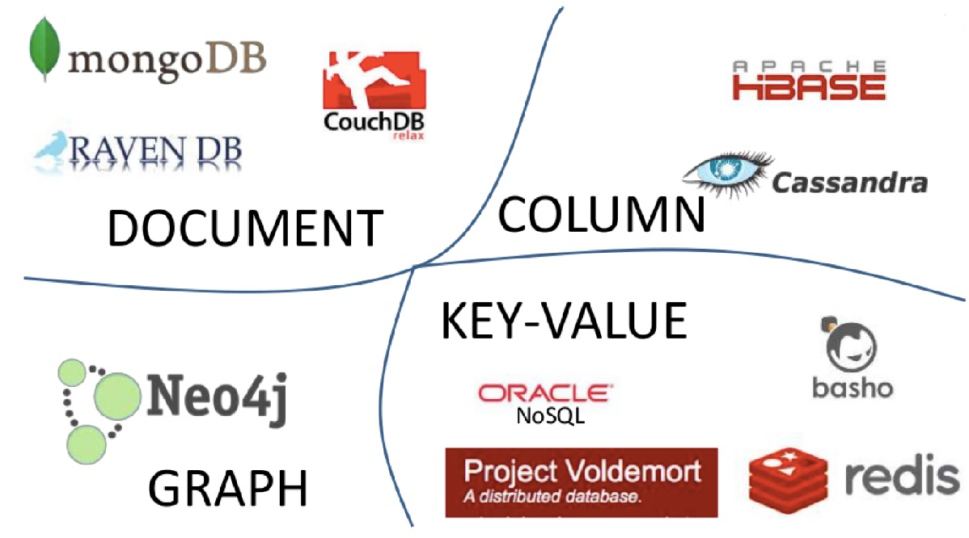
Categories of NoSQL databases
Key-Value
  Memcached, Redis, Riak, …
Column-oriented
  Cassandra, …
Document (JSON)
  MongoDB, CouchDB, …
Tabular
  Big Table, Hase, …
Graph
  Neo4J, …
XML, Object…
eXist, BaseX, Marclogic, ZODB, …
http://martinfowler.com/articles/nosqlKeyPoints.html https://www.youtube.com/watch?v=qI_g07C_Q5I

Slide 9
New challenges
•
Cloud
•
Replication
•
massive data explosion: „Big Data“
•
Globally distributed systems
Specialized requirements
➡ more specialized databases
➡ Relational databases are no longer the only option

Slide 10
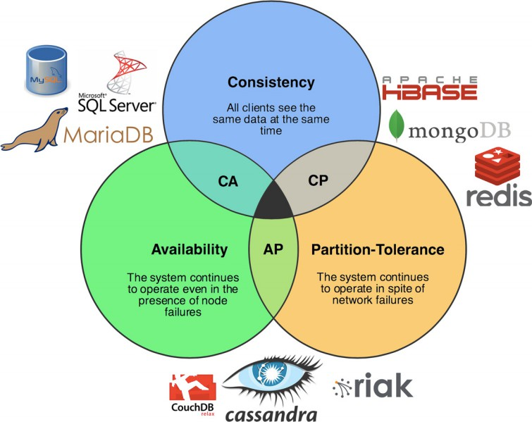
CAP Theorem
It is impossible for a distributed computer system to simultaneously provide all three of the following guarantees:
Consistency
(every read receives the most recent write or an error)
Availability
(every request receives a response, without guarantee that it contains the most recent version of the information)
Partition tolerance
(the system continues to operate despite arbitrary partitioning due to network failures)
(Eric Brewer)
PICK TWO

Slide 11
My personal hunt for a multi-purpose NoSQL database …
•
Should fit most mid-size projects
•
Document store (+ graphs)
•
Arbitary query options
•
Cross-table/collection relationships
•
(optional) transactional integrity (ACID) across multiple documents and operations
•
replication/clustering

Slide 12
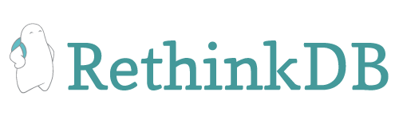







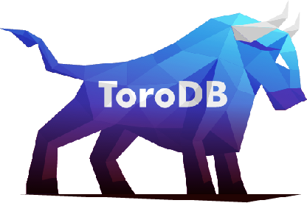
My personal hunt…
…and various others

Slide 13








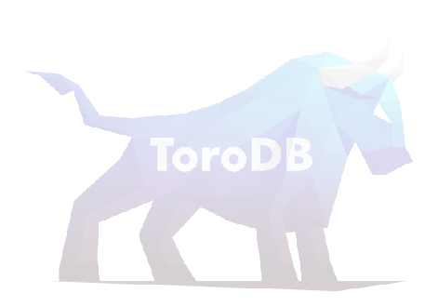
My personal hunt…
…and various others

Slide 14





bought in 2015 by

Slide 15

The high-end $$$$ solution
•
the most professional, feature-complete, feature-rich NoSQL database ever
•
document (XML/JSON) store and graph database
•
focus on data integration and data consolidation
•
expensive but worth the money if you need the features
•
widely used in enterprises (saved „Obama-Care“ project)

Slide 16

A native multi-model database
Document store (JSON)
  JOINs, secondary indexes, ACID transactions
Key-value store
Graph database
  integrates with document store
  rich graph query operations
  nodes and edges can contain complex data
➡ all models can be combined

Slide 17

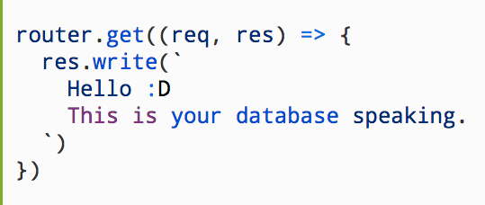
Foxx framework
implement your own REST micro-services directly with Javascript running inside ArangoDB
unified data storage logic (decouples API from external services)
reduced network overhead (no network latencies)
you can use the full JS Stack
batteries included
build-in job queue

Slide 18
AQL - One Query Language to rule them all
AQL = Arango Query Language
declarative, human-readable DSL (I hate JSON queries)
document queries, graph queries, joins, all combined in one statement
ACID support with multi-collection transactions
easy to understand with some SQL background

Slide 19


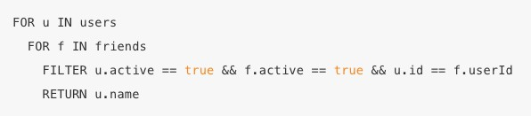


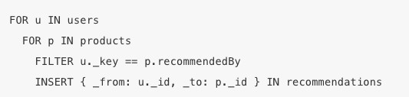





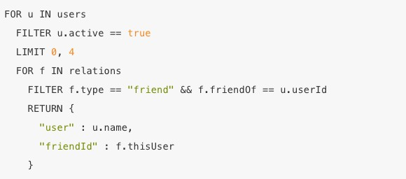


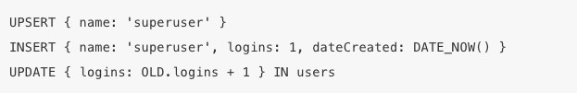


Slide 20



Slide 21



Slide 22



Slide 23



Slide 24



Slide 25
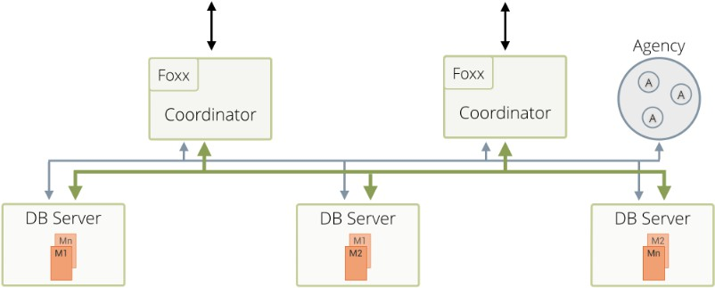
Custering, replication, sharding
•
Agency (high-avail resilient key/value store, Raft Consensus Protocol)
Coordinators Primary DB servers Secondaries Asynchronous/
synchronous replication
with automatic fail-over
•
•
•
•

Slide 26
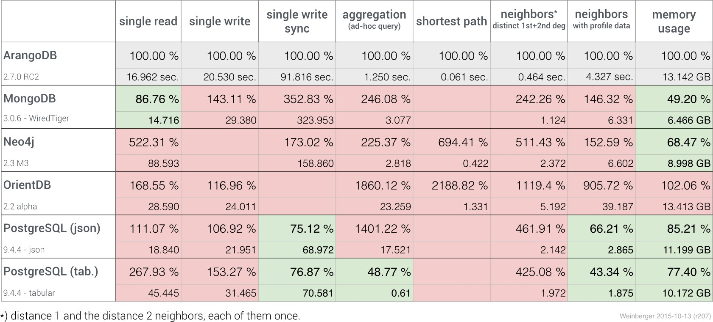
Benchmark (against ArangoDB V 2)
https://www.arangodb.com/2015/10/benchmark-postgresql-mongodb-arangodb/

Slide 27
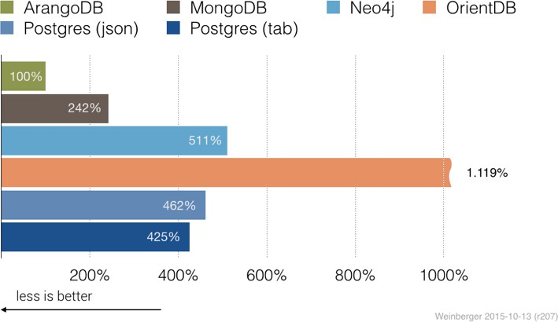
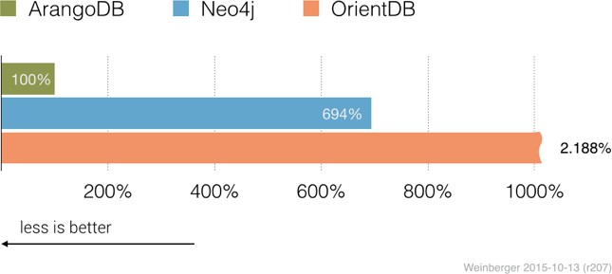
Benchmark (against ArangoDB V 2)
Neighbour search
Shortest path
https://www.arangodb.com/2015/10/benchmark-postgresql-mongodb-arangodb/

Slide 28
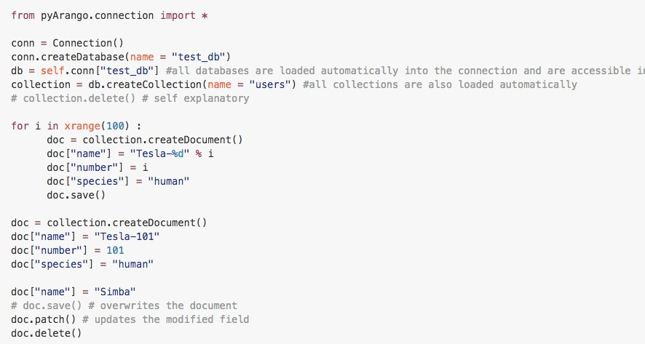
Python bindings (PyArango)

Slide 29
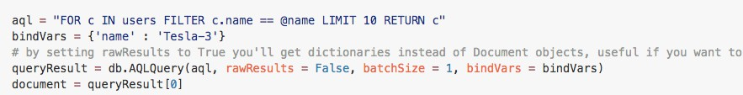
Python bindings (PyArango)
Query (AQL)
Query (by example)

Slide 30
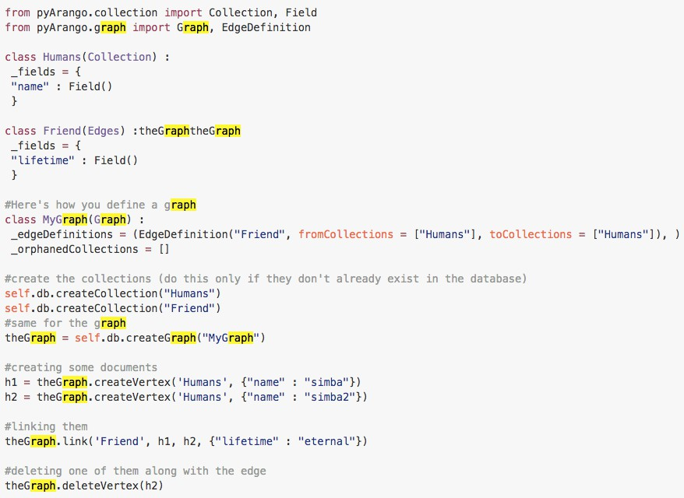
Graphs

Slide 31
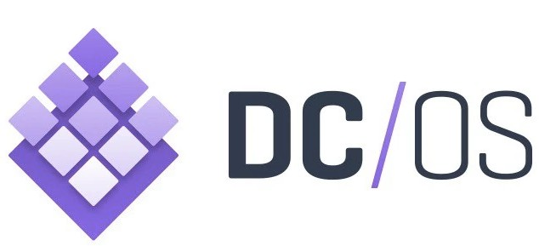


Deployment & operations

Slide 32
Misc
current version 3.0, (3.1 RC3)
good documentation
regular updates and fixes
nicely supported
supported by ArangoDB GmbH in Cologne

Slide 33
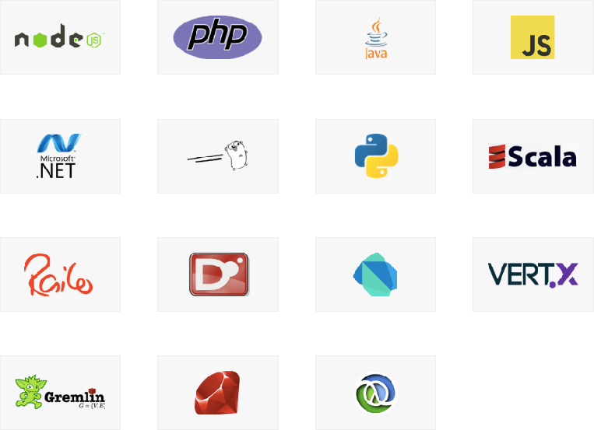
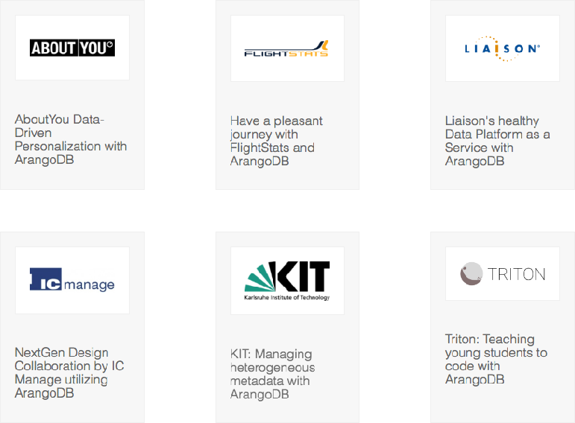
Community Edition (Apache License 2.0)
•
•
Enterprise Edition (SLA, support options, smart graphs, auditing, better security control)
https://www.arangodb.com/arangodb-drivers/
https://www.arangodb.com/why-arangodb/references/

Slide 34


Questions?
Why we

