Slide 1

zopyx-fastapi-auth
An opinionated security solution for FastAPI
Andreas Jung • info@zopyx.com • www.zopyx.com • www.andreas-jung.com

Slide 2
Agenda
Introduction to FastAPI
Quick intro intro authentication and authorization
Key concepts of fastapi-auth
Integration and usage in FastAPI
Pluggable user source architecture
User management
Demo time
Q & A

Slide 3



About me
Software developer & software architect
Requirements engineering
Python developer & Python expert
Publishing developer & consultant
since mid-90s
CMS Solutions
Publishing Solutions
Individual software solutions
Funder of print-css.rocks project Independent PrintCSS consulting
NGOs, EDU
medical & pharmaceutical
energy
research & development quantum mechanics
https://www.zopyx.com https://andreas-jung.com
info@zopyx.com

Slide 4

Introduction to FastAPI

Slide 5
What is FastAPI?
FastAPI is a modern, fast (high-performance), web framework for building APIs with Python 3 based on standard Python type hints and the data-validation framework Pydantic.
from fastapi import FastAPI
app = FastAPI()
@app.get("/") def read_root():
return {"Hello": "World"}
@app.get("/items/{item_id}")
def read_item(item_id: int, q: str = None): return {"item_id": item_id, "q": q}
if name == " main ": import uvicorn
uvicorn.run(app, host="0.0.0.0", port=8000)

Slide 6
Reasons for using FastAPI
Use of Pydantic
FastAPI uses Pydantic for data validation and serialization, ensuring robust input and output handling.
Full Async Support
FastAPI supports asynchronous programming, enabling high-performance and efficient request handling.
Automatic OpenAPI Generation
FastAPI automatically generates OpenAPI documentation, simplifying API development and testing.
It is Fast
FastAPI is optimized for speed, making it one of the fastest web frameworks available.
High Adoption Rate
FastAPI’s growing popularity and community support make it a reliable choice for modern web development.

Slide 7
Authentication — Authorization

Slide 8

What is authentication?
Authentication verifies the identity of a user, device, or entity.
It uses credentials like username + passwords, biometrics, or security tokens.
This ensures only authorized access to sensitive information or resources.

Slide 9
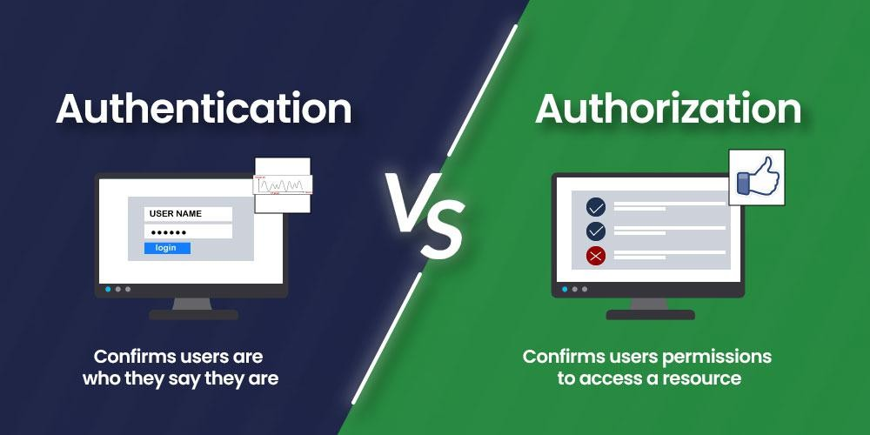
What is authorization?
Authorization determines what resources a user or system can access.
It occurs after authentication and enforces permissions and policies.
This ensures users can only perform actions they are permitted to.

Slide 10
zopyx-fastapi-auth
An opinionated authentication solution for FastAPI

Slide 11
Why zopyx-fastapi-auth
…when there are already many other solutions!?
Usecase
Migration of a CMS Plone-based application from Plone to FastAPI for the University of Saarbrücken.
Problem
  None of the existing authentication frameworks for FastAPI has fit our needs
  No direct translation of security concepts of the legacy system available for FastAPI
  Transparent authentication against three different user sources (local, SAP, LDAP)

Slide 12
Concepts: Permissions
An access right that defines what actions a user or role can perform, such as viewing, editing, or deleting resources within an application.
Permissions are defined as code.
from fastapi_auth.permissions import Permission
VIEW_PERMISSION = Permission(name="view", description="View permission") EDIT_PERMISSION = Permission(name="edit", description="Edit permission") DELETE_PERMISSION = Permission(name="delete", description="Delete permission")

Slide 13
Concepts: Roles
from fastapi_auth.permissions import Role
ADMIN_ROLE = Role(
name="Administrator", description="Admin role",
permissions=[VIEW_PERMISSION, EDIT_PERMISSION, DELETE_PERMISSION],
)
USER_ROLE = Role(
name="User", description="User role",
permissions=[VIEW_PERMISSION, EDIT_PERMISSION],
)
VIEWER_ROLE = Role(
name="Viewer", description="Viewer role", permissions=[VIEW_PERMISSION],
)
A collection of permissions wrapped together as a role.
Roles define a user’s access level and responsibilities within an application.
A user can have multiple roles, each granting a different set of permissions.
Roles are defined in code.

Slide 14
Concepts: Roles II
Roles must be registered with the (gobal) roles registry. Interim solution…likely to go away soon.
from fastapi_auth.roles import ROLES_REGISTRY
ROLES_REGISTRY.register(ADMIN_ROLE) ROLES_REGISTRY.register(USER_ROLE) ROLES_REGISTRY.register(VIEWER_ROLE)

Slide 15
Concepts: Users
A user represents the currently user context accessing the system.
User types:
Anonymous User
Authenticated User
(Superuser)
Users are stored in (external) user sources like a database, LDAP etc.

Slide 16

The User object in fastapi-auth
The Protected() method is used to protect an endpoint by permission, role or a custom checker
@app.get(„/admin")
def admin(user: User = Depends(Protected(<protection_conditions)): return {"user": user}
Integration with FastAPI through dependency injection
Successful authorization will return a User object
Unsuccessful authorization HTTP 403/Forbidden
User properties: name, description, roles, is_anonymous

Slide 17
Concepts II
A user can have multiple roles
A role can multiple permissions

Slide 18
How to use fastapi-auth in your FastAPI app?
Endpoint protection by role(s)
# This is an endpoint that requires the user to be authenticated. In this case, # the user must have the ADMIN_ROLE role. It is also possible to require a
# permission instead. Use the Protected dependency to require authentication. # An unauthenticated request as ANONYMOUS_USER will be rejected.
@app.get(„/admin")
def admin(user: User = Depends(Protected(required_roles=[ADMIN_ROLE]))): return {"user": user}

Slide 19
How to use fastapi-auth in your FastAPI app?
Endpoint protection by permission
from fastapi_auth.dependencies import Protected
@app.get(„/admin2")
def admin2(user: User = Depends(Protected(required_permission=VIEW_PERMISSION))): return {"user": user}

Slide 20
How to use fastapi-auth in your FastAPI app?
Endpoint protection by custom checker
from fastapi_auth.dependencies import Protected
def my_check(request: Request, user: User) -> bool:
# perform some checks based on request and/or user.... return True # or False
@app.get(„/admin3")
def admin3(user: User = Depends(Protected(required_checker=my_check))): return {"user": user}

Slide 21
Concept of user sources
A user source manages user accounts
A user source can authenticate (or not) a user based on the parameters of a login form
…usually determined by validating the username and the password against the data stored in a database
Typical: RDBMS, LDAP etc.

Slide 22
Pluggable authenticators
from fastapi import Request
from fastapi.authenticator_registry import Authenticator, AUTHENTICATOR_REGISTRY from fastapi.users import User
class MyAuthenticator(Authenticator):
async def authenticate(request: Request) -> User: # extract credentials from request
username = request.form.... password = request.form....
# perform authentication against your own authentication system user_data = my_backend.authenticate_user(username, password)
return User(name=user_data["name"], roles=[...]) AUTHENTICATOR_REGISTRY.add_authenticator(MyAuthenticator(), 0)

Slide 23
Build-in user management
zopyx-fastapi-auth comes with a default user management
with sqlite as database backend
commandline utility fastapi-auth-user-admin
fastapi-auth-user-admin add <username> <password> „Role1,Role2…“
fastapi-auth-user-admin delete <username>
fastapi-auth-user-admin lists-users
fastapi-auth-user-admin set-password <username> <new-password>

Slide 24
Internals
based on starlette.middleware.sessions
authentication information stored and exchanged through an encrypted cookie (symmetric encryption)
client/browser can not decrypt the cookie
lifetime of cookie: session or persistent
ToDo:
  switching to secure cookies (starlette-securecookies)
  better control over lifetime of cookies, expiration, revocation!?

Slide 25

Demo time

Slide 26
Resources
https://github.com/zopyx/fastapi-auth
https://pypi.org/project/zopyx-fastapi-auth/

Slide 27
Questions & Answers

Slide 28

Thank you for listening
Andreas Jung • info@zopyx.com • www.zopyx.com • www.andreas-jung.com

